Slide 1

Vocabulary: share, peek, scarce, and cottage
📘 Subject: English
🎓 Grade: 5
📆 Unit: 1 – First Semester (2025-2026)

Slide 2

By the end of this lesson, students are expected to:
recognize and define the words
share, peek, scarce, and cottage
use the new words in complete and meaningful sentences
connect the new vocabulary to real-life experiences

Slide 3
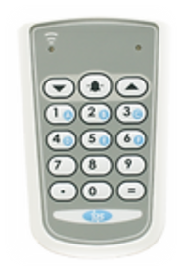
Pre-Assessment

Slide 4
What does the word share mean?
1) to keep everything for yourself 2) to give part of what you have to others 3) to buy something new 4) to hide something

Slide 5

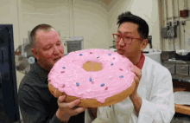
What does the word share mean?
2) to give part of what you have to others

Slide 6
2. Which one shows someone peeking?
1) reading a whole book in one day 2) looking quickly behind a door to see who is there 3) sleeping in bed 4) talking loudly in class

Slide 7






2. Which one shows someone peeking?
2) looking quickly behind a door to see who is there

Slide 8
3. What does the word scarce mean?
1) a very large number 2) easy to find anywhere 3) hard to find; not enough 4) something you throw away

Slide 9

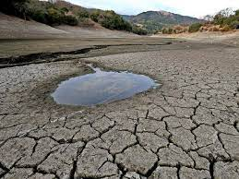
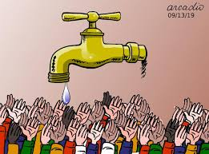
3. What does the word scarce mean?
3) hard to find; not enough

Slide 10
4. Which of the following is a cottage?
1) a very tall building 2) a castle with towers 3) a shopping mall 4) a small simple house in the countryside

Slide 11
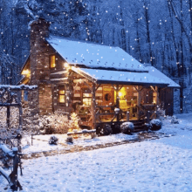

4. Which of the following is a cottage?
4) a small simple house in the countryside

Slide 12

Link to Life – Discuss with a Partner
When was the last time you had to share something with a friend or sibling?
What or who do you usually peek at?
Can you think of something that is scarce in Jordan?
Have you ever stayed in a cottage during a holiday?

Slide 13
Group Work Rubric
1. Participation: Each member participates and shares ideas with the group.
2. Task Completion: The task is divided fairly and is completed on time.
3. Collaboration: Group members listen to each other, respect ideas, and use only English to communicate.
4. Noise Level: Members work quietly and keep noise level appropriate.

Slide 14
Differentiation
Student’s Number | Task
1 | Label the pictures and choose one word to use in a complete sentence.
2 | Use each word in a complete sentence + challenge
3 | Write a short story using all four words and present it to the class.
4 | Fill in the blank with the correct word.

Slide 15
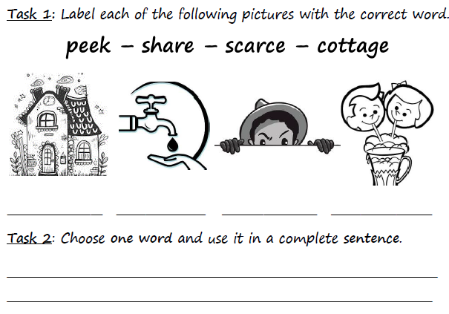
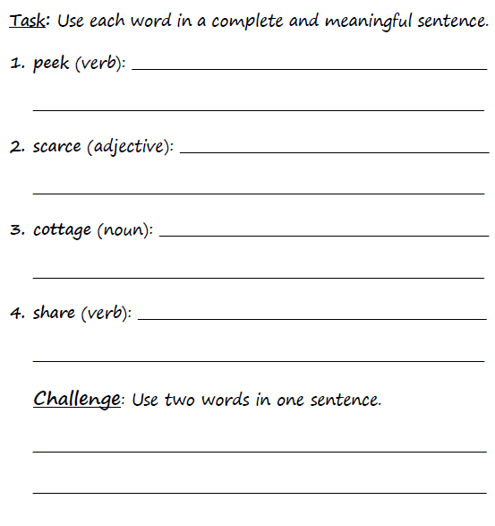
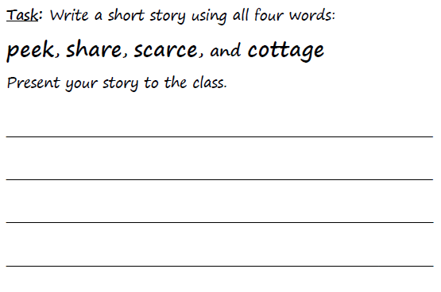
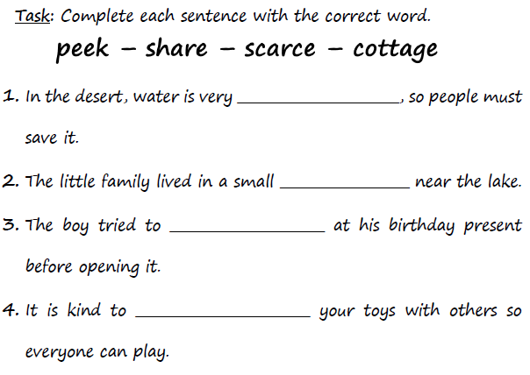

Slide 16
1
2
3
4

Slide 17

Peer Work and Self-Evaluation
Student’s Number | Task
1+4 | Check each other’s work.
2+3 | Check each other’s work.

Slide 18
Feedback
I peeked behind the door to see my friend.
Fresh fruit is scarce in winter.
We stayed in a small cottage near the forest.
cottage scarce peek share
I share my toys with my little brother.
I like to share my snacks with my friends.
Villagers had to share food because it was scarce.
One summer, we stayed in a small cottage near the forest. Food was scarce, so we had to share everything carefully. One morning, I decided to peek out the window and saw a deer eating apples from the tree. It was the most exciting part of our trip!
scarce
cottage
peek
share

Slide 19
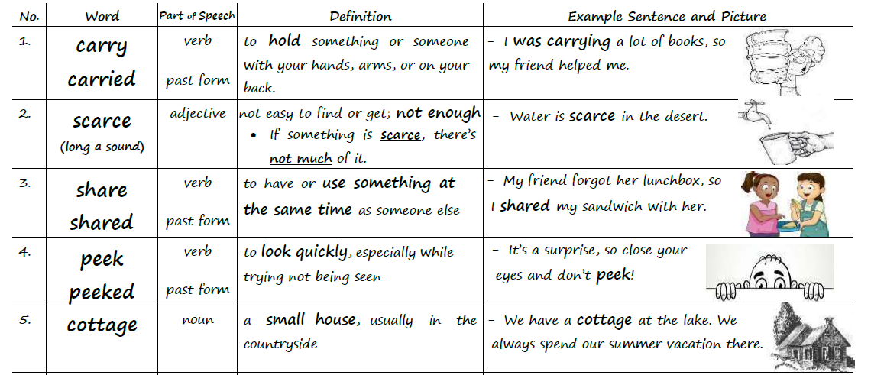
Vocabulary Worksheet p.1

Slide 20


Critical Thinking
Buzz in
Imagine you are staying in a cottage where food is scarce. You peek outside and see an animal taking some of your food. Would you share with the animal or keep the food for yourself? Why?

Slide 21


recognize and define the words
share, peek, scarce, and cottage
use the new words in complete and meaningful sentences
connect the new vocabulary to real-life experiences

Slide 22
Homework Use the words carry, peek, share, scarce, and cottage in complete and meaningful sentences.

