Slide 1
MATH SUBJECT Substitution and Elimination Method
10th Grade
Unit 5, Revision class

Slide 2


The Islamic Scientific College
Lesson: Substitution and Elimination Method
Unit : 5
Grade: 10
Subject: Math
Outcomes
Introduction
Pre-assessment
Revise and apply substitution and elimination methods to solve simultaneous linear equations
Essential activity
Constructive evaluation
Feedback
Differentiation learning
Real-life situation
Critical thinking
Summative evaluation
Exit ticket

Slide 3

The Islamic Scientific College
Lesson: Substitution and Elimination Method
Unit : 5
Grade: 10
Subject: Math
Two friends buy sandwiches and juices. Ali buys 2 sandwiches and 3 juices for 18 JD, while Huda buys 3 sandwiches and 2 juices for 17 JD. Can you figure out the cost of one sandwich and one juice?
Outcomes
Introduction
Pre-assessment
Essential activity
Constructive evaluation
Feedback
Differentiation learning
Real-life situation
Critical thinking
Summative evaluation
Exit ticket

Slide 4
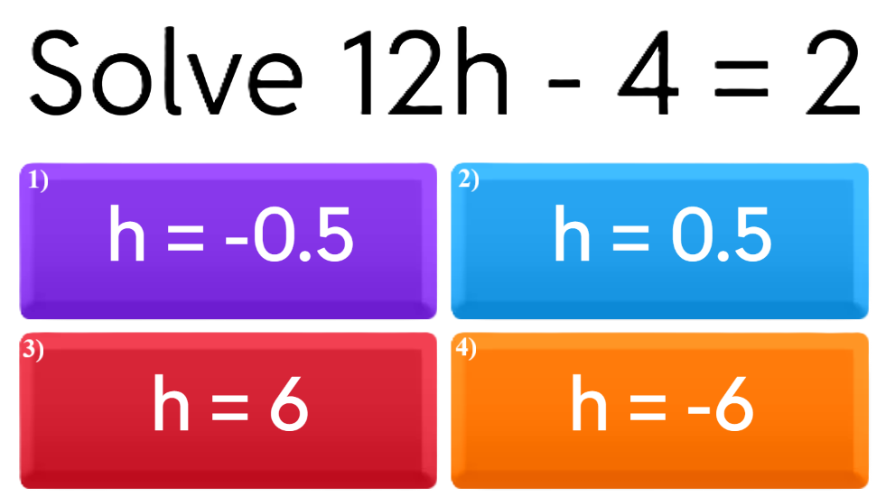
The Islamic Scientific College
Lesson: Substitution and Elimination Method
Unit : 5
Grade: 10
Subject: Math
Outcomes
Introduction
Pre-assessment
Essential activity
Constructive evaluation
Feedback
Differentiation learning
Real-life situation
Critical thinking
Summative evaluation
Exit ticket

Slide 5
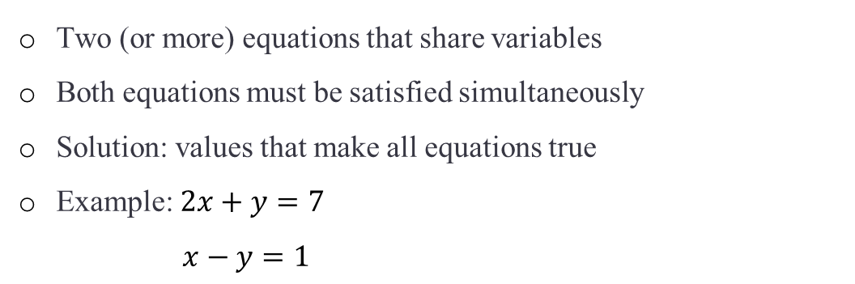
Review
The Islamic Scientific College
Lesson: Substitution and Elimination Method
Unit : 5
Grade: 10
Subject: Math
What are Simultaneous Equations?
Outcomes
Introduction
Two (or more) equations that share variables
Both equations must be satisfied simultaneously
Solution: values that make all equations true
Example: $2x+y=7$
$x−y=1$
Pre-assessment
Essential activity
Constructive evaluation
Feedback
Differentiation learning
Real-life situation
Critical thinking
Summative evaluation
Exit ticket

Slide 6
The Substitution Method
The Islamic Scientific College
Lesson: Substitution and Elimination Method
Unit : 5
Grade: 10
Subject: Math
Outcomes
Introduction
Isolate one variable in first equation
Substitute that expression into second equation
Solve for remaining variable
Substitute back to find the other variable
Pre-assessment
Essential activity
Constructive evaluation
Feedback
Differentiation learning
Real-life situation
Critical thinking
Summative evaluation
Exit ticket

Slide 7








The Islamic Scientific College
Lesson: Substitution and Elimination Method
Unit : 5
Grade: 10
Subject: Math
Use substitution method to solve the following pair of simultaneous equations.
Outcomes
$$4x+9y=−7$$
$$3x+2y=−10$$
Introduction
Pre-assessment
The solution
Essential activity
Solve one equation
for one variable
Substitute $x$:
$$4\left(\frac{−10−2y}{3}\right)+9y=−7$$
$$\frac{−40−8y}{3}+9y=−7$$
Solve for $y$
$$19y=−21+40$$
$$19y=19$$
$$y=1$$
Final Answer
(by substitution):
$$x=−4, y=1$$
Constructive evaluation
Feedback
$$3x+2y=−10$$
$$x=\frac{−10−2y}{3}$$
Differentiation learning
Real-life situation
Substitute $y=1$
$$x=\frac{−10−2\left(1\right)}{3}$$
$$x=−4$$
Critical thinking
Multiply everything by 3:
$$−40−8y+27y=−21$$
$$−40+19y=−21$$
Summative evaluation
Exit ticket

Slide 8
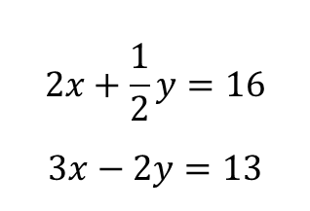
The Islamic Scientific College
Lesson: Substitution and Elimination Method
Unit : 5
Grade: 10
Subject: Math
Use substitution method to solve the following pair of simultaneous equations.
Outcomes
$$2x+\frac{1}{2}y=16$$
$$3x−2y=13$$
Introduction
Pre-assessment
Essential activity
Constructive evaluation
Feedback
Differentiation learning
Real-life situation
Critical thinking
Summative evaluation
Use GeoGebra to check your solution
Exit ticket

Slide 9



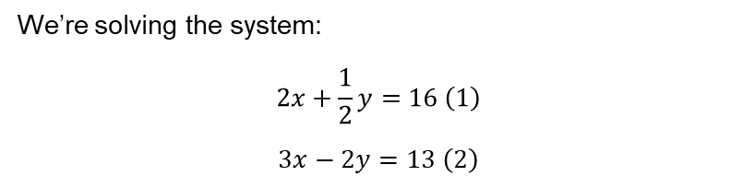
The Islamic Scientific College
Lesson: Substitution and Elimination Method
Unit : 5
Grade: 10
Subject: Math
We’re solving the system:
$$2x+\frac{1}{2}y=16 \left(1\right)$$
$$3x−2y=13 \left(2\right)$$
Outcomes
Introduction
Pre-assessment
Essential activity
Step 1: Multiply the whole equation by 2:
$$4x+y=32 \left(3\right)$$
So the system becomes:
$$4x+y=32 \left(3\right)$$
$$3x−2y=13 \left(2\right)$$
Step 2: Solve (3) for $y$
$$y=32−4x \left(4\right)$$
Step 3: Substitute into (2)
$$3x−2\left(32−4x\right)=13$$
$$3x−64+8x=13$$
$$11x−64=13$$
$$11x=77$$
$$x=7$$
Step 4: Find $y$using (4)
$$y=32−4\left(7\right)$$
$$y=32−28$$
$$y=4$$
✅ Final Answer:
$$x=7, y=4$$
Constructive evaluation
Feedback
Differentiation learning
Real-life situation
Critical thinking
Summative evaluation
Exit ticket

Slide 10
The Islamic Scientific College
Lesson: Substitution and Elimination Method
Unit : 5
Grade: 10
Subject: Math
Outcomes
The Elimination Method: Key Steps
Introduction
Pre-assessment
Align equations vertically
Multiply equations if needed
Add or subtract equations
Solve for remaining variable
Essential activity
Constructive evaluation
Feedback
Differentiation learning
Real-life situation
It is easier to use the elimination method when the coefficients of a variable match or can be easily made to match
Critical thinking
Summative evaluation
Exit ticket

Slide 11

The Islamic Scientific College
Lesson: Substitution and Elimination Method
Unit : 5
Grade: 10
Subject: Math
Use elimination method to solve the following pair of simultaneous equations.
Outcomes
$$−3c+4d=4$$
$$9c−2d=3$$
Introduction
Pre-assessment
Essential activity
Constructive evaluation
Feedback
Differentiation learning
Real-life situation
Critical thinking
Summative evaluation
Exit ticket

Slide 12

The Islamic Scientific College
Lesson: Substitution and Elimination Method
Unit : 5
Grade: 10
Subject: Math
Use elimination method to solve the following pair of simultaneous equations.
Outcomes
$$\frac{x}{4}+\frac{2y}{3}=3$$
$$\frac{x}{2}​+\frac{y}{3}​=3$$
Introduction
Pre-assessment
Essential activity
Constructive evaluation
Feedback
Differentiation learning
Real-life situation
Critical thinking
Summative evaluation
Use GeoGebra to check your solution
Exit ticket

Slide 13
The Islamic Scientific College
Lesson: Substitution and Elimination Method
Unit : 5
Grade: 10
Subject: Math
Outcomes
5.a
5.e
Introduction
1
2
Pre-assessment
Essential activity
Constructive evaluation
Feedback
5.b
5.j
Differentiation learning
3
4
Real-life situation
Critical thinking
Summative evaluation
Exit ticket
Please turn to page 158 in your book, and answer according to your seat number.

Slide 14

The Islamic Scientific College
Lesson: Substitution and Elimination Method
Unit : 5
Grade: 10
Subject: Math
Outcomes
Introduction
Suppose you double both equations in a system. Does the solution change? Why or why not? Can you give a real-life example to prove your answer?
Pre-assessment
Essential activity
Constructive evaluation
Feedback
Differentiation learning
Real-life situation
Critical thinking
Summative evaluation
Exit ticket

Slide 15

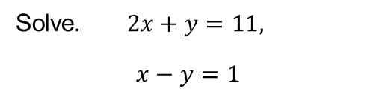
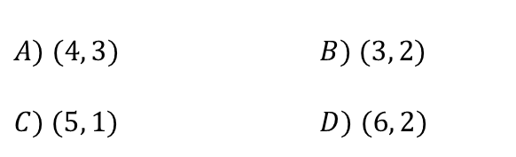
The Islamic Scientific College
Lesson: Substitution and Elimination Method
Unit : 5
Grade: 10
Subject: Math
Solve. $2x+y=11,$
$$x−y=1$$
Outcomes
Introduction
Pre-assessment
$$A) (4, 3) B) (3, 2) \\ C) (5, 1) D) (6, 2)$$
Essential activity
Constructive evaluation
Feedback
IRS
Differentiation learning
Real-life situation
Critical thinking
Summative evaluation
Exit ticket

Slide 16
The Islamic Scientific College
Lesson: Substitution and Elimination Method
Unit : 5
Grade: 10
Subject: Math
Outcomes
Write on sticky note
Introduction
Pre-assessment
Which method (substitution or elimination) do you prefer and why?
One word that describes how confident you feel about today’s topic.
Essential activity
Constructive evaluation
Feedback
Differentiation learning
Real-life situation
Critical thinking
Summative evaluation
Exit ticket

Slide 17
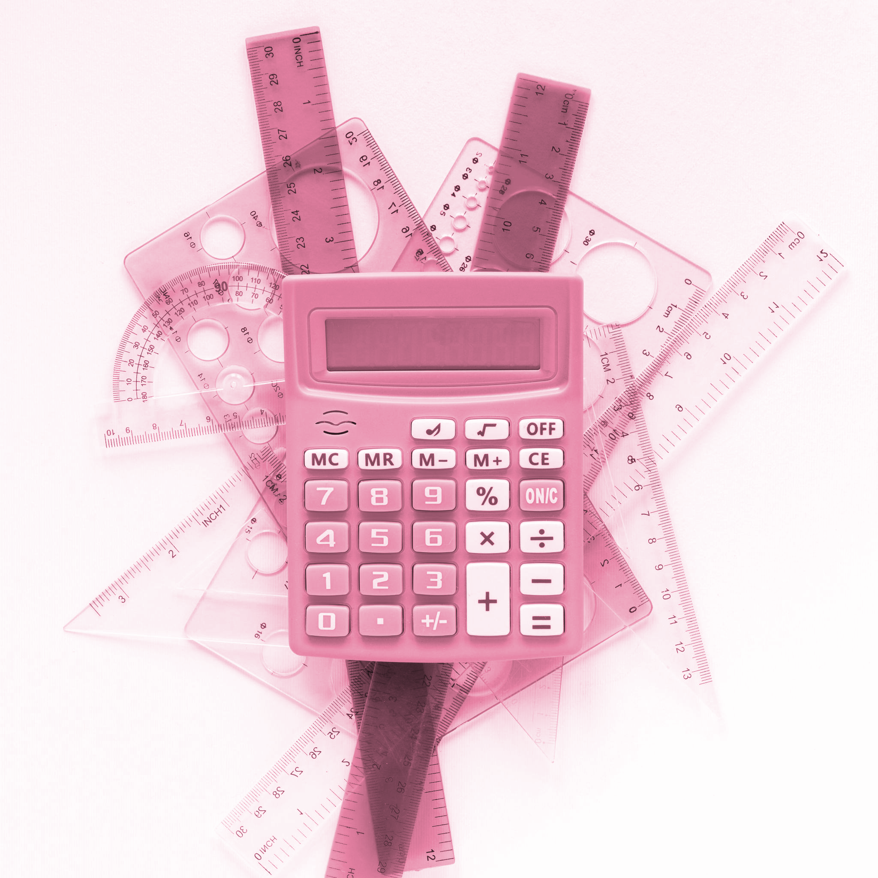
Any Question
The Islamic Scientific College
Lesson: Substitution and Elimination Method
Unit : 5
Grade: 10
Subject: Math
Outcomes
Introduction
Pre-assessment
Essential activity
Constructive evaluation
Feedback
Differentiation learning
Real-life situation
Critical thinking
Summative evaluation
Exit ticket

