Slide 1

Grammar: Parts of Speech
Nouns, Verbs, and Adjectives
📘 Subject: English
🎓 Grade: 5
📆 Unit: 1 – First Semester (2025-2026)

Slide 2

By the end of this lesson, students
are expected to:
- identify nouns , verbs , and adjectives in sentences.
explain what each part of speech does.
use nouns , verbs , and adjectives correctly.

Slide 3

Pre-Assessment

Slide 4
Which word is a noun?
run
happy
school
beautiful

Slide 5
Which word is a noun?
run
happy
school = place
beautiful

Slide 6
Which word is a verb?
dance
blue
chair
kitten

Slide 7
Which word is a verb?
dance = action
blue
chair
kitten

Slide 8
What do adjectives do?
name people, places, and things
show actions
describe nouns

Slide 9
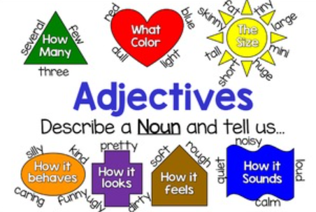
What do adjectives do?
name people, places, and things
show actions
describe nouns

Slide 10

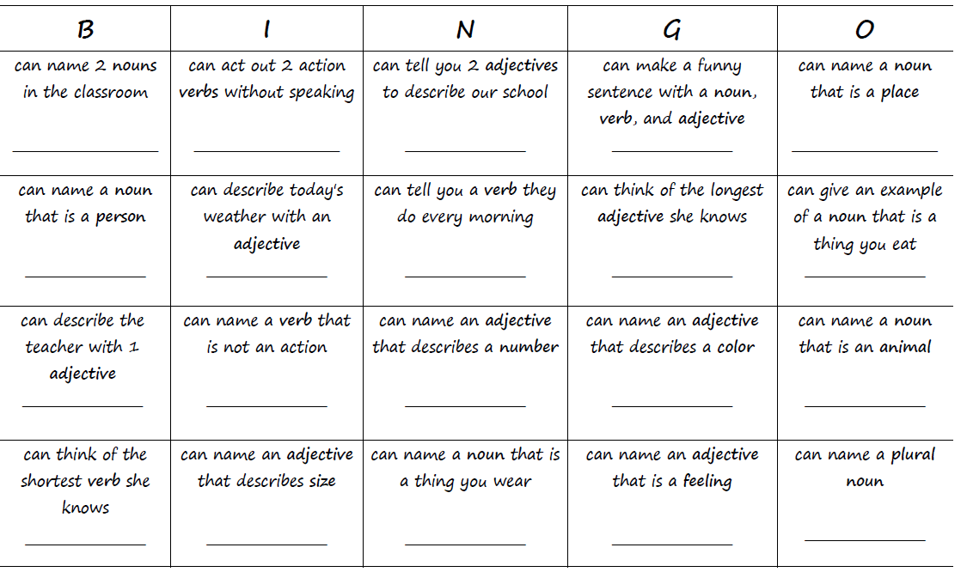
Warm up – Find Someone Who

Slide 11
Group Work Rubric
1. Participation: Each member participates and shares ideas with the group.
2. Task Completion: The task is divided fairly and is completed on time.
3. Collaboration: Group members listen to each other, respect ideas, and use only English to communicate.
4. Noise Level: Members work quietly and keep noise level appropriate.

Slide 12
Differentiation
Student’s Number | Task
1 | Color nouns blue, verbs pink, and adjectives green.
2 | Fill in the blanks with nouns, verbs, or adjectives to make a funny short story.
3 | Write a funny mini-story that has at least 2 nouns, 2 verbs, and 2 adjectives.
4 | 👀 Look around the classroom and quickly write nouns, verbs, and adjectives.

Slide 13
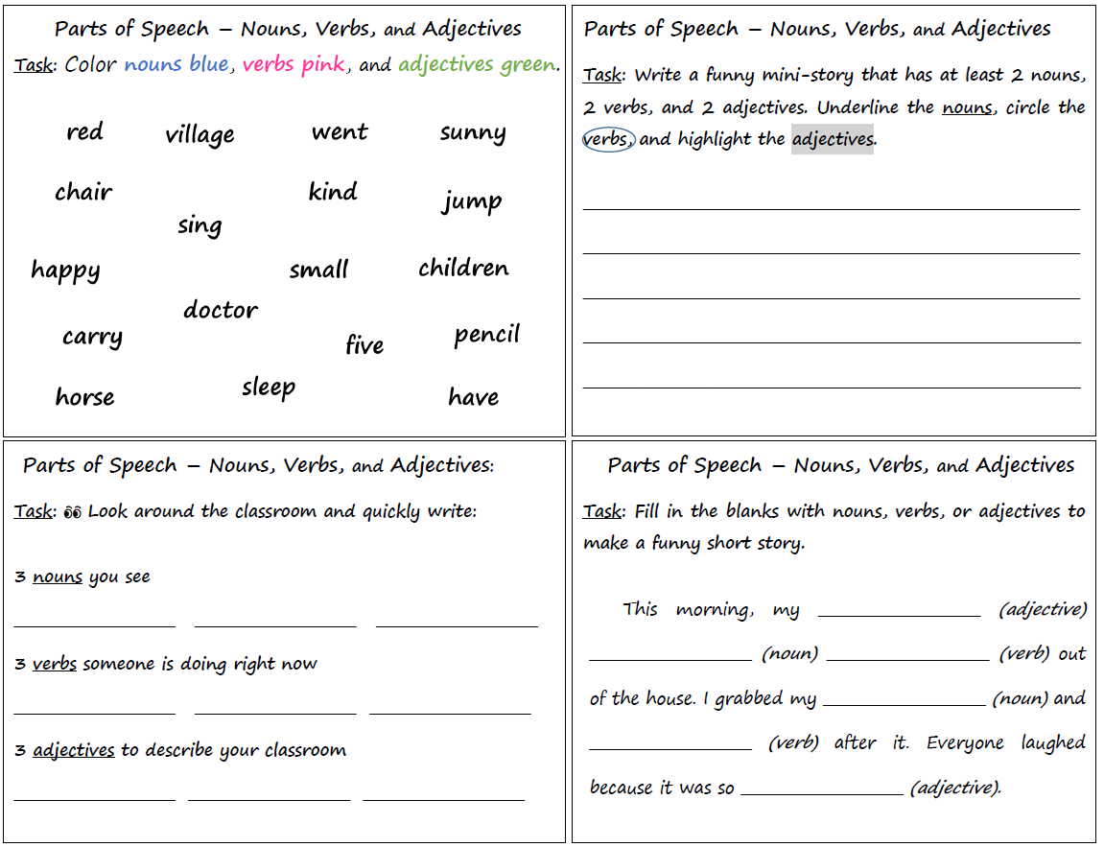

Slide 14
1
3
4
2

Slide 15

Peer Work and Self-Evaluation
Student’s Number | Task
1+4 | Check each other’s work.
2+3 | Check each other’s work.

Slide 16
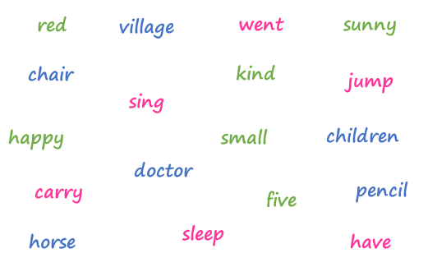
Feedback
The children were happy and small. They jumped and sang in the village all day.
book
desk
teacher
silly
dog
ran
write
talk
read
shoes
chased
loud
clean
bright
funny

Slide 17


Critical Thinking
Buzz in
Why is it important to use adjectives in our sentences?

Slide 18


Link to Life –
Discuss with a partner.
Think about your favorite place.
What nouns (things) do you find in that place?
What verbs show what you do there?
What adjectives describe how it feels or looks?

Slide 19


- identify nouns , verbs , and adjectives in sentences.
explain what each part of speech does
use nouns , verbs , and adjectives correctly

Slide 20

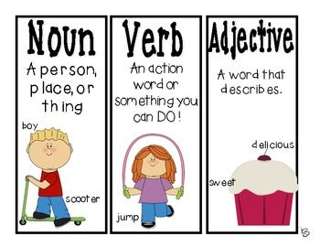
Write one sentence that includes
two nouns, one verb, and two adjectives.

Slide 21


Let’s Play!
https://wordwall.net/resource/17093040/writing-parts-of-speech/people-place-or-thing-1h
https://wordwall.net/resource/27948878/parts-of-speech/is-it-a-noun
https://wordwall.net/resource/38494342/parts-of-speech/noun-verb-adjective-sort
https://www.liveworksheets.com/worksheet/en/english-second-language-esl/1848841
https://www.liveworksheets.com/worksheet/en/english-second-language-esl/335276

