Slide 1
How to Solve a System of Equations Using Elimination

Slide 2


The Islamic Scientific College
Lesson: Elimination Method
Unit : 5
Grade: 10
Subject: Math
Learning Objectives
Outcomes
Introduction
Pre-assessment
Understand the concept of elimination method
Apply elimination method to solve simultaneous linear equations
Essential activity
Constructive evaluation
Feedback
Differentiation learning
Real-life situation
Critical thinking
Summative evaluation
Exit ticket

Slide 3

The Islamic Scientific College
Lesson: Elimination Method
Unit : 5
Grade: 10
Subject: Math
Outcomes
On the balance scale ⚖️, the left side has 2 red bags and 1 blue bag.
The right side has 4 blue bags.
If the scale is perfectly balanced, what relationship can you find between the red bag and the blue bag?
Introduction
Pre-assessment
Essential activity
Constructive evaluation
Feedback
Differentiation learning
Real-life situation
Critical thinking
Summative evaluation
Exit ticket
Think-Pair-Share

Slide 4


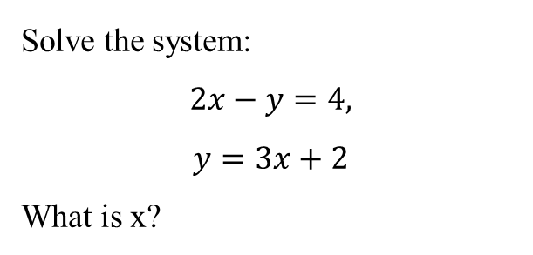
The Islamic Scientific College
Lesson: Elimination Method
Unit : 5
Grade: 10
Subject: Math
Solve the system:
$$2x−y=4,$$
$$y=3x+2$$
What is x?
Outcomes
Introduction
Pre-assessment
Essential activity
$$a) 1 b) 2$$
$$c)3 d) 4$$
Constructive evaluation
Feedback
Differentiation learning
IRS
Real-life situation
Critical thinking
Summative evaluation
Exit ticket

Slide 5

The Islamic Scientific College
Lesson: Elimination Method
Unit : 5
Grade: 10
Subject: Math
Outcomes
What is the Elimination Method?
Introduction
Pre-assessment
A technique to solve simultaneous linear equations
Works by eliminating one variable through addition or subtraction
Sometimes more efficient than substitution method
Key principle: Add or subtract equations to cancel out one variable
presentation
Constructive evaluation
Feedback
Differentiation learning
Real-life situation
Critical thinking
Summative evaluation
Exit ticket

Slide 6
The Islamic Scientific College
Lesson: Elimination Method
Unit : 5
Grade: 10
Subject: Math
Outcomes
Key Steps in Elimination Method
Introduction
Arrange equations in standard form
Make coefficients of one variable equal in magnitude
Add or subtract equations to eliminate one variable
Solve for remaining variable
Substitute to find the other variable
Check solution in both original equations
Pre-assessment
presentation
Constructive evaluation
Feedback
Differentiation learning
Real-life situation
Critical thinking
Summative evaluation
Exit ticket

Slide 7

Example
The Islamic Scientific College
Lesson: Elimination Method
Unit : 5
Grade: 10
Subject: Math
Outcomes
Introduction
Solve the simultaneous linear equations
Pre-assessment
$$2x+y=−1$$
$$3x−4y=4$$
Presentation
Constructive evaluation
Feedback
Differentiation learning
Real-life situation
Critical thinking
Summative evaluation
Exit ticket

Slide 8




The Islamic Scientific College
Lesson: Elimination Method
Unit : 5
Grade: 10
Subject: Math
Use the elimination method to solve the following pairs of simultaneous linear equations. (check your work using desmos)
Outcomes
Introduction
$$\left(2.a\right) 5x−2y=11$$
$$x+y=5$$
$$\left(2.c\right) 5x−4y=−1$$
$$2x−3y=1$$
Pre-assessment
Essential activity
Constructive evaluation
Feedback
Differentiation learning
Real-life situation
Critical thinking
Summative evaluation
Exit ticket
Page 158
Rally Coach

Slide 9


The Islamic Scientific College
Lesson: Elimination Method
Unit : 5
Grade: 10
Subject: Math
Given the system of equations:
What is the solution (c,d)?
Outcomes
Introduction
Pre-assessment
Round Table
Strategy
Essential activity
Constructive evaluation
Feedback
Differentiation learning
Real-life situation
Critical thinking
Summative evaluation
Exit ticket

Slide 10

The Islamic Scientific College
Lesson: Elimination Method
Unit : 5
Grade: 10
Subject: Math
Outcomes
1.c
2.e
Introduction
1
2
Pre-assessment
Essential activity
Constructive evaluation
Feedback
3.d
4.d
Differentiation learning
3
4
Real-life situation
Critical thinking
Summative evaluation
Exit ticket
Please turn to page 158 in your book, and answer according to your seat number.

Slide 11


The Islamic Scientific College
Lesson: Elimination Method
Unit : 5
Grade: 10
Subject: Math
Outcomes
When given a pair of equations, how would you decide whether substitution or elimination is the easier method to use? Give an example.
Introduction
Pre-assessment
Essential activity
Constructive evaluation
Feedback
Differentiation learning
Real-life situation
Critical thinking
Summative evaluation
Exit ticket

Slide 12

Let,s play
The Islamic Scientific College
Lesson: Elimination Method
Unit : 5
Grade: 10
Subject: Math
Outcomes
Introduction
Pre-assessment
Essential activity
Constructive evaluation
Feedback
Differentiation learning
Real-life situation
Critical thinking
Summative evaluation
Exit ticket

Slide 13

The Islamic Scientific College
Lesson: Elimination Method
Unit : 5
Grade: 10
Subject: Math
A school buys 3 notebooks and 2 pens for 8 JD. Another day, they buy 5 notebooks and 3 pens for 13 JD. Using the elimination method, find the price of one notebook and one pen.
Outcomes
Introduction
Pre-assessment
Essential activity
Constructive evaluation
Feedback
Differentiation learning
Real-life situation
Critical thinking
Summative evaluation
Exit ticket

Slide 14


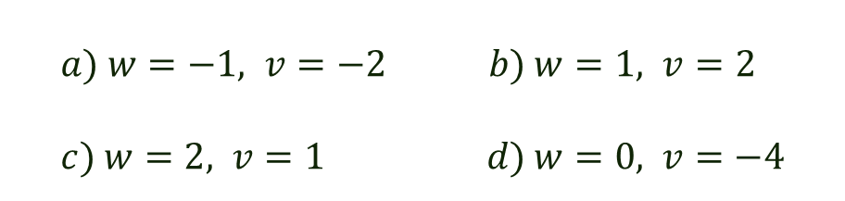
The Islamic Scientific College
Lesson: Elimination Method
Unit : 5
Grade: 10
Subject: Math
Given the system of equations:
$$2w−3v=−4$$
$$3w−v=1$$
What is the solution (𝑤,𝑣)?
Outcomes
Introduction
Pre-assessment
Essential activity
$$a) w=−1, v=−2 b) w=1, v=2 \\ c) w=2, v=1 d) w=0, v=−4$$
Constructive evaluation
Feedback
Differentiation learning
Real-life situation
Critical thinking
Summative evaluation
Exit ticket

Slide 15
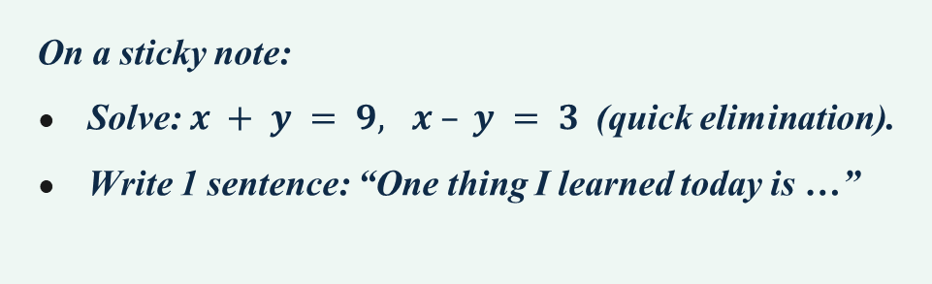
Exit ticket
The Islamic Scientific College
Lesson: Elimination Method
Unit : 5
Grade: 10
Subject: Math
Outcomes
Introduction
Pre-assessment
On a sticky note:
Solve: $x + y = 9, x – y = 3$(quick elimination).
Write 1 sentence: “One thing I learned today is …”
Essential activity
Constructive evaluation
Feedback
Differentiation learning
Real-life situation
Critical thinking
Summative evaluation
Exit ticket

Slide 16

Exit ticket
The Islamic Scientific College
Lesson: Elimination Method
Unit : 5
Grade: 10
Subject: Math
Outcomes
Introduction
Pre-assessment
Essential activity
Constructive evaluation
Feedback
Differentiation learning
Real-life situation
Critical thinking
Summative evaluation
Exit ticket

