Slide 1
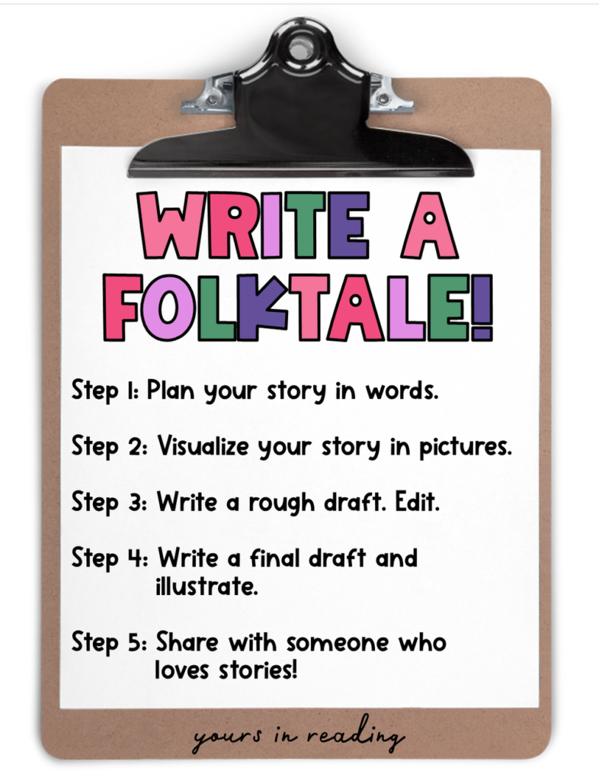

Slide 2
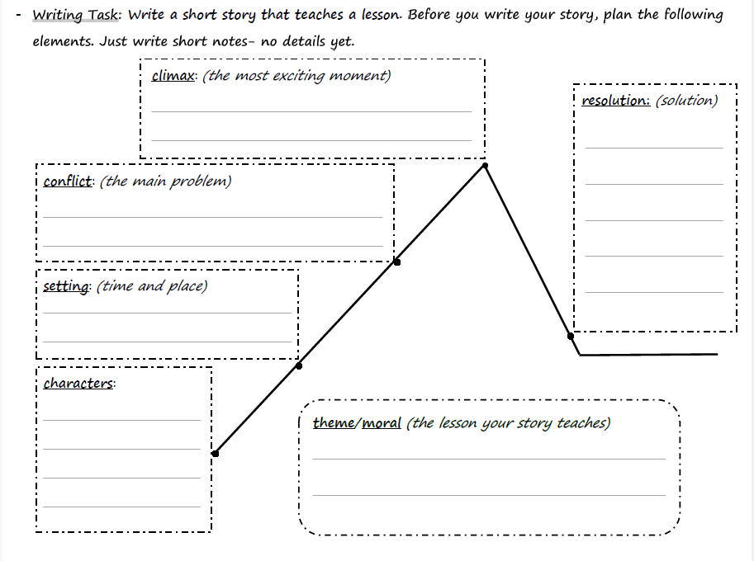

Slide 3
Theme / Moral
Bravery is rewarded.
Greed causes trouble.
Honesty is the best choice.
Do not judge by appearances.
Hard work pays off.
Wisdom is better than strength.
Helping others helps you too.
A small act of kindness makes a big difference.
Teamwork makes things easier.

Slide 4



Characters
animals
people
magical
clever fox
young farmer
a helpful fairy
brave lion
lonely girl
magical turtle
tricky monkey
kind woodcutter
talking tree
wise owl
honest boy
helpful dog
adventurous child
mountain giant
proud peacock
selfish girl
fire-breathing dragon
hard-working ant
grumpy old man
enchanted bird
lazy bear
wise grandmother

Slide 5
Setting (time)
Long, long ago …
Once upon a time …
Many years ago …
Long ago, when magic filled the earth …
Long ago, during the age of heroes …

Slide 6












Setting (place)
nature
villages/towns
magical/fantasy
deep jungle
busy marketplace
kingdom of talking animals
dark cave
snowy mountain
small village
island of giants
peaceful meadow
a farm
enchanted forest
sky palace
school
stormy sea

Slide 7
Conflict
A greedy character takes more than needed.
A trickster plays a prank that goes too far.
A liar causes trouble.
An character needs to be rescued.
A dangerous storm, hurricane, or flood threatens the village.
Someone loses something important.
A lazy character refuses to help the group.
A proud character boasts and gets into trouble.

Slide 8

Climax
The trick is discovered.
The character finally admits the truth out loud.
The storm, flood, earthquake, or fire hits and forces everyone to act fast.
A character risks everything to save someone.
The character finally faces their fear.
The main character must make a hard choice.
The lost item is found in a surprising place.
The character is caught in a trap.
A secret is revealed. Everyone learns the truth.
The boastful character learns a hard lesson

Slide 9
Resolution (Happy Ending!)
The characters forgive each other.
The characters share what they have.
The village works together to rebuild.
The trickster apologizes and learns.
The hero is rewarded for kindness or honesty.
The lazy character promises to help next time.
The storm ends and everyone is safe.
The problem is solved with teamwork.
The greedy character loses everything but learns a lesson.
The characters celebrate with a feast or dance.

Slide 10
Beginning
(setting, characters, and main conflict)
Add details about the setting.
Describe your main characters.
Make your conflict exciting.
Long ago in …, there lived… but one day …

Slide 11
Middle and End
(climax, resolution, and theme)

Slide 12
Climax
- Suddenly, everything changed when …
To everyone’s surprise …
The moment everyone feared had come …
At that very moment, something surprising happened …
It was then that the truth was revealed …
Then, in the middle of the night …

Slide 13
Resolution and Theme
- From that day on …
At last, peace returned to the village …
So, the village was safe again …
That was the day things changed forever
- The villagers never forgot that …
From then on, everyone knew that …
And so, … learned that …
The tale reminds us to always …

Slide 14
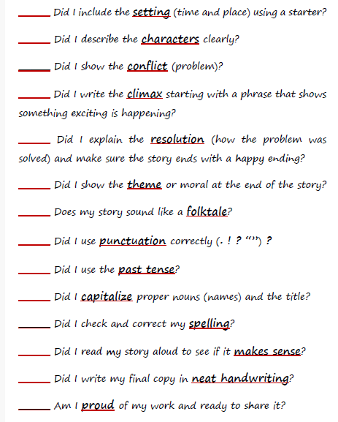
Checklist

Slide 15
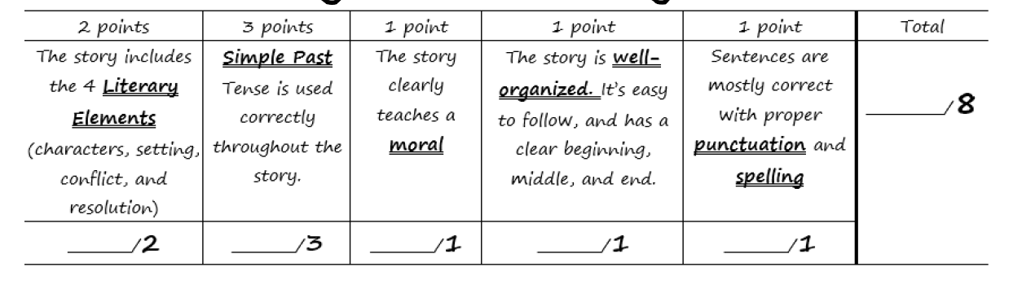
Writing a Short Story Rubric

