Slide 1
Healthy Eating Yearly Planner
🢂
Jan
Feb
Mar
Apr
May
Jun
Jul
Aug
Unit 1
Sep
Oct
Nov
Dec
🢀

Slide 2
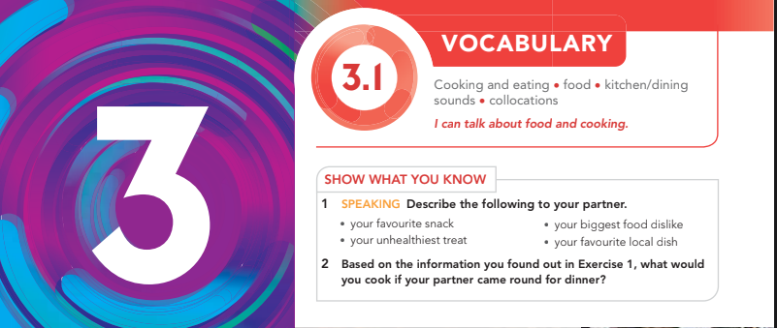
🢂
Jan
Feb
Mar
Apr
May
Jun
Jul
Aug
Sep
Oct
Nov
Dec
🢀

Slide 3
Snacks: chips, cookies, nuts, popcorn, fruit, chocolate.
Treats (usually unhealthy): candy, ice cream, cake, soda.
Meals/Foods: pizza, pasta, burger, salad, rice, chicken.
Local dishes mansaf, falafel, hummus, shawarma).

Slide 4
Read the three excerpts and then answer the questions
Reading page 28

Slide 5
🍴 Activity: Which Chef Said It? Match the Idea
Read each statement below. Decide which chef (1, 2, or 3) said it.
* “Cooking is like making a painting.”
* “I want my customers to stay healthy and safe.”
* “My restaurant is lively, noisy, and fun.”
* “Every little detail in the kitchen matters.”
* “I adapt my menu for people with allergies.”
Henry North
Logan Brown
Cody Armstrong
Henry North
Logan Brown

Slide 6
Which chef cares most about health?
Which chef cares most about atmosphere and fun?
Which chef cares most about art and creativity?
Logan Brown
Cody Armstrong
Henry North

Slide 7
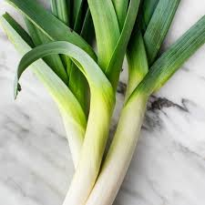
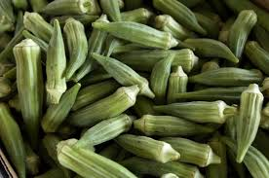
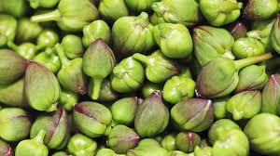
Vegetables
Okra
Capers
Leeks

Slide 8
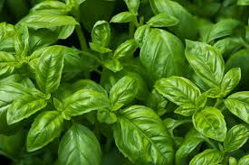
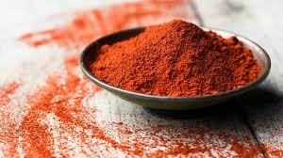
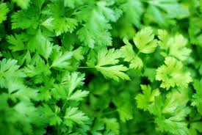
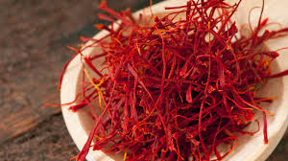
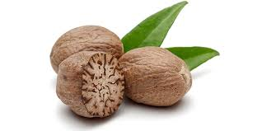
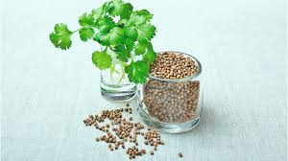
Herbs and Spices
Basil
Paprika
Parsley
Saffron
nutmeg
Coriander

Slide 9
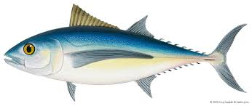
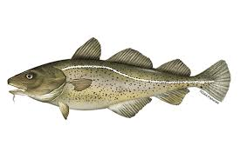
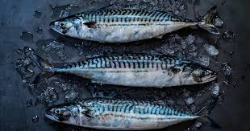
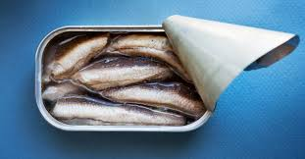
Fish
Tuna
Cod
Mackerel
Sardines

Slide 10
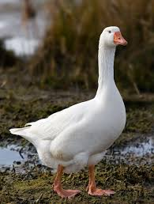
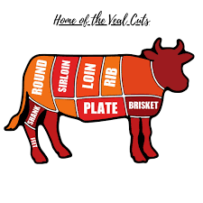
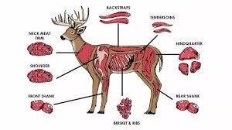
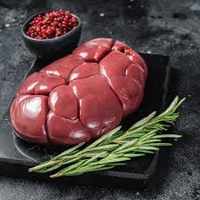
Meat
Goose
Veal
Venison
Kidneys

Slide 11
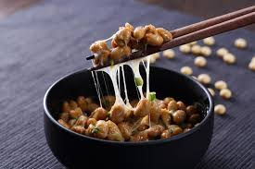
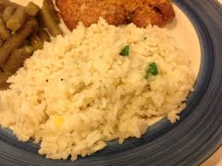
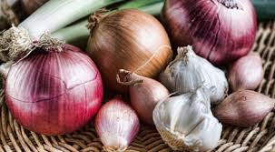
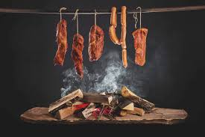
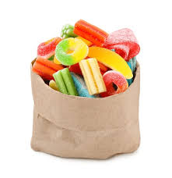
Smells , flavors and textures
Slimy
Glutinous
Perfumed
Smoked
Chewy

Slide 12
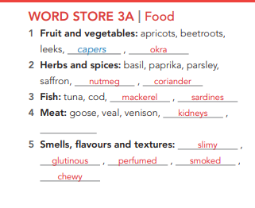

Slide 13
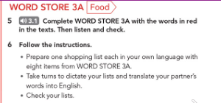
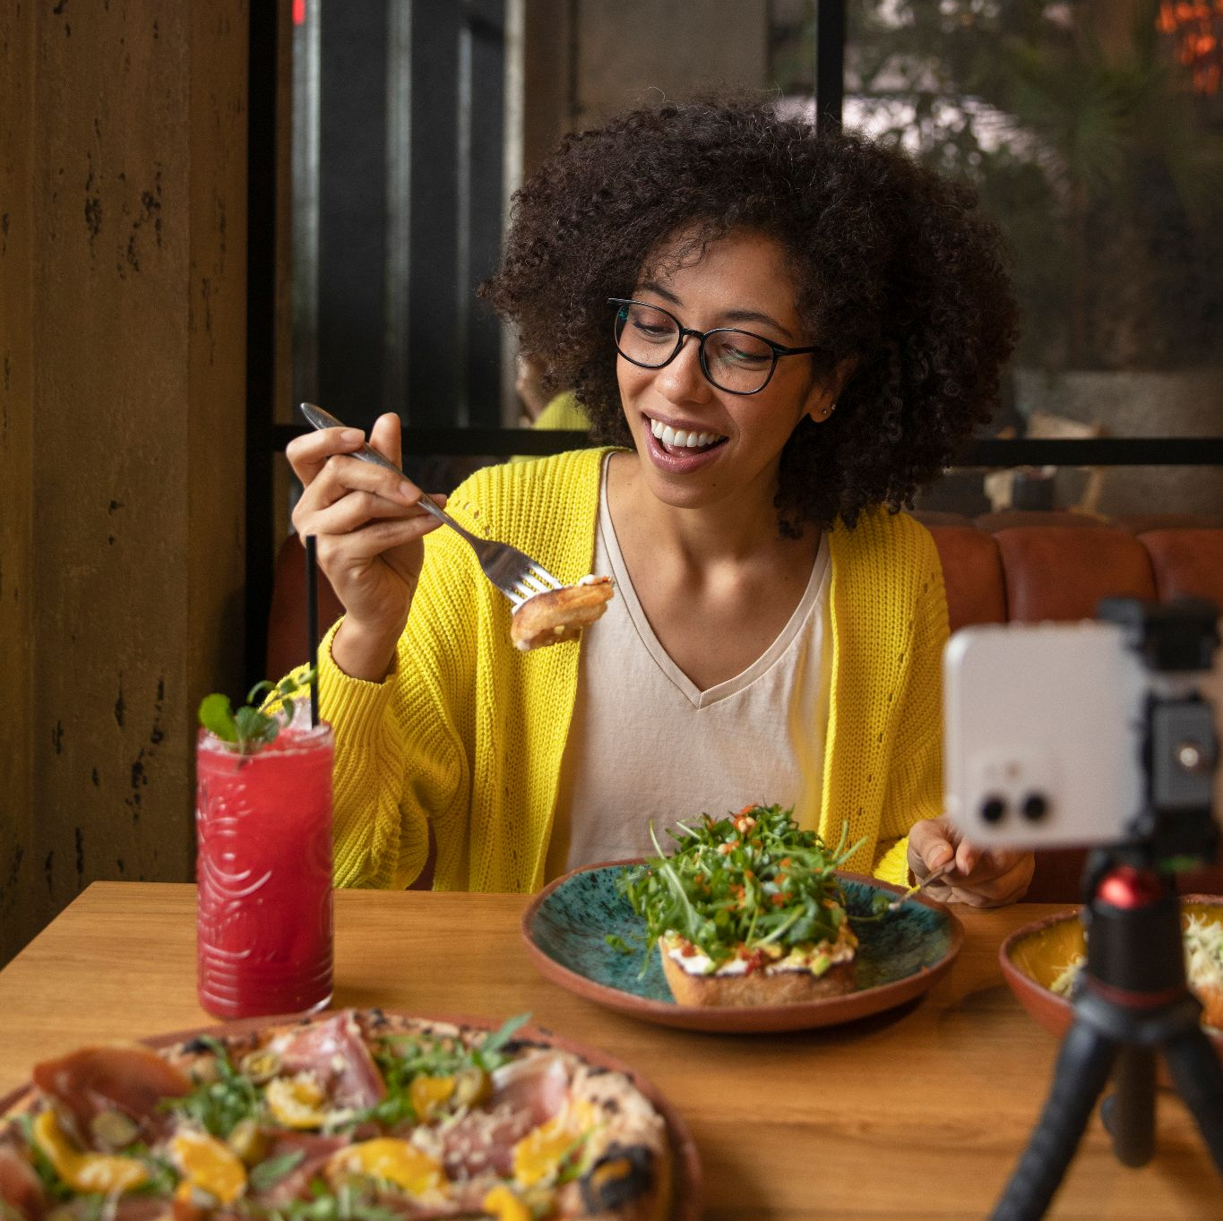
🢂
Jan
Feb
Mar
Apr
May
Jun
Jul
Aug
Sep
Oct
Nov
Dec
🢀

Slide 14
Round Table
1. Alarm clock ringing .
2.Birds chirping
3. Car engines
4.Door creaking
5.Footsteps
5..School bell
5.Keyboard typing
6.Pages flipping
7..TV or music.
8.Water running
1: 30
Name sounds that you can hear daily

Slide 15
Chinking:
Explanation: A light sound made when glass or metal objects lightly touch each other.
Example: Chinking is the sound you hear when you stack glasses or cups together, like in a dishwasher.
Buzzy
Explanation: A continuous, low, vibrating sound, like that of a busy place or a bee.
Example: Buzzy describes the sound of a lively café or a crowded space with lots of conversation and movement.
Crunchy:
Explanation: A hard, crisp sound made when something is crushed or bitten into.
Example: Crunchy is the sound of biting into a crisp or a cracker.

Slide 16
Hum:
Explanation: A steady, low, continuous sound, often soft and background-like.
Example: "Hum is the sound of traffic from a distance or an appliance like a fridge.
Popping:
Explanation: A short, sudden burst or sharp sound, often loud and quick.
Example: "Popping is the sound you hear when a balloon bursts or popcorn kernels explode in a pot.
Sizzling:
Explanation: A hissing or bubbling sound, usually made when something is frying or cooking in a hot pan.
Example: "Sizzling is the sound of bacon or meat when it cooks on a hot pan.
Clinking:
Explanation: A sharp, light sound made when metal or glass objects touch.
Example: Clinking is the sound of knives and forks touching in a school canteen."

Slide 17
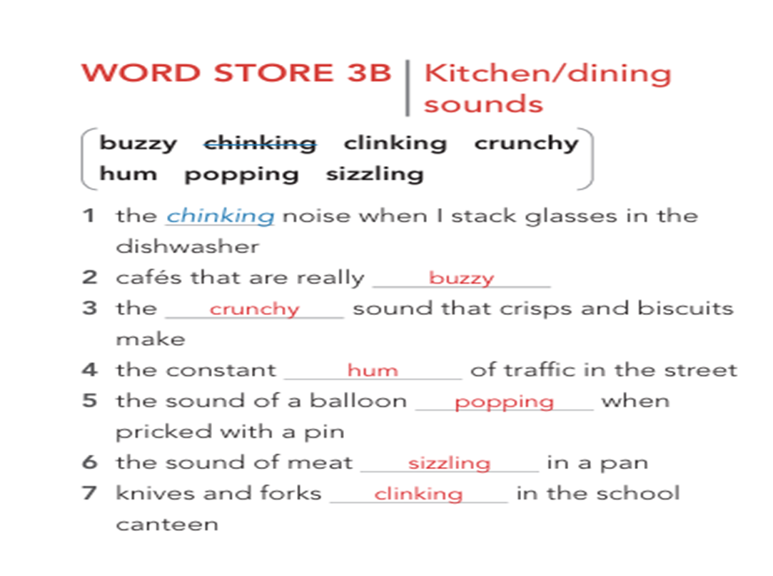

Slide 18
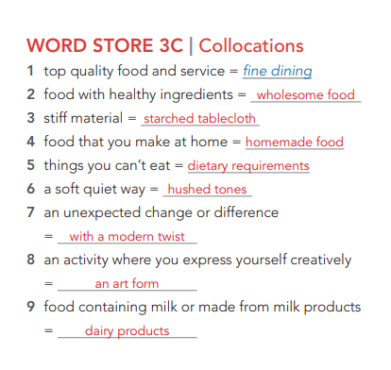

Slide 19

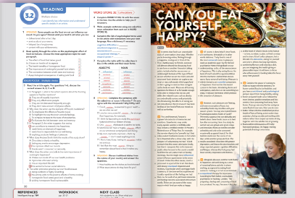
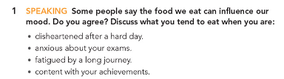
https://padlet.com/maisawad_1987/my-terrific-padlet-4k5cfkjpp10lwvrz
having lost determination or confidence; dispirited.

Slide 20
When you are disheartened after a hard day
👉 Disheartened = sad, tired, or disappointed.
Example answer: “When I feel down after a bad day, I usually eat chocolate or ice cream because it makes me feel comforted.”
When you are anxious about your exams
👉 Anxious = nervous, stressed, or worried.
Example answer: “When I’m stressed about exams, I don’t want heavy food. I prefer something light, like fruit or tea, to calm me down.”
When you are fatigued by a long journey
👉 Fatigued = very tired and exhausted.
Example answer: “After a long trip, I like eating warm soup or rice because it gives me energy and makes me feel relaxed.”
When you are content with your achievements
👉 Content = happy and satisfied with what you’ve done.
Example answer: “When I’m proud of myself, I celebrate with pizza or a big meal with friends.

Slide 21

Paragraph 1
Tips before you start :
1. Read the paragraph carefully .
2. Underline the new concepts and search for their meanings .
3. Read each question and underline the keywords .
4. Write your answers .
Performance : individual .
Task : each student will answer different questions .

Slide 22
🢂
"It seems that food is an unavoidable topic of conversation these days. Whether you're browsing online, flicking through a magazine, zoning out in front of the TV, or chatting away to friends, someone will almost certainly be discussing food in one form or another.“
Explanation: This section highlights that food has become a very popular topic in modern life. The author suggests that no matter where we are—online, reading, watching TV, or talking to friends—food is always a common subject.
Jan
Feb
Mar
Apr
May
Jun
Jul
Aug
Sep
Oct
Nov
Dec
🢀

Slide 23
"Favourite talking points include whether we are over- or underweight because of the type of food we eat; whether we eat too much junk and processed food; whether we ought to eat meat or not; and exactly which superfood or diet is going to save our lives and give us the body we want.
"Explanation: Here, the passage goes into detail about the specific issues people like to discuss about food. Some of these include concerns about weight (whether people are eating too much or too little), junk food consumption, debates about eating meat, and trends around “superfoods” or diets that are thought to improve health and appearance.
This part introduces various ideas that are commonly debated or worried about when it comes to food.

Slide 24
"These are all burning questions for those of us fortunate enough to be able to choose what we eat, and while diet-related issues such as obesity are undoubtedly serious and potentially life-threatening, the effects of eating are not only physical.“
Explanation: This section highlights that these food-related questions are important for people who have the privilege of choice in what they eat. It mentions that issues like obesity are serious and can even be life-threatening. The phrase "not only physical" introduces the idea that food affects more than just our bodies—it can influence other aspects of our lives too, which leads into the next part.
👉 Burning questions : very important, urgent, or strongly debated questions
Fortunate : lucky or having good luck.

Slide 25
"Recent research has been looking at how food affects our moods as well as our bodies.“
Explanation: In the final part, the passage reveals that recent studies are examining the impact of food on our emotions in addition to physical health. This suggests that what we eat doesn’t just influence our bodies (like weight and health) but also has the potential to affect how we feel emotionally.

Slide 26
Paragraph 1
Tips before you start :
1. Read the paragraph carefully .
2. Underline the new concepts and search for their meanings .
3. Read each question and underline the keywords .
4. Write your answers .
Performance : individual .
Task : each student will answer different questions .

Slide 27
Paragraph 2
First and foremost, flavour is a powerful conductor of memories and emotions. Strawberries may evoke a very special summer, a birthday cake may conjure a childlike wonder.
"Explanation: This section introduces the idea that flavor can connect us to memories and emotions. Certain foods, like strawberries or birthday cake, can bring back specific feelings or memories, like a wonderful summer or the excitement of childhood. This helps students see how tastes and smells are tied to past experiences.
1. Conductor :Something that carries or transmits (like electricity or, here, memories and emotions).
2. Evoke: To bring a memory, feeling, or image into mind.
3. Conjure : To bring something to mind as if by magic.

Slide 28
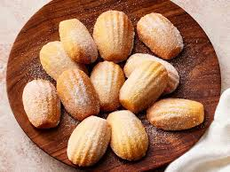
In Proust's Remembrance of Things Past, for example, the narrator depicts the 'powerful joy' that a tea-soaked madeleine awakes in him when he is 'dispirited after a dreary day, with the prospect of a depressing morrow’.
Explanation: Here, the passage gives an example from literature to illustrate the connection between taste and memory. In this story by Proust, a character experiences joy when he eats a madeleine (a small cake) dipped in tea. This act of tasting brings back memories of happier times, even when he feels down. This part helps students understand how flavors can bring back joyful memories, even when one is feeling sad.
1. Depicts – shows, describes, or paints a picture with words.
2. Dispirited – without hope or energy; sad and discouraged.
3. Dreary – dull, boring, or gloomy; lacking excitement.
4. Prospect – the possibility or expectation of something happening in the future.
5. Depressing – making someone feel very sad or hopeless.
6.. Morrow (old-fashioned) – tomorrow or the following day.

Slide 29
It isn't so much that the sweet cake tastes lovely, but that it transports him to his innocent youth, when his aunt in the country would feed him the very same treat on Sunday mornings.
Explanation: This part clarifies that it’s not just the taste of the cake that brings joy, but the memories it triggers. The cake reminds the narrator of his childhood and of a specific memory—Sunday mornings with his aunt. This reinforces how flavors can bring back memories of meaningful, comforting experiences.

Slide 30
"But the single most influential sense in flavour appreciation is the sense of smell. Unlike the other senses, smell is processed in a part of the brain that deals with strong emotional responses and memory.
"Explanation: Here, the author emphasizes the importance of smell in how we experience flavor. Smell is unique because it connects directly to parts of the brain that control emotions and memories, making it especially powerful for bringing back specific feelings or moments.
Influential means having the power to affect or change how people think, behave, or what happens.

Slide 31
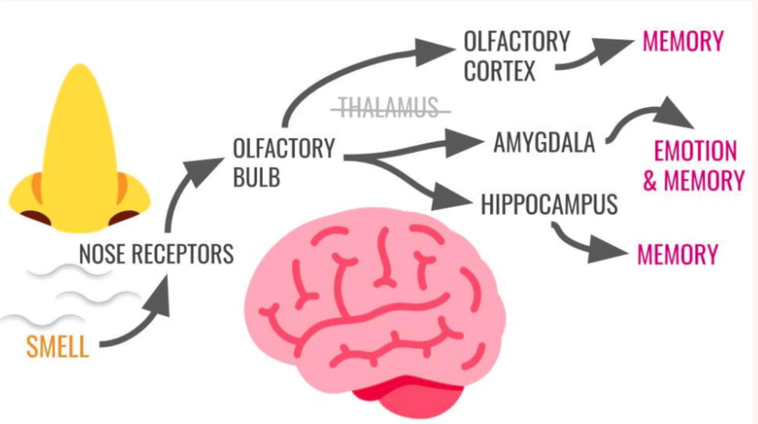

Slide 32
"A particular smell can trigger both a memory of the time we first experienced it and a repetition of the feelings we had then. So, for each of us, particular memories and feelings become associated with certain smells.
"Explanation: This section explains that smells can remind us of the first time we encountered them, along with the emotions we felt. So, specific smells become connected with certain memories and feelings for each person. This gives students insight into how our brains link smells with emotions.
Associated means connected, linked, or related to something.

Slide 33
"These are just some of the many ways in which food can make us happy.
"Explanation: The author wraps up the first part by summarizing that food can bring happiness by reminding us of positive memories and emotions.

Slide 34
Part 3

Slide 35
“Of course, it does help if these foods are toothsome, delectable or in other words delicious.”
Meaning: Naturally, it’s even better if the food tastes really good.
  Toothsome = tasty and pleasant to eat.
  Delectable = very delicious.
“‘Tasty food is one of the most universal routes to pleasure,’ reads an academic paper by the Oxford psychiatrist Morten Kringelbach on our understanding, so far, of the neuroscience of happiness.”
Meaning: A study by psychiatrist Morten Kringelbach from Oxford says that tasty food is one of the most common ways people everywhere feel pleasure. His research is about how the brain creates happiness.
  Universal = common to all people everywhere.
  Routes = ways or paths.
  Academic paper = a scientific study.
  Psychiatrist = a doctor who treats mental health problems.
  Neuroscience = the study of the brain and nervous system.

Slide 36
“This is why eating forms the basis of much scientific experimentation into the mechanics behind that elusive, warm, fuzzy sense of well-being.”
Meaning: That’s why scientists often study eating to understand how it creates happiness.
words:
  Forms the basis = is the foundation / main starting point.
  Experimentation = testing through experiments.
  Mechanics = how something works.
  Elusive = difficult to find or explain.
  Fuzzy sense = a soft, unclear but pleasant feeling.
  Well-being = feeling healthy, happy, and comfortable.

Slide 37
“Pleasure is widely viewed as an essential component of happiness.”
Meaning: Most people agree that pleasure is an important part of being happy.
words:
  Widely viewed = most people think so.
  Essential = very important, necessary.
  Component = part or piece of something.
🢂
Jan
Feb
Mar
Time | Meals | Time | Meals
08:00 | Sunny side up + milk | 18:00 | -
10:00 | Coffee | 19:00 | Chicken + Juice
12:00 | Pizza + pasta | 20:00 | -
14:00 | - | 22:00 | Oat and tea
15:00 | Fruits
Apr
May
Jun
Jul
Aug
Sep
Oct
Nov
Dec
🢀

Slide 38
“Food excites the reward system in the brain, stimulating desire and anticipation, and when we eat something we enjoy, it releases hormones which produce the sensation of pleasure.”
Meaning: Food activates the brain’s reward system, making us want it and look forward to it. When we eat food we like, our brain releases chemicals (hormones) that make us feel pleasure.
  Excites = activates, makes active.
  Reward system = part of the brain that makes us feel good when we do something enjoyable.
  Stimulating = encouraging, causing activity.
  Desire = wanting something strongly.
  Anticipation = looking forward to something.
  Sensation = a feeling in the body or mind.

Slide 39
“However, such pleasures are fleeting, and overconsumption of tasty but unhealthy foods may interfere with your reward system.”
Explanation:
Pleasures = enjoyable experiences.
Fleeting = short-lived; doesn’t last long.
Overconsumption = eating or drinking too much.
Reward system = part of the brain that makes us feel pleasure or satisfaction.
➡️ Meaning: Eating tasty but unhealthy foods may feel good at first, but the happiness doesn’t last. Eating too much of them can affect the brain’s way of feeling pleasure.

Slide 40
“You may also feel different. Psychologist Andrew Smith of Cardiff University suspects that our attitudes and beliefs about these foods cause us to feel low after consuming them.”
Explanation:
Psychologist = a scientist who studies the mind and behavior.
Suspects = thinks something is true (without full proof).
Attitudes = the way we think or feel about something.
Beliefs = ideas we accept as true.
Feel low = feel sad or depressed.
Consuming = eating or drinking.
➡️ Meaning: Andrew Smith (a psychologist) thinks that the way we think about unhealthy food—believing it’s bad for us—might make us feel sad after eating it.

Slide 41
“In a study he carried out, one group were given crisps and chocolate (foods we tend to consider unhealthy and only to be consumed occasionally as special treats!) for their teatime snack over the course of ten days, while another group ate fruit.”
Explanation:
Study = research or experiment.
Carried out = did, performed.
Crisps = thin fried potato slices (called chips in the US).
Occasionally = sometimes, not often.
Special treats = food we eat only on special occasions for pleasure.
Over the course of ten days = during ten days.
➡️ Meaning: In his experiment, one group ate crisps and chocolate every day for 10 days, while the other group ate fruit.

Slide 42
“The results associated chocolate with greater depression, and those who ate chocolate and crisps reported greater cognitive difficulties and fatigue, whereas the fruit group had lower anxiety, depression and distress.”
Explanation:
Results = findings from the study.
Associated = connected or linked.
Depression = a state of deep sadness or low mood.
Cognitive difficulties = problems with thinking, memory, or concentrating.
Fatigue = extreme tiredness.
Whereas = in contrast, but.
Anxiety = worry or nervousness.
Distress = extreme sadness or emotional pain.
➡️ Meaning: The study found that people who ate chocolate and crisps felt more depressed, had trouble thinking, and were more tired. On the other hand, the fruit group felt less worried, less sad, and less emotionally upset.

Slide 43
🔎 Critical Thinking Questions
Why do you think eating unhealthy foods makes people feel good at first but worse later?
Could our beliefs about food (thinking chocolate is “bad”) influence how our body reacts to it? Why or why not?
If fruit leads to better mood and less anxiety, what does that tell us about the relationship between food and mental health?
The study lasted ten days. Do you think the results would be stronger or weaker if it lasted several months? Why?

Slide 44
Part 5
“Alongside pleasure, another contributor to happiness and well-being is a sense of meaningfulness and this is where cooking, as opposed to eating food, comes in.”
Explanation:
Alongside = together with.
Contributor = something that helps to cause or increase something.
Well-being = a state of being comfortable, healthy, or happy.
Meaningfulness = having purpose or value.
As opposed to = instead of; in contrast to.
➡️ Meaning: Besides pleasure, happiness also comes from having meaning in life. Cooking, not just eating, can give that sense of meaning.

Slide 45
“Cooking is in fact an established occupational therapy for depression.”
Explanation:
In fact = actually; to emphasize something true.
Established = officially accepted or proven.
Occupational therapy = a type of treatment that helps people recover through practical daily activities.
Depression = a mental health condition that causes deep sadness and lack of energy.
➡️ Meaning: Cooking is officially used as a form of therapy to help people with depression.

Slide 46
“According to Mark Salter, a consultant psychiatrist in Hackney, London, ‘The preparing, sharing and consuming of food is so precious,’ he says, ‘because it lies slap at the heart of what it means to be human - to love, to relate, to plan, to feed, to enjoy and to share.’”
Explanation:
Consultant psychiatrist = a senior doctor who treats mental health problems.
Precious = very valuable or important.
Slap at the heart (informal) = exactly at the center; essential.
Relate = to connect or interact with others.
➡️ Meaning: Mark Salter says that preparing, sharing, and eating food is very important because it represents the core of human life: love, relationships, planning, feeding, enjoying, and sharing.

Slide 47
“It isn't only a pleasure, but a life skill. It's elemental, caring for yourself and others.”
Explanation:
Life skill = a basic ability needed for everyday living.
Elemental = fundamental, basic, essential.
➡️ Meaning: Cooking is not just fun; it’s an essential skill and a way to care for yourself and the people around you.

Slide 48
“When choosing ingredients, combining flavours and creating a dish, you are imagining the health-giving or pleasurable impact it will have on those who will consume it.
”Explanation:
Ingredients = the foods used to make a dish.
Combining flavours = mixing tastes together.
Consume = eat or drink.
Impact = effect
.Health-giving = making someone healthier.
➡️ Meaning: While cooking, you think about how the food will affect the health or happiness of the people who will eat it.
:“Cooking takes the focus away from yourself.”
Explanation:
Takes the focus away from yourself = shifts attention from your own problems to others or to the task.
➡️ Meaning: Cooking helps people stop thinking only about themselves and focus on others or the activity.

Slide 49
“Combine the power of cooking to make us happy with the tendency for home-cooked food to be healthier, and you have a nutritional and psychological jackpot.”
🔑 Key Words
Combine – put two or more things together.
Tendency – what usually happens.
Home-cooked – food made at home.
Nutritional – related to food and health.
Psychological – related to the mind and emotions.
Jackpot – a big success or reward.
💡 Explanation
Cooking makes people feel happy. Home-cooked food is usually healthier. When you put these two together, you get both health benefits and emotional happiness.

Slide 50
“Apart from being healthy, eating home-prepared food is also followed by more intense, positive emotions and less anxiety than consuming food away from home.”
🔑 Key Words
Apart from – besides; in addition to.
Intense – very strong.
Positive emotions – good feelings like joy or excitement.
Anxiety – nervousness, stress, or worry.
Consuming – eating or drinking.
💡 Explanation
Eating food at home is not only healthy. It also makes people feel stronger happiness and reduces stress compared to eating at restaurants.

Slide 51
“If you go one step further and grow some food of your own, then you do even better.”
🔑 Key Words
Go one step further – do something extra.
Grow – to plant and take care of food.
💡 Explanation
If you don’t just cook but also grow your own food, you get even more benefits.

Slide 52
“What with the established positive health effects of being active rather than sedentary, being outside and working with nature rather than cooped up inside all day, together with the satisfaction of growing food and the deliciousness of freshly harvested produce, the happy-making potential of eating is enormous.”
🔑 Key Words
Established – already known or proven.
Active – moving, doing things.
Sedentary – sitting still, not moving much.
Cooped up – stuck inside, not free.
Satisfaction – good feeling after finishing something well.
Deliciousness – the taste of being very good.
Harvested – collected from plants (fruits/vegetables).
Potential – possibility of something happening.
Enormous – very big.
💡 Explanation
When people are active and spend time outdoors in nature, they become healthier and happier. Growing your own food gives you pride and satisfaction. Freshly picked food is tasty. All of this shows that food has a huge power to make us happy.

Slide 53
Workbook page 30
🢂
Jan
Feb
Mar
Apr
May
Jun
Jul
Aug
Sep
Oct
Nov
Dec
🢀

Slide 54
An American doctor did some studies and found that sugar is like an addictive substance. Due to this there have been calls in the US for laws to restrict access to sugar. The more sceptical among us might question whether this isn't just another case of food-related scaremongering.
Main idea:
A doctor found that sugar may be addictive, but some people doubt this and think it’s just exaggerated fear.
Meanings:
Addictive substance = something you can get hooked on, like cigarettes or drugs.
Restrict access = limit how much people can get.
Sceptical = not easily convinced, doubtful.
Scaremongering = spreading fear, sometimes without good reason.

Slide 55
Obviously, there are products on the market that are not healthy, are costly, addictive and cause diseases. But sugar? OK, we know it rots your teeth if you don’t clean them. If you eat too much sugar, you put on weight. It can alter your metabolism, so when you eat sugar, you crave more. And yes, there is the “sugar-high” that kids on soda have. But honestly, sugar is harmless enough, isn’t it? Or maybe most of us don’t want to face the bitter truth about sugar.
Main idea:
Sugar seems harmless, but it causes tooth decay, weight gain, cravings, and “sugar highs.” Most people ignore its dangers.
Meanings:
Rots your teeth = damages and decays teeth.
Metabolism = how the body changes food into energy.
Crave = strongly want more of something.
Sugar-high = a burst of energy and excitement after eating a lot of sugar.
Bitter truth = unpleasant fact we don’t want to admit.

Slide 56
An American professor of paediatrics has studied childhood obesity. His expertise is human metabolism. He shares lectures on social media, and many went viral. He says there are more obese people in the world than undernourished people. Many believe obesity is from eating too much fat, but he argues that is not the case.
Main idea:
A professor says the global obesity problem is not mainly caused by fat, but something else.
Meanings:
Paediatrics = medicine for children.
Obesity = being very overweight.
Undernourished = not having enough food or nutrients.
Viral (lectures) = became very popular online, shared by many people.

Slide 57
In the 1970s, doctors linked fat to heart attacks, so the Western world went low-fat. The problem was, without fat, food tasted like cardboard. So the food industry added sugar (corn syrup, sucrose) to products. This means 35 years ago, we removed fat but added invisible sugar to almost everything.
Main idea:
When fat was removed from foods, sugar was added to replace flavor, leading to widespread sugar consumption.
Meanings:
Cardboard (taste like) = bland, tasteless.
High-fructose corn syrup = a sweetener made from corn.
Sucrose = table sugar.
Invisible sugar = hidden sugar in foods we don’t expect (like pumpkin or spinach pie).

Slide 58
What happens in your liver when you eat too much of this 'invisible' sugar? Well, there's a complicated chain of events, but the upshot is something called 'leptin resistance'. Leptin is a hormone produced to tell us when we're full. When we eat too much fructose, leptin is sometimes switched off and we lose the ability to tell when we've consumed as much as we need. Fructose makes us want to eat more; it tells us not to be satisfied. That is good when food is scarce, but it's a disaster when it's readily available. The professor believes this is why so many people are 'off-the-scale' obese these days.
Main idea:
Too much sugar causes leptin resistance, which prevents us from knowing when we’re full, making us overeat.
Meanings:
Upshot = result, outcome.
Leptin = a hormone that tells the body it’s full.
Scarce = not much available.
Off-the-scale obese = extremely overweight, beyond normal levels.

Slide 59
Text:
So, should sugar consumption be regulated by law? For a substance to be controlled, it must have certain characteristics. It must have the potential to be abused, it must be unhealthy, and it must be widespread. Sugar, it seems, ticks all these boxes. Sugar is in abundance everywhere, it's addictive, and it's unhealthy.
Main idea:
Sugar has the same traits as other regulated substances—it’s addictive, harmful, and everywhere.
Meanings:
Regulated = controlled by rules or laws.
In abundance = in large amounts, everywhere.

Slide 60
There is, of course, a big barrier to any effort to regulate sugar consumption, namely the food industry. The food industry has no impetus to change. They're making money hand over fist. Some industries still have collective influence that somehow allows them to continue selling products that have been proven to be unhealthy.
Main idea:
The food industry doesn’t want change because it profits from selling sugary products.
Meanings:
Impetus = motivation or reason to act.
Hand over fist = making money very quickly.
Collective influence = power held by a group working together.

Slide 61
What if sugar is the culprit? What can we do? We can start the long, laborious process of coming out of denial. We can make sugar products expensive, harder to buy, and harder to advertise. We can keep them away from children. Make them taboo. To radically cut our intake would be to radically shake up the economy.
Main idea:
Solutions include raising prices, limiting ads, restricting children’s access, and reducing sugar intake—even though this would affect the economy.
Meanings:
Culprit = the thing causing the problem.
Laborious = difficult and taking a lot of effort.
Taboo = something forbidden or not accepted by society.
Radically = completely, in a big way.

Slide 62
Here are some tips for eating less sugar or even cutting sugar completely out of your diet. Firstly, try having less sugar in your juice or breakfast cereal, swap soda for water or fruit-infused water. Next, choose natural yoghurt and add your own fruit. Avoid dried fruit, since it often has extra sugar. Choose whole wheat breads and pastas with no added sugar. Always read labels to check for hidden sugar. If you need a sweet snack, eat fruit—“an apple a day keeps the doctor away.”
Main idea:
Practical tips include cutting sugar in drinks, eating natural yogurt, avoiding dried fruit, choosing whole grains, reading labels, and eating fresh fruit.
Meanings:
Infuse = soak something in liquid to give flavor.
Naturally occurring = already present in food.
Whole wheat = food made from the entire grain, healthier than refined.
Food labels = printed information on food packaging.

Slide 63
