Slide 1


Stone Soup pp.32 and 33
Unit: 1
Big Question: What are the pros and cons of sharing?
Genre: Folktale

Slide 2

Outcomes By the end of this lesson, students are expected to
Literary Eements
Major Events
Big Question
identify the resolution and analyze the theme
summarize and retell the major events using past tense verbs
discuss the value and importance of sharing and helping others

Slide 3

IRS

Slide 4
IRS
What did the little girl and the little boy offer to add to the soup?
1. onion and meat
2. carrots and bread
3. potatoes and carrots

Slide 5
IRS
What did the little girl and the little boy offer to add to the soup?
1. onion and meat
2. carrots and bread
3. potatoes and carrots

Slide 6
IRS
What did John say about the soup after smelling the aroma?
1. It needs more salt.
2. It will be the best soup ever.
3. It smells terrible.

Slide 7
IRS
What did John say about the soup after smelling the aroma?
1. It needs more salt.
2. It will be the best soup ever.
3. It smells terrible.

Slide 8
IRS
What did John ask the children after seeing they looked hungry?
1. to go home and eat
2. to bring more vegetables
3. to help the stir the soup
4. to share the soup with him

Slide 9
IRS
What did John ask the children after seeing they looked hungry?
1. to go home and eat
2. to bring more vegetables
3. to help the stir the soup
4. to share the soup with him

Slide 10



Warm-up Activity
Think of your favorite meal.
What ingredients are needed to make that meal?

Slide 11

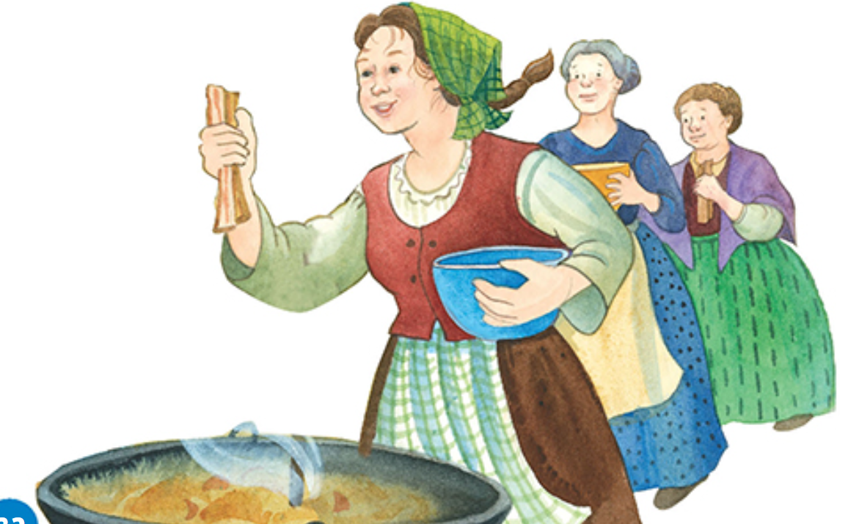
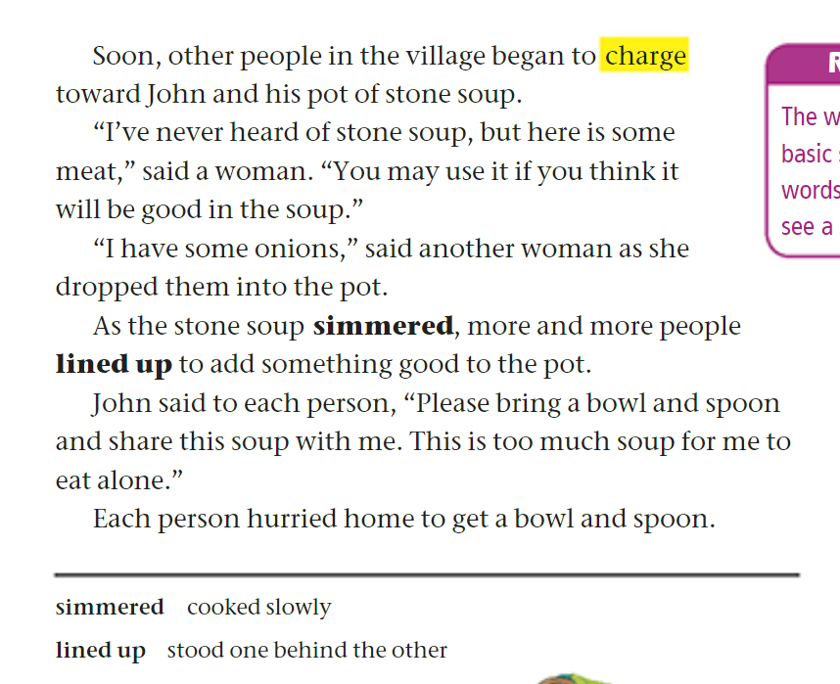
page 32

Slide 12

Discussion Questions on p.32
1. Why did the villagers start charging toward John?
2. What ingredients did the women add to the pot?
3. What did the people do as the soup simmered?
4. What did John ask each person to bring?
5. Why does John say, "This is too much soup for me to eat alone"?
6. What does this story teach about sharing and helping others?
5. What do the following pronouns refer to?
it (line 4) me (line 11)

Slide 13
Feedback
Why did the villagers start charging toward John?
2. What ingredients did the women add to the pot?
3. What did the people do as the soup simmered?
4. What did John ask each person to bring?
5. Why does John say, "This is too much soup for me to eat alone"?
6. What does this story teach about sharing and helping others?
7. What do the following pronouns refer to?
it (line 4) me (line 11)
They smelled the nice aroma of the stone soup and wanted to see what was happening.
John wanted to encourage the villagers to join him and share the soup.
When people share what they have, they can make something great that everyone can enjoy.

Slide 14
Feedback
Why did the villagers start charging toward John?
2. What ingredients did the women add to the pot?
3. What did the people do as the soup simmered?
4. What did John ask each person to bring?
5. Why does John say, "This is too much soup for me to eat alone"?
6. What does this story teach about sharing and helping others?
7. What do the following pronouns refer to?
it (line 4) me (line 11)
They smelled the nice aroma of the stone soup and wanted to see what was happening.
John wanted to encourage the villagers to join him and share the soup.
When people share what they have, they can make something great that everyone can enjoy.

Slide 15
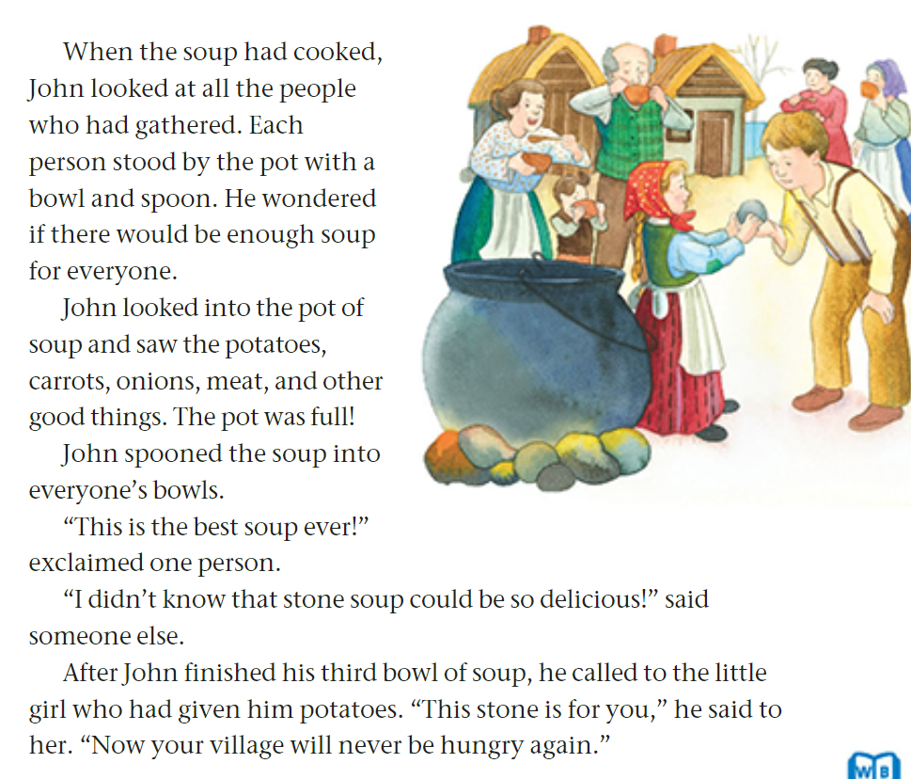
page 33

Slide 16
Discussion Questions on p. 33
1. What were the people who gathered around the pot holding?
2. What ingredients did John see when he looked into the pot?
3. Was there enough soup for everyone? How do we know?
4. What did people say about the soup after they tasted it?
5. Did John enjoy the soup? How do we know?
6. What did John give to the little girl after finishing his soup?
7. Why did John give the stone to the little girl?
8. What part of the plot is told on p.33? ________________________
9. What is the theme of the folktale “Stone Soup”?

Slide 17
Feedback
1. What were the people who gathered around the pot holding?
2. What ingredients did John see when he looked into the pot?
3. Was there enough soup for everyone? How do we know?
4. What did people say about the soup after they tasted it?
5. Did John enjoy the soup? How do we know?
6. What did John give to the little girl after finishing his soup?
7. Why did John give the stone to the little girl?
8. What part of the plot is told on p.33? ________________________
9. What is the theme of the folktale “Stone Soup”?
Jonn gave the stone to the girl to thank her and to remind her that people will never be hungry if they share.
resolution
9. If people share and help each other, everyone will get something good.

Slide 18


Linking to Life
When have you shared something with others that made everyone happier?

Slide 19
Differentiation
Student’s Number | Task
1 | Imagine John comes back to the village later. Write a short ending (3–5 sentences) showing how the villagers now share food differently because of what they learned.
2 | Draw a picture of the pot of soup. Label at least 3 ingredients you read about in the story.
3 | Write 3–4 sentences about what the villagers learned from making the soup together. Use the past tense
4 | Circle the words simmered and lined up in the text. Write their meanings (use the box at the bottom for help). Use each word in a complete and meaningful sentence.

Slide 20
Differentiation
Once done, share your answers with students who have the same number as you.

Slide 21


Buzz in!
Critical Thinking:
What might have happened if the villagers refused to share?

Slide 22
IRS

Slide 23
IRS
Which adjectives describe John’s character?
1. honest and trustworthy
2. creative and kind
3. brave and funny
4. lazy and selfish

Slide 24
IRS
Which adjectives describe John’s character?
1. honest and trustworthy
2. creative and kind
3. brave and funny
4. lazy and selfish

Slide 25
IRS
Which sentence tells the resolution of the story?
1. long time ago, in a village
2. All villagers charged towards the pot of soup.
3. John was hungry and couldn’t trade his pot for food.
4. People in the village enjoyed the soup, and John gave the stone to the girl.

Slide 26
IRS
Which sentence tells the resolution of the story?
1. long time ago, in a village
2. All villagers charged towards the pot of soup.
3. John was hungry and couldn’t trade his pot for food.
4. People in the village enjoyed the soup, and John gave the stone to the girl.

Slide 27
IRS
Which sentence tells the theme of the story?
1. Sharing and working together can help everyone.
2. Honesty is always the best choice.
3. A liar is not believed even when they speak the truth.
4. Treat others as you want to be treated.

Slide 28
IRS
Which sentence tells the theme of the story?
1. Sharing and working together can help everyone.
2. Honesty is always the best choice.
3. A liar is not believed even when they speak the truth.
4. Treat others as you want to be treated.

Slide 29


What was your favorite part of the story?
Partner A talks for 30 seconds while Partner B listens quietly.
Switch roles.
Each of you writes one sentence about your favorite part on a slip of paper and hands it in.

