Slide 1
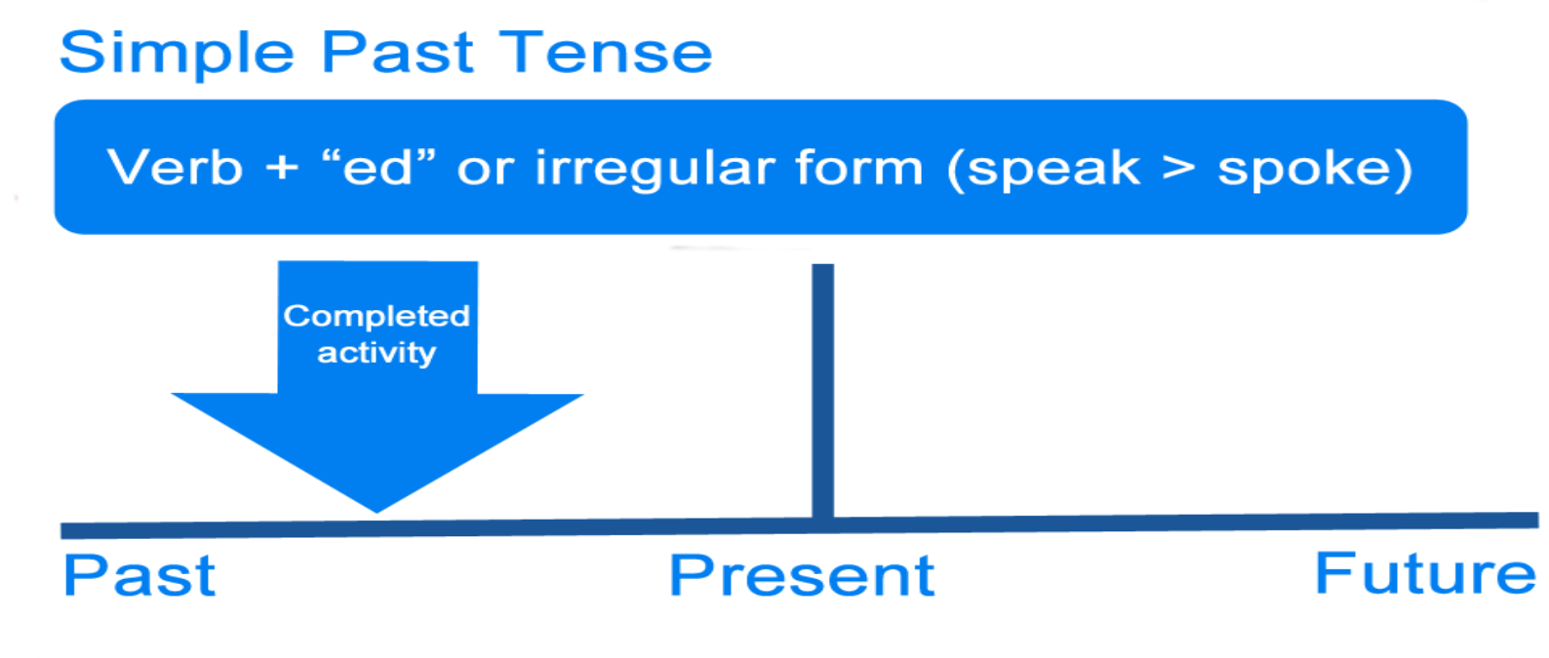
Grammar - Simple Past Tense

Slide 2
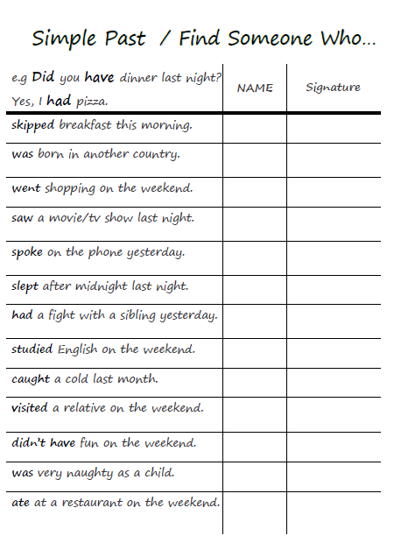
Find Someone Who…
Did you…?
Were you…?

Slide 3
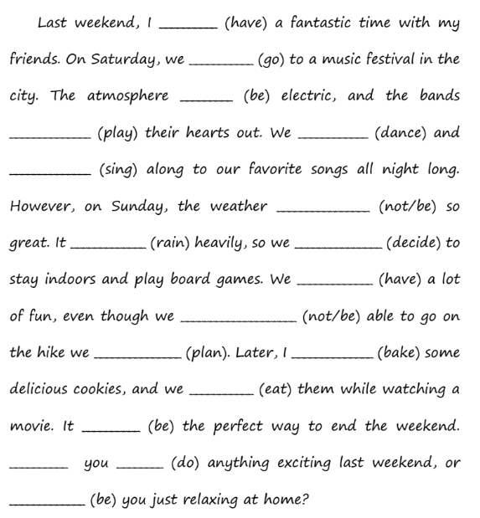
Complete the following paragraph with the simple past form of each of the verbs in parenthesis.

Slide 4
had
went
Complete the following paragraph with the simple past form of each of the verbs in parenthesis.
was
played
danced
sang
wasn’t
rained
decided
had
weren’t
planned
baked
ate
was
Did
do
were

Slide 5
Correct the verbs.
1- She were a student in our school.
2- Did they bought a new house last week?
3- Did he was a teacher before ?
4- Was there problems with the new app?
5- I didn’t saw the sunset yesterday ?
6- After I studyied, I chated online with my friends.

Slide 6
Correct the verbs.
1- She were a student in our school. was
2- Did they bought a new house last week? buy
3- Did he was a teacher before ?
Was he a teacher before?
4- Was there problems with the new app? Were
5- I didn’t saw the sunset yesterday ? see
6- After I studyied, I chated with my friend. studied – chatted

Slide 7
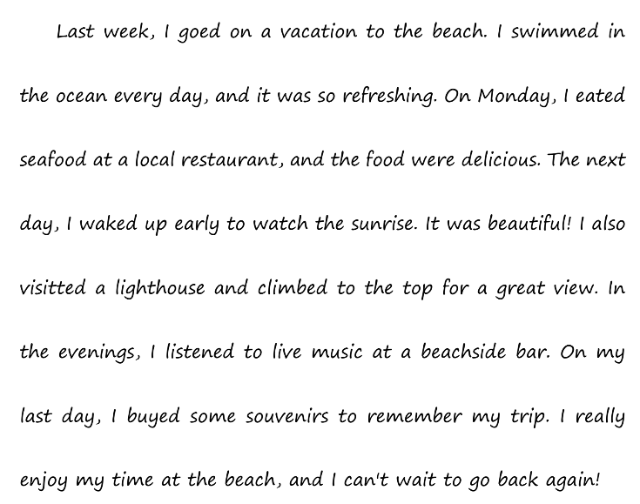
Fix the Mistakes

Slide 8
Fix the Mistakes
went
swam
ate
was
woke
visited
bought
enjoyed

Slide 9
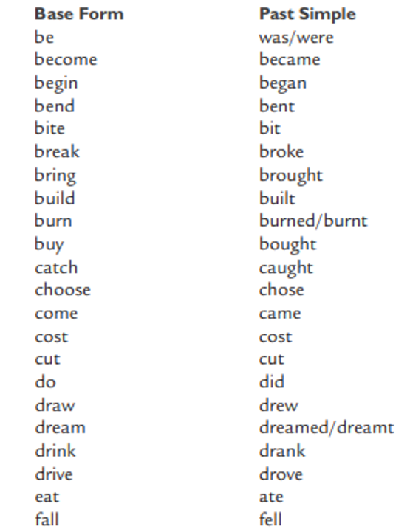
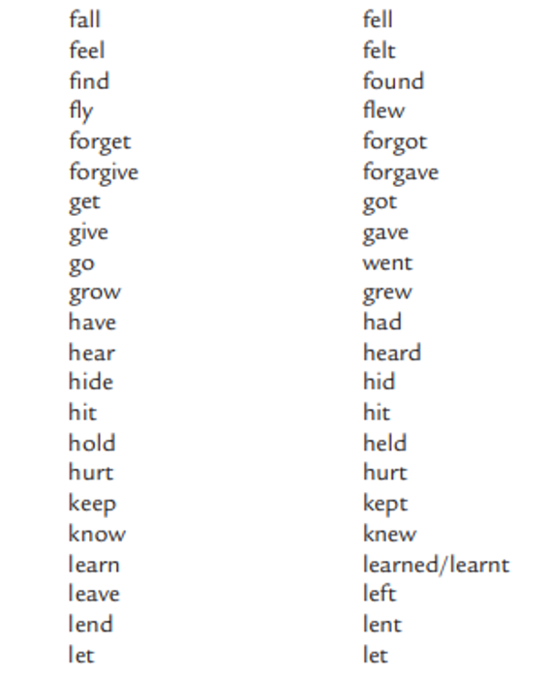

Slide 10
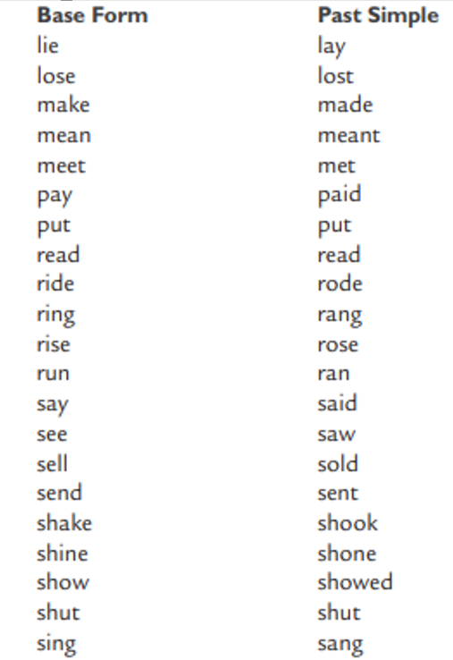
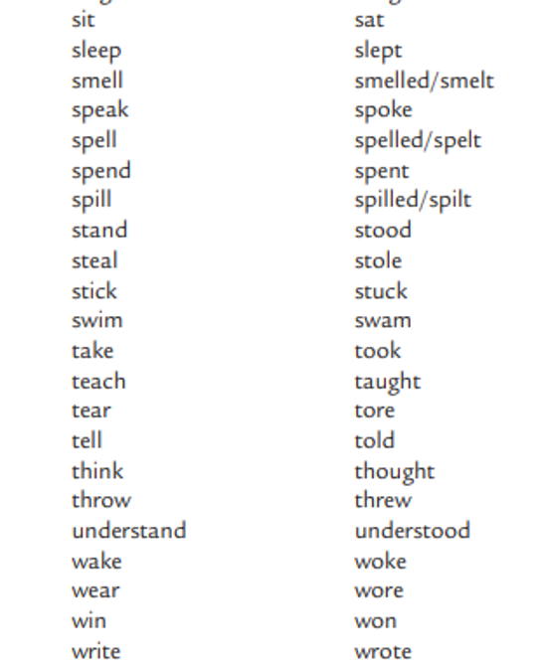

Slide 11
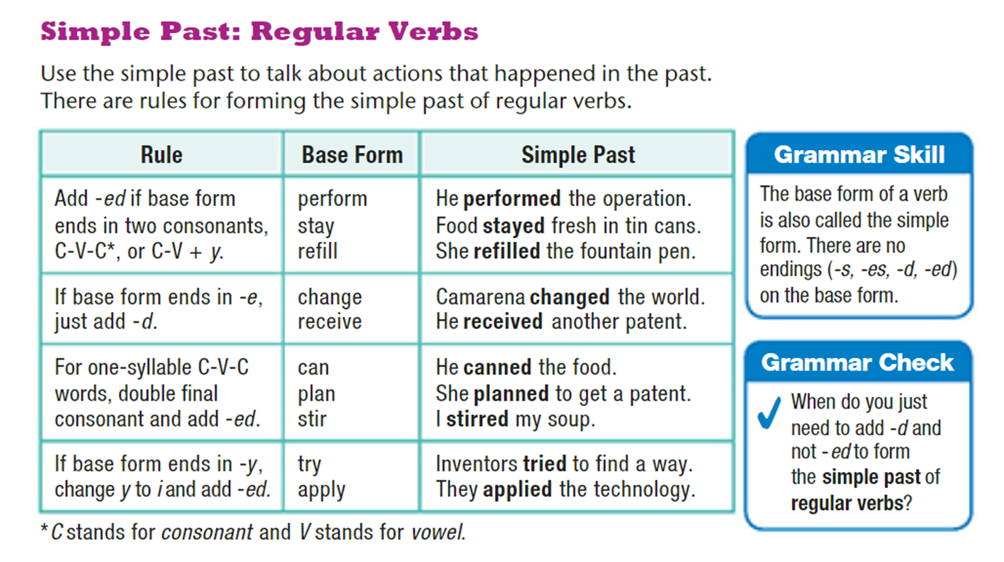
Student Book p.30

Slide 12
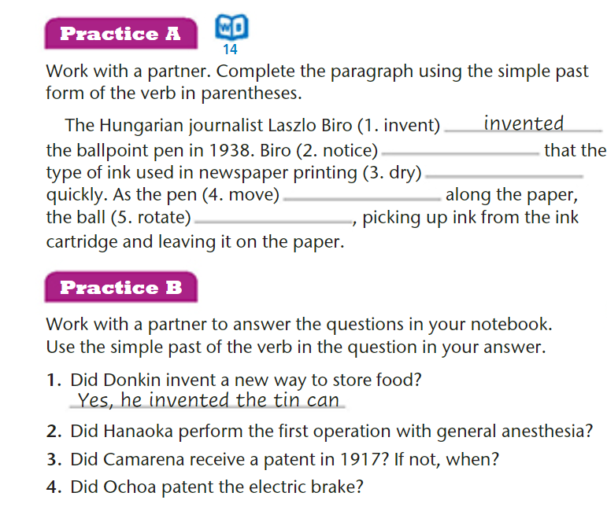
Student Book p.30

Slide 13
Student Book p.30
noticed
dried
moved
rotated

Slide 14
Student Book p.30
Yes, he performed …
No, he received a patent on 1942.
Yes, he patented it in 1907.

Slide 15
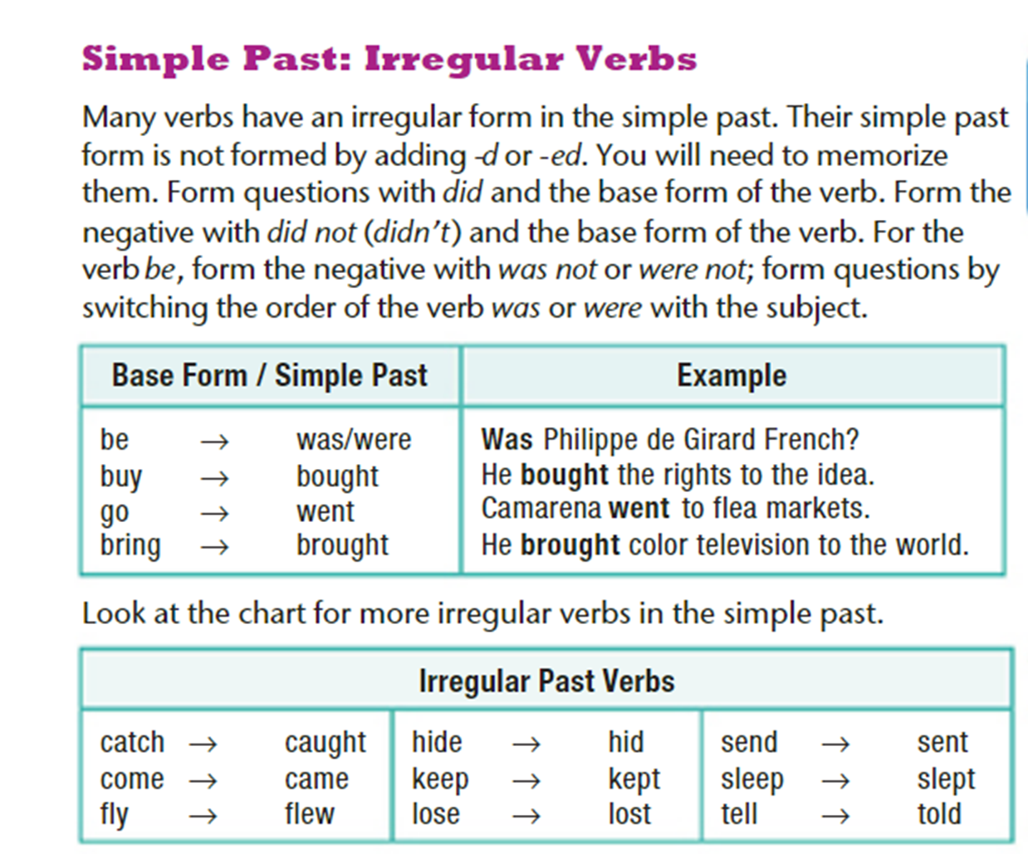
Student Book p.31

Slide 16
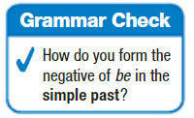
Form the negative of ( be)in the simple past with wasn’t or weren’t

Slide 17
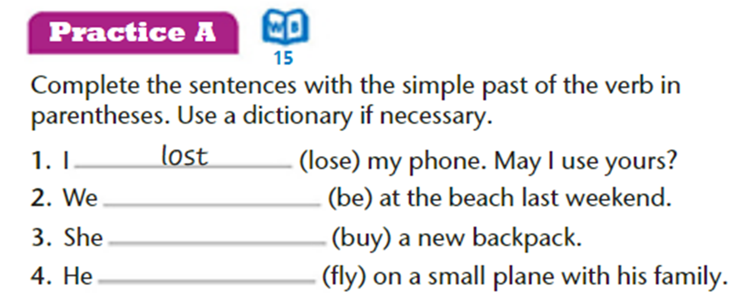
Student Book p.31

Slide 18
Student Book p.31
were
bought
flew

Slide 19
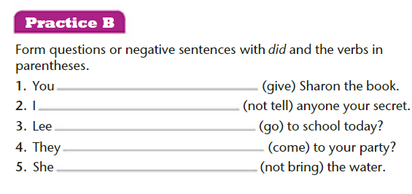
Student Book p.31

Slide 20
Student Book p.31
didn’t give
didn’t tell
Did Lee go
Did they come
didn’t bring

Slide 21
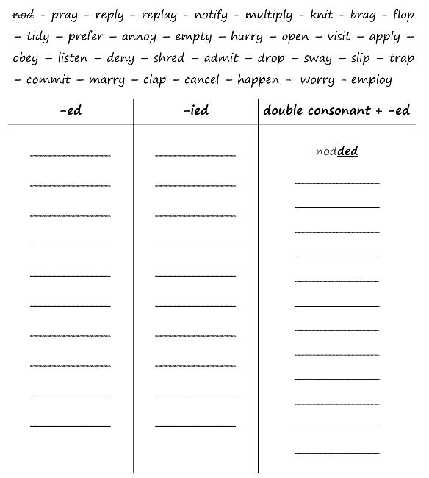
More Practice on Adding –ed to Regular Past Verbs

Slide 22
More Practice on Adding –ed to Regular Past Verbs
nod – pray – reply – replay – notify – multiply – knit – brag – flop
– tidy – prefer – annoy – empty – hurry – open – visit – apply –
obey – listen – deny – shred – admit – drop – sway – slip – trap
– commit – marry – clap – cancel – happen - worry - employ
prayed
replied
replayed
notified
knitted
annoyed
multiplied
bragged
opened
flopped
tidied
exceptions
preferred
visited
emptied
shredded
obeyed
hurried
admitted
listened
applied
dropped
swayed
slipped
denied
trapped
happened
married
committed
employed
worried
clapped
cancelled

Slide 23
Let’s Play a Game!
https://jeopardylabs.com/play/simple-past-regular-and-irregular-verbs

Slide 24
More Practice on Regular Verbs (adding –ed)
https://www.liveworksheets.com/it5698ka
https://www.liveworksheets.com/yf800046mt
https://www.liveworksheets.com/nn1224621xl

Slide 25

More Practice – Regular and Irregular Verbs
https://www.liveworksheets.com/uv667104uc
https://www.liveworksheets.com/ap31441ck
https://www.liveworksheets.com/ez60046qy
https://www.liveworksheets.com/zf299790ak
https://www.liveworksheets.com/ud1091373af
https://www.liveworksheets.com/qr1191233bz
https://www.liveworksheets.com/ys1014151hf
https://app.wizer.me/preview/EJNTZ9

