Slide 1
Unit 1-Reading 2
Early Inventions
Comprehension pages 24-27
8th Grade

Slide 2
Outcomes
01
02
03
04
build background knowledge about technology and inventions
relate the big question of unit 1 and how change can improve people’s lives to the selection
summarize the 11 inventions and identify the function of each invention
respond to comprehension questions effectively

Slide 3
Genre: science article
Big Question: How can change improve people’s lives?
Discussion:
Has your life or the life of someone you know been improved by change? How?
Introduction:
“Early Inventions” is a science article about inventions, or devices that people design to improve their lives. Many of these inventions have made a big difference in how we live. This article describes different inventions from the nineteenth and twentieth centuries. It tells about the people who thought of the inventions and how they created them.

Slide 4
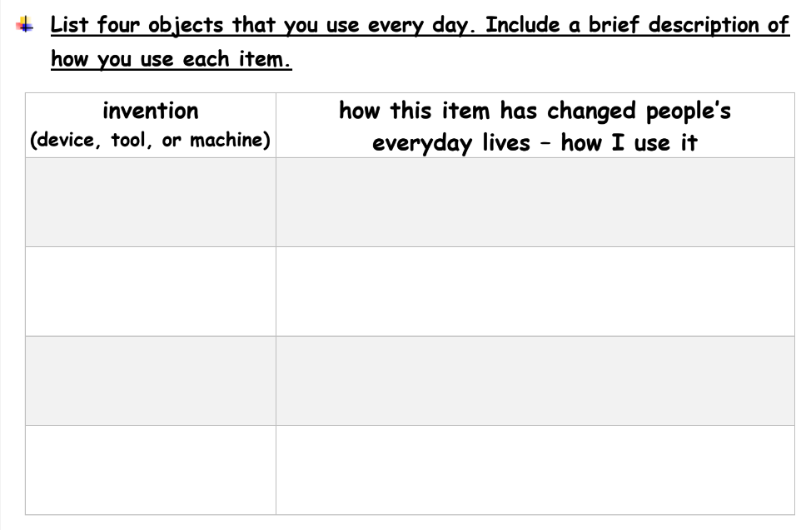
Introduction

Slide 5
Introduction
to warm leftovers, defrost frozen items, and prepare simple meals
microwave oven
washing machine
to clean clothes automatically
vacuum cleaner
to clean floors and carpets
smartwatch
to track fitness activities

Slide 6
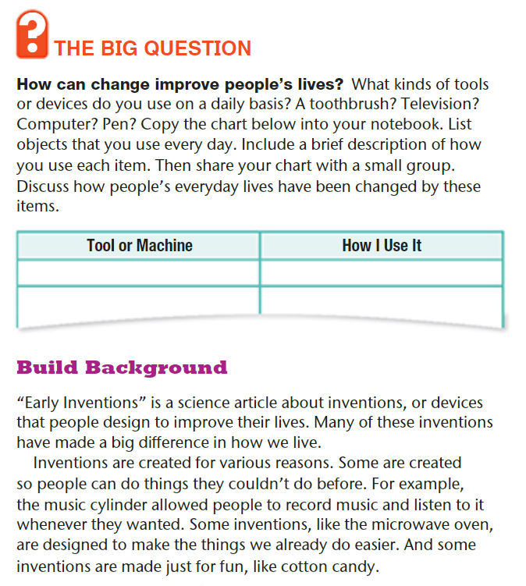
Student Book p.20

Slide 7
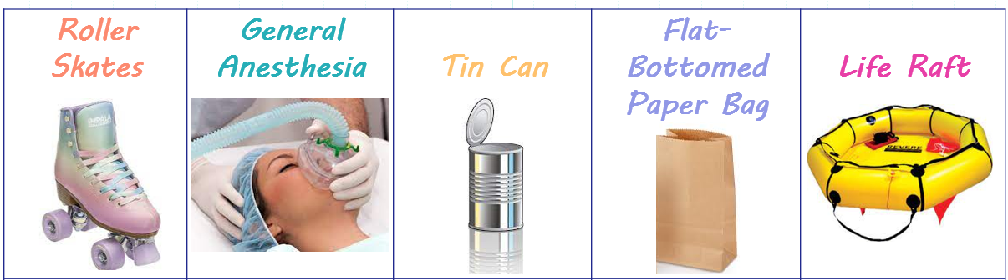
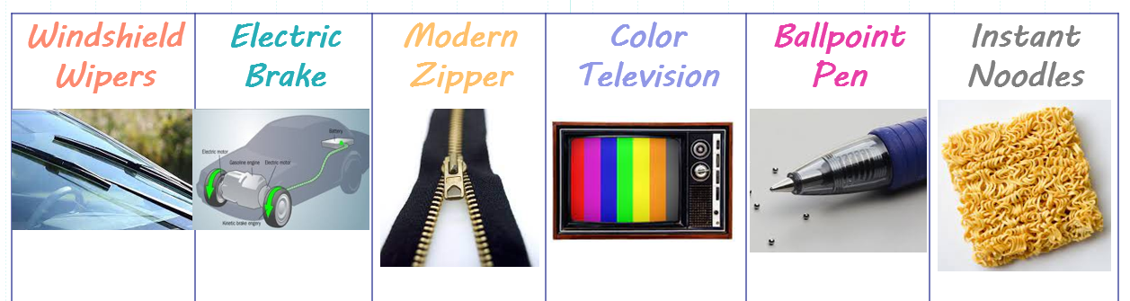

Slide 8
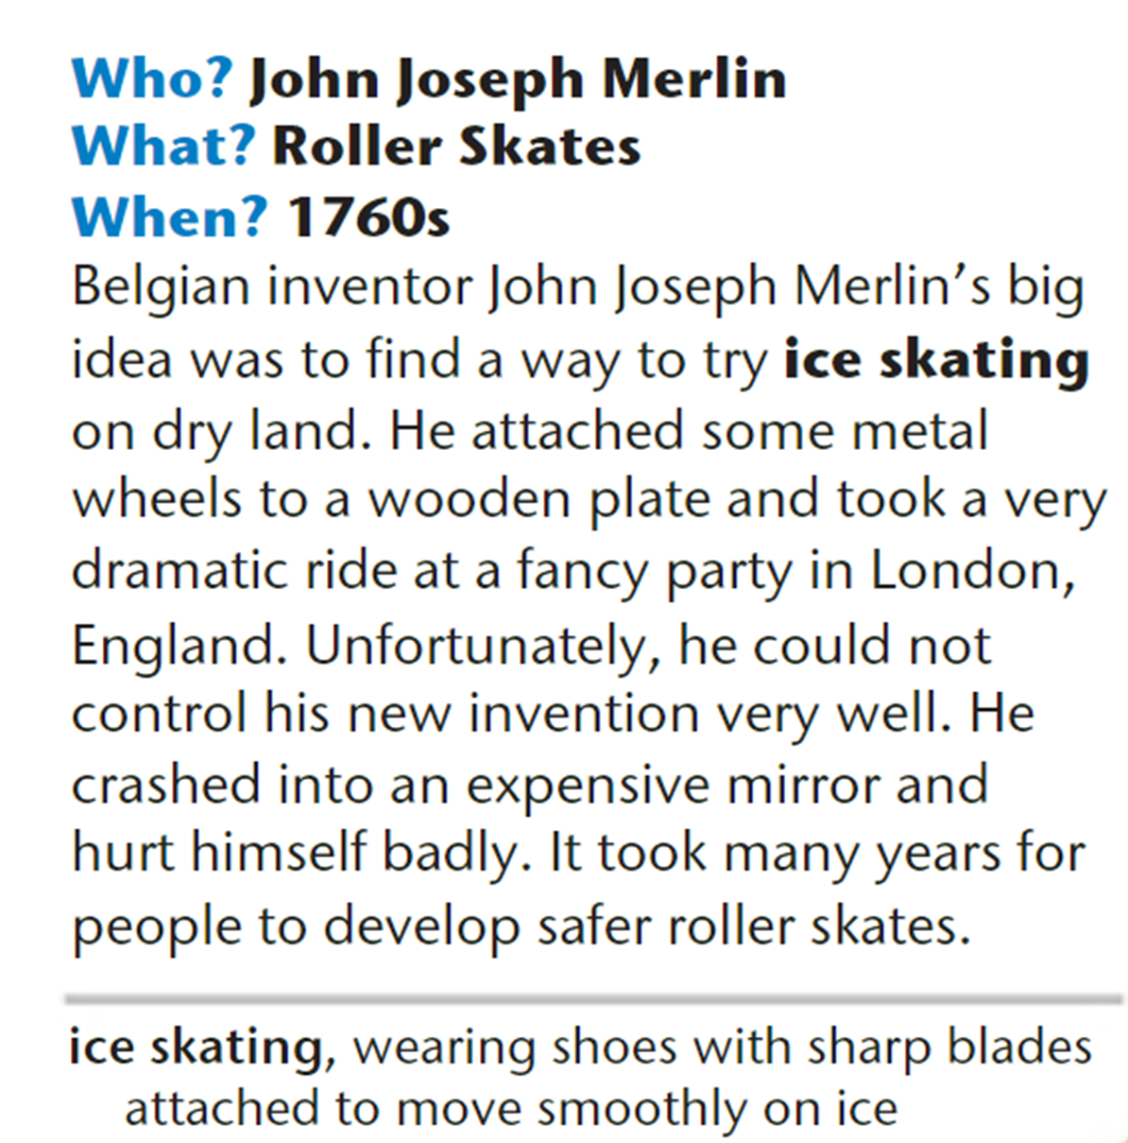

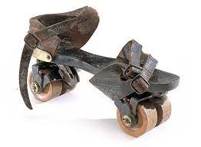
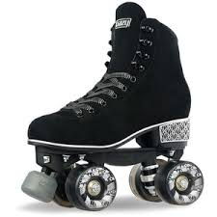
Page 24

Slide 9
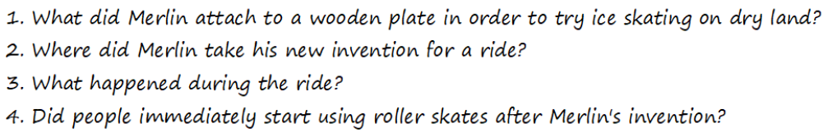
Page 24
Questions

Slide 10
Page 24
Feedback
1
2
3
4
No

Slide 11
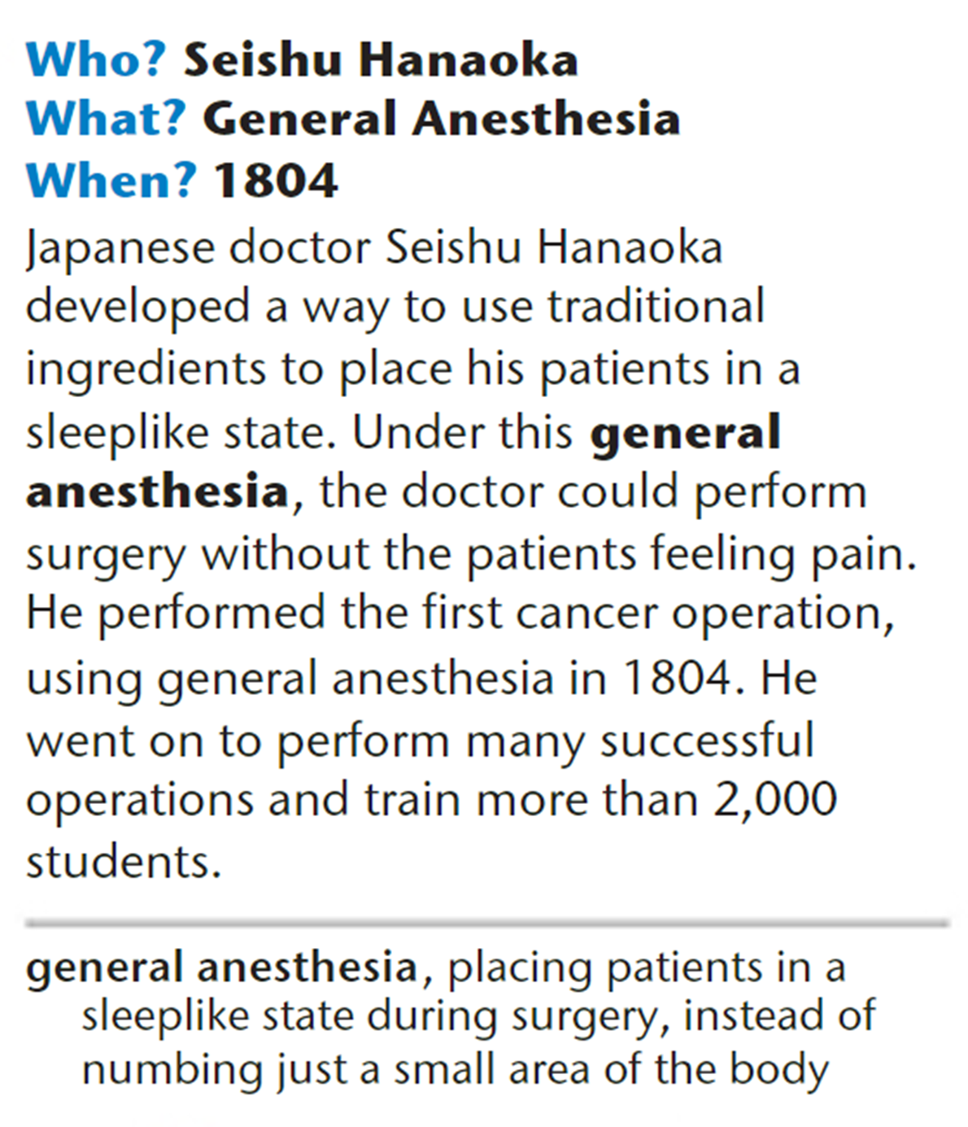
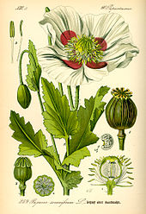

Page 24

Slide 12
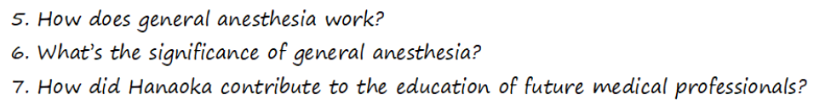
Page 24
Questions

Slide 13
Page 24
Feedback
5
6
7

Slide 14

Page 24
Questions

Slide 15
Page 24
Feedback
False
False
True

Slide 16
invention | inventor | inventor’s nationality | year | how it was invented | function
Roller Skates | John Joseph Merlin | Belgian | 1760s | He attached metal wheels to a wooden plate. | to skate on dry land
invention | inventor | Inventor’s nationality | year | how it was invented | Function
General Anesthesia | Seishu Hanaoka (a doctor) | Japanese | 1804 | He used traditional ingredients to put patients in a sleeplike state. | Doctors could perform surgery without the patients feeling pain.

Slide 17
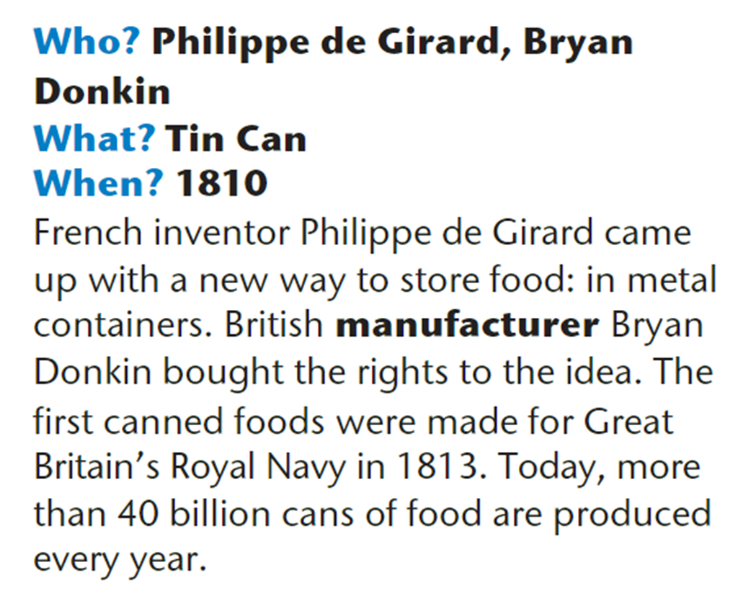
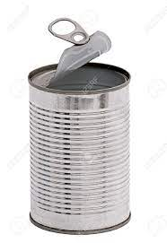

Page 25

Slide 18
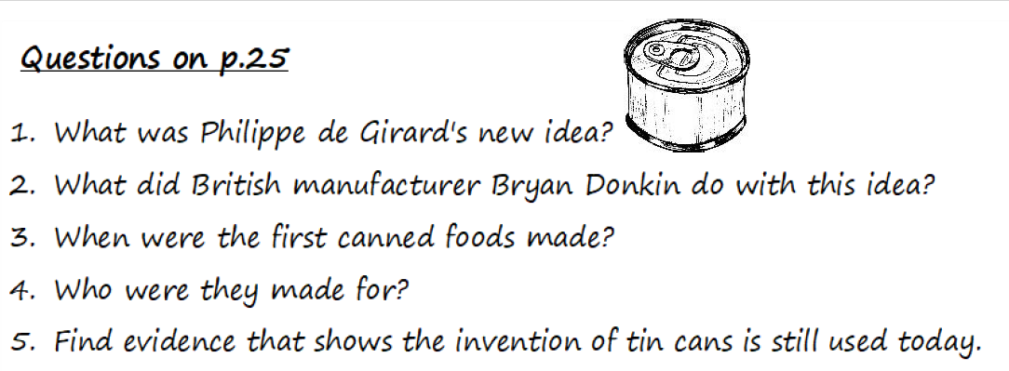
Page 25
Questions

Slide 19
Page 25
Feedback
2
4
3
5

Slide 20
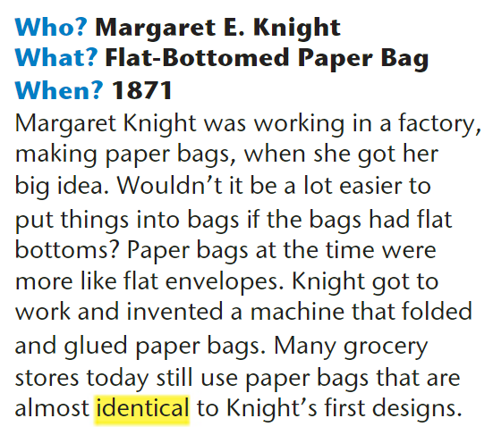
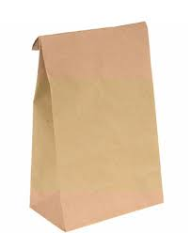
Page 25

Slide 21
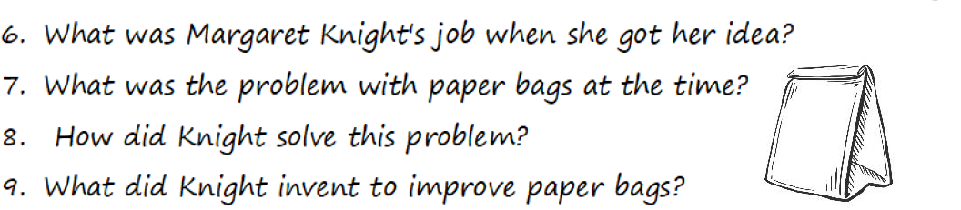
Page 25
Questions

Slide 22
Page 25
Questions
6
8
7
9

Slide 23
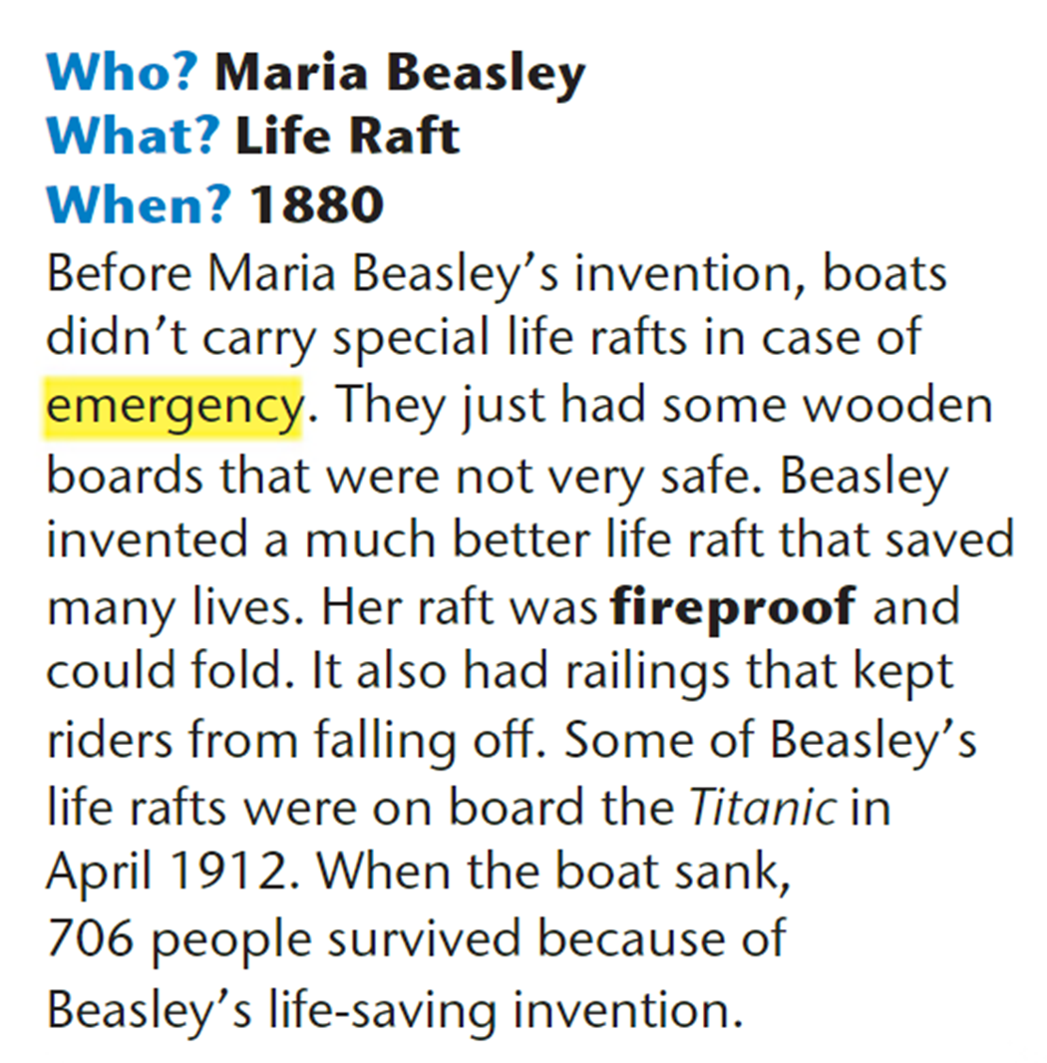
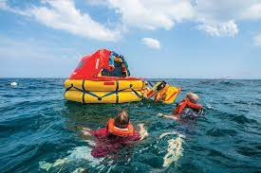
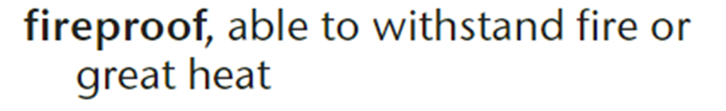
Page 25

Slide 24
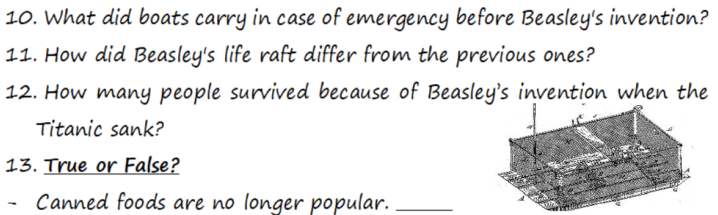
Page 25
Questions

Slide 25
Page 25
Feedback
10
11
12

Slide 26

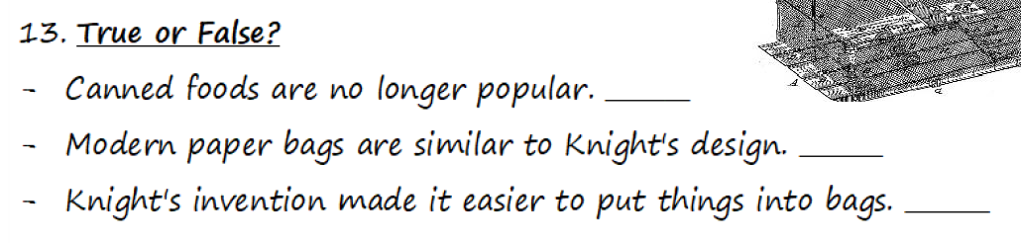

Slide 27

False
True
True

Slide 28
invention | inventor | inventors’ nationalities | year | how it was invented | Function
Tin Can | Philippe de Girard (idea) + Bryan Donkin (manufacturing) | French British | 1810 | Girard got the idea, and Donkin bought it and manufactured tin cans. | to store food for a longer time in metal containers
invention | inventor | inventor’s nationality | year | how it was invented | Function
Flat – Bottomed Paper Bags | Margaret E. Knight | American | 1871 | Knight got the idea while working in a factory for paper bags. She invented a machine that folded and glued paper bags. | Flat-bottomed bags could stand upright, hold more items, and made things easier to pack and carry.
invention | inventor | inventor’s nationality | year | how it was invented | Function
Life Raft | Maria Beasley | American | 1880 | Beasley invented fireproof boats that could fold and had railings to keep riders from falling off. | to save lives in case of maritime emergencies

Slide 29
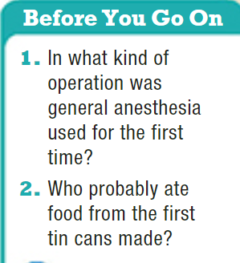
p.25
cancer operation
British sailors

Slide 30
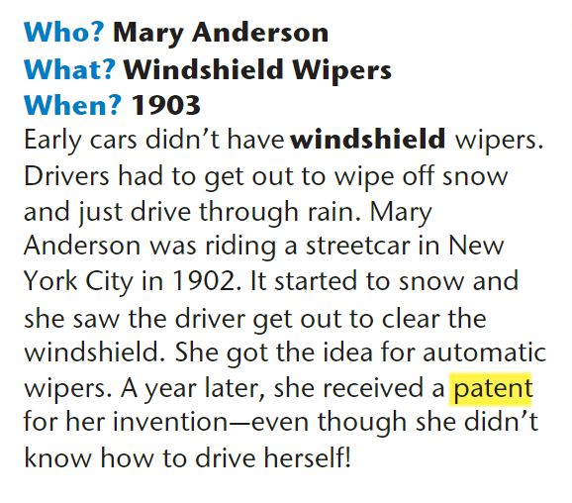
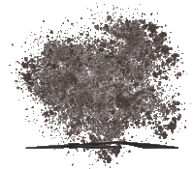

Page 26

Slide 31
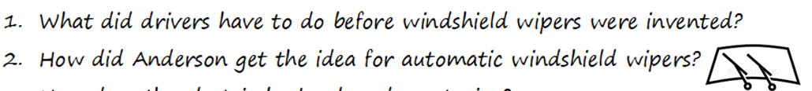
Page 26

Slide 32
Feedback
1
2

Slide 33
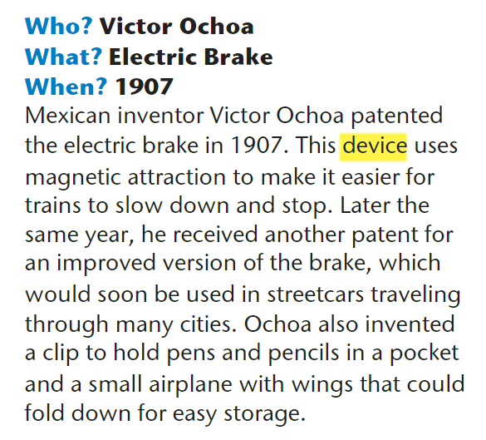
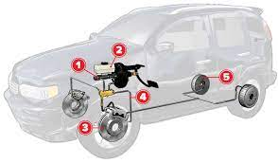

Page 26

Slide 34
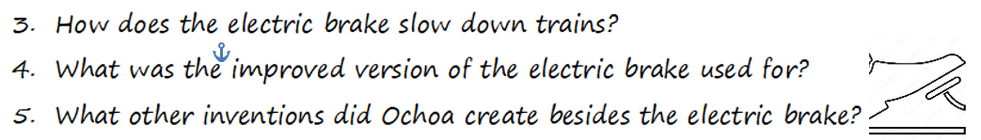
Page 26

Slide 35
Feedback
3
4
5

Slide 36
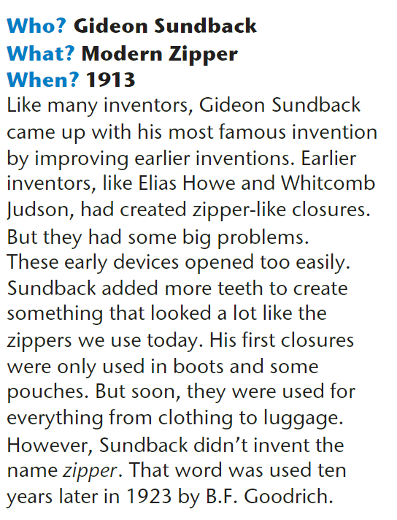

Page 26

Slide 37
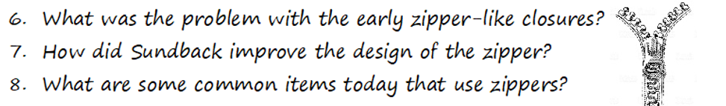
Page 26

Slide 38
Feedback
6
7
8

Slide 39
Feedback
6
7
8

Slide 40
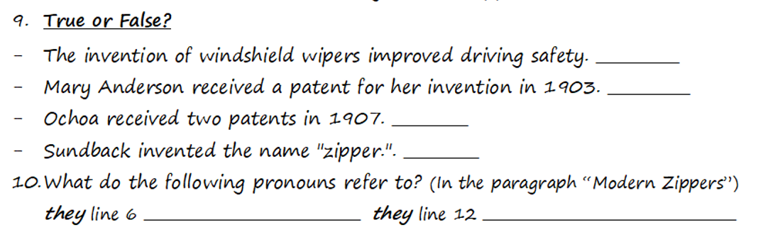
Page 26

Slide 41
Page 26
true
true
true
false
zipper-like closures
his first closures

Slide 42
invention | inventor | inventor’s nationality | year | how it was invented | Function
Windshield Wipers | Mary Anderson | American | 1903 | Anderson saw a driver who had to get out to clear the windshield while snowing. | They improve driving safety by automatically clearing cars’ windshields while raining or snowing so that drivers can see better.
invention | inventor | inventor’s nationality | year | how it was invented | Function
Electric Brake | Victor Ochoa | Mexican | 1907 | using the technology of magnetic attraction instead of mechanical brakes | Electric brakes give drivers more control when stopping vehicles. They make it easier and faster for trains and cars to slow down and stop
invention | inventor | inventor’s nationality | year | how it was invented | Function
Modern Zipper | Gideon Sundback | Swedish | 1913 | He improved early zippers that opened easily by adding more teeth. | Zippers quickly and easily open and close clothing and accessories such as boots and pouches.

Slide 43
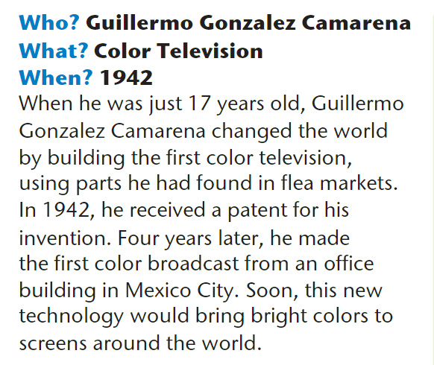

Page 27

Slide 44
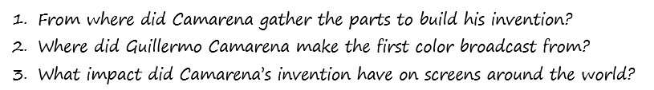
Page 27

Slide 45
Feedback
1
2
3

Slide 46
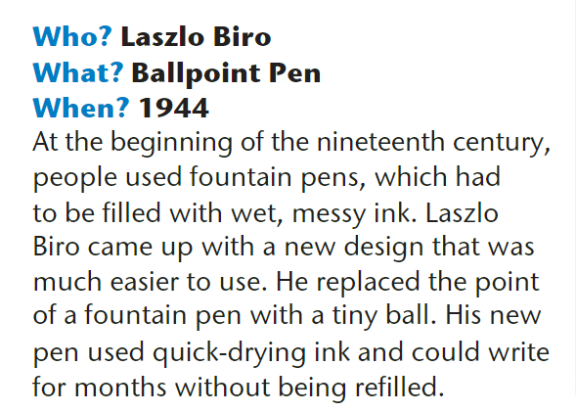
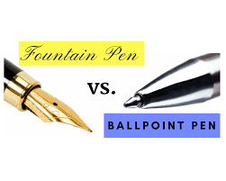
Page 27

Slide 47
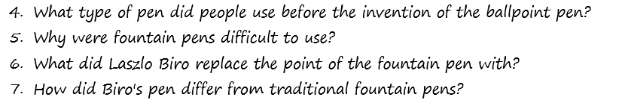
Page 27

Slide 48
Feedback
4
5
6
7

Slide 49
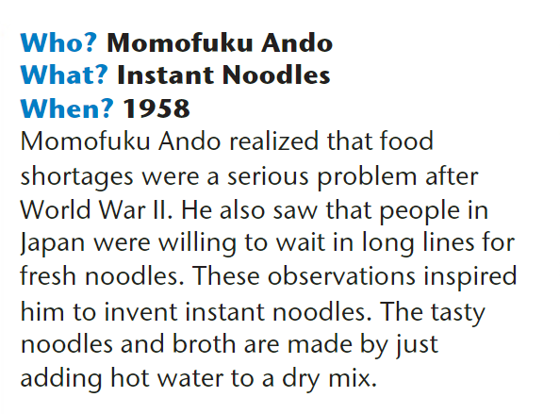

Page 27

Slide 50
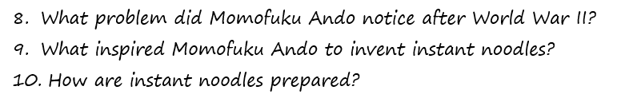
Page 27

Slide 51
Feedback
8
9
10

Slide 52
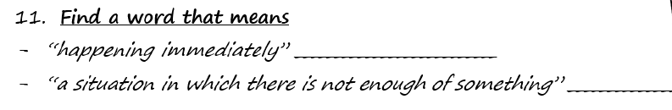

Slide 53
instant
shortage

Slide 54
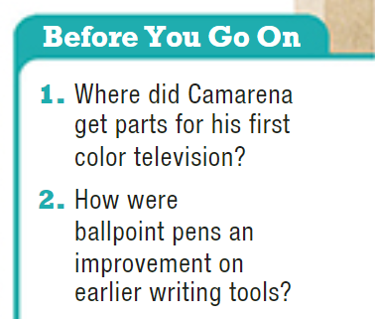
p.27
at flea market
They were neater, easier to use, and quicker to dry.

Slide 55
invention | inventor | inventor’s nationality | year | how it was invented | Function
Color Television | Guillermo Camarena | Mexican | 1942 | He used parts he found in flea market to build a color TV. | to produce colored video images instead of black and white images
invention | inventor | inventor’s nationality | year | how it was invented | Function
Ballpoint Pen | Laszlo Biro | Hungarian | 1944 | He replaced the point of a fountain pen that had wet and messy ink with a tiny ball. | Ballpoint pens used fast-drying ink and were easier and cleaner to use.
invention | inventor | inventor’s nationality | year | how it was invented | Function
Instant Noodles | Momofuku Ando | Japanese | 1958 | He saw people after WW2 waiting in long lines for fresh noodles, so he invented noodle cups with dry mix that is cooked by adding only hot water. | to shorten the cooking time of noodles and make it easier

