Slide 1




Unit 1 – Reading 2
Early Inventions
Vocabulary
8th Grade
Key Words and Academic Words pp. 21+22

Slide 2
Outcomes
01
02
03
recognize and define the new words
pronounce and spell the new words correctly
use the new words through speaking and writing

Slide 3
device
emergency
function
invention
idea
create
significant
identical
technology
patent

Slide 4

device
part of speech: noun
definition:
a machine or other small object made for a special purpose
example:
The iron is a device for pressing clothes.

Slide 5



emergency
part of speech: noun
definition:
a serious or dangerous situation
example:
Call 911 n case of an emergency.

Slide 6



idea
part of speech: noun
definition:
a thought or suggestion
example:
Our group had the best idea for the class presentation.

Slide 7



identical
part of speech: adjective
definition:
exactly the same as something else
example:
They were wearing identical coats.

Slide 8








invention
part of speech: noun
definition:
something new that is created for the first time
example:
The invention of the vacuum cleaner made cleaning the house faster and easier.

Slide 9
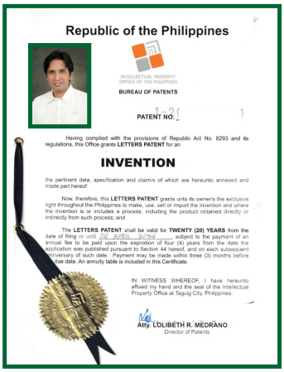
patent
part of speech: noun
definition:
an official letter or document from the government that says that the inventor is the only one who has the right to make and sell his invention
example:
- The inventor applied for a patent from the government. He didn’t want anyone else to make or sell his invention.

Slide 10

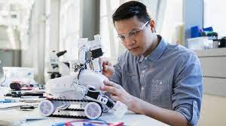
create
part of speech: verb
definition:
make or invent
example:
- An inventor created a robot that cleans floors.

Slide 11
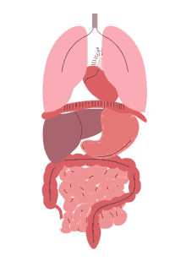
function
part of speech: noun
definition:
the purpose or job of something
example:
The function of a phone is to make and receive calls.

Slide 12
significant
part of speech: adjective
definition:
important or noticeable
example:
I’ve noticed a significant improvement in her work in the last month.

Slide 13

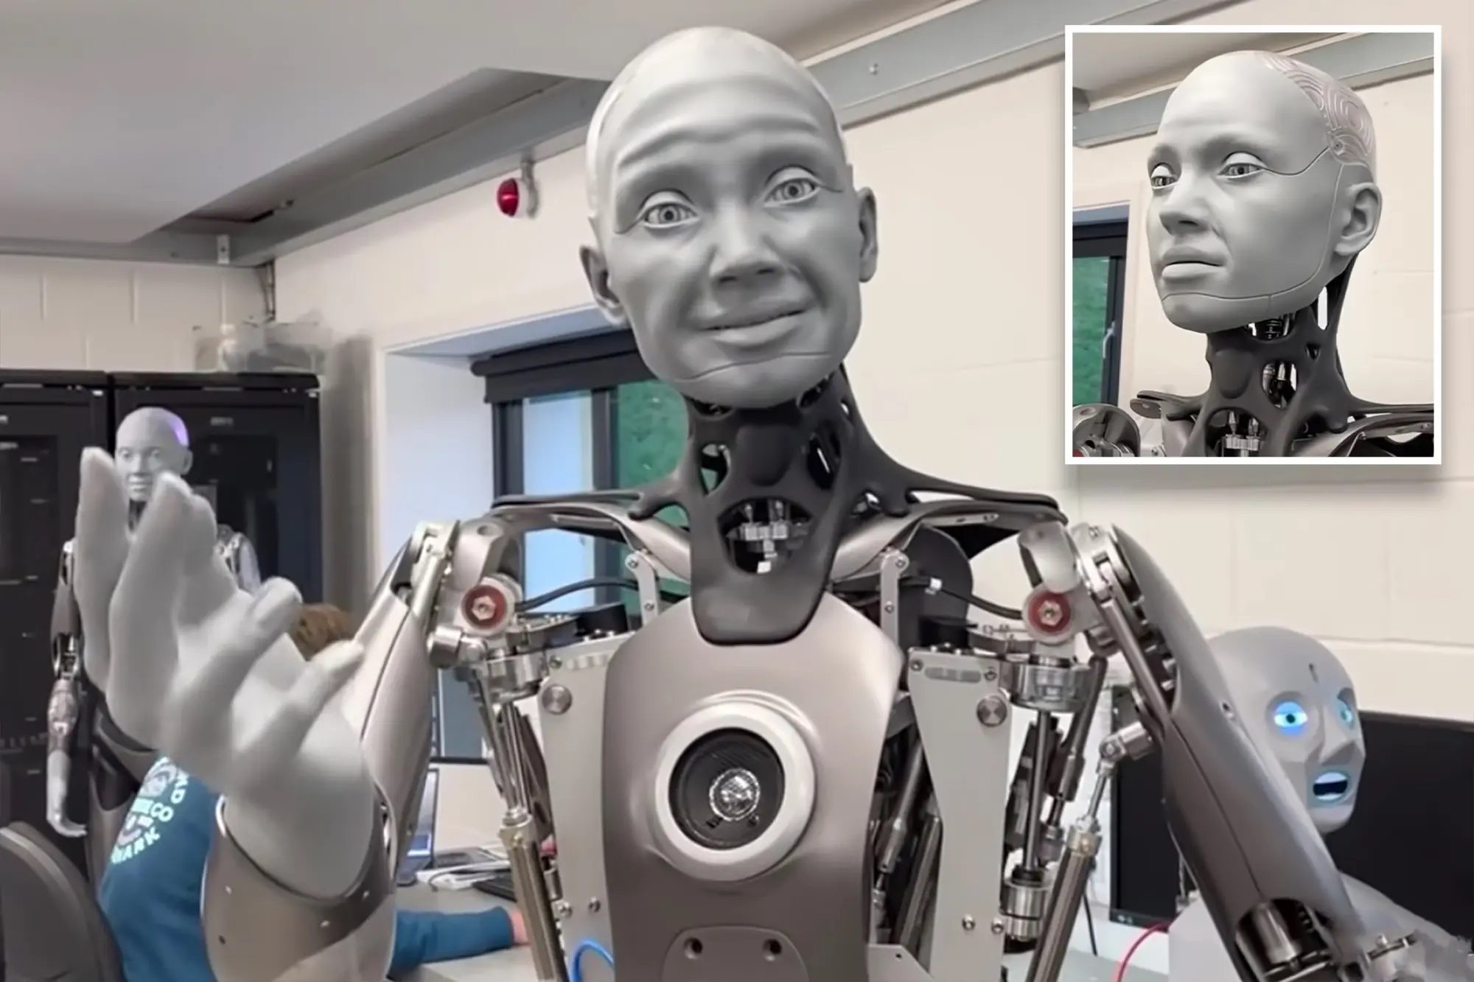
technology
part of speech: noun
definition:
all the knowledge and equipment used in science
example:
New kinds of technology will be invented in the future.

Slide 14
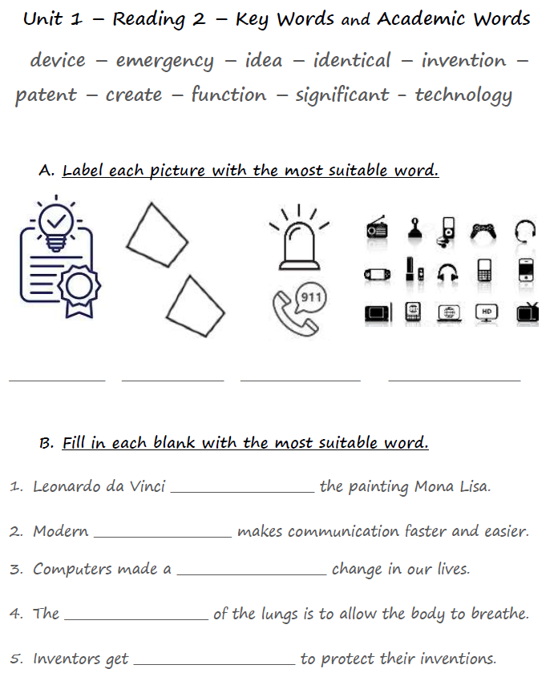
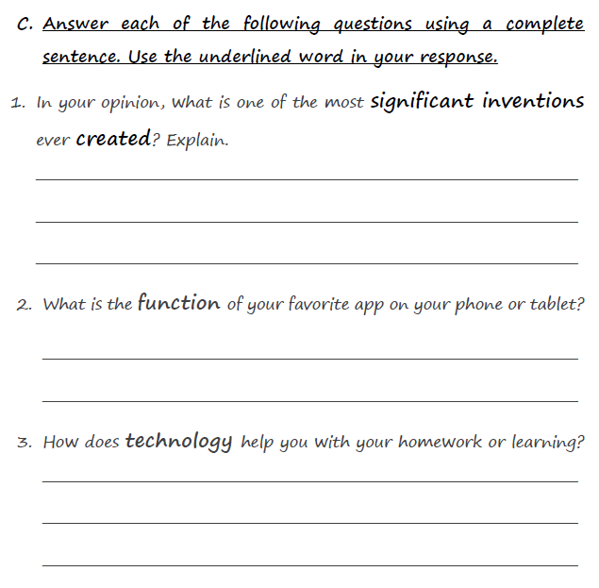

Slide 15
One of the most significant inventions is the internet. It has made it easier to connect people worldwide and share knowledge instantly.
patent identical emergency devices
My favorite app is Instagram. Its main function is to allow users to share photos and videos, explore creative content, and stay updated with friends' lives
created
technology
significant
AI technology helps me with my homework by offering personalized assistance. AI tools can explain difficult concepts and check my work for errors
function
patents

Slide 16
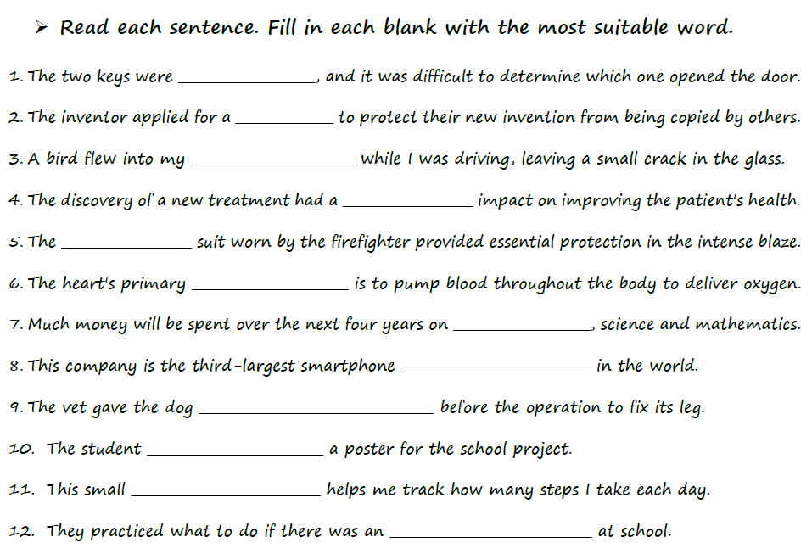
Vocabulary Worksheet p.2
created
manufacturer
emergency
identical
general anesthesia
windshield
fireproof
significant
device
patent
function
technology

Slide 17
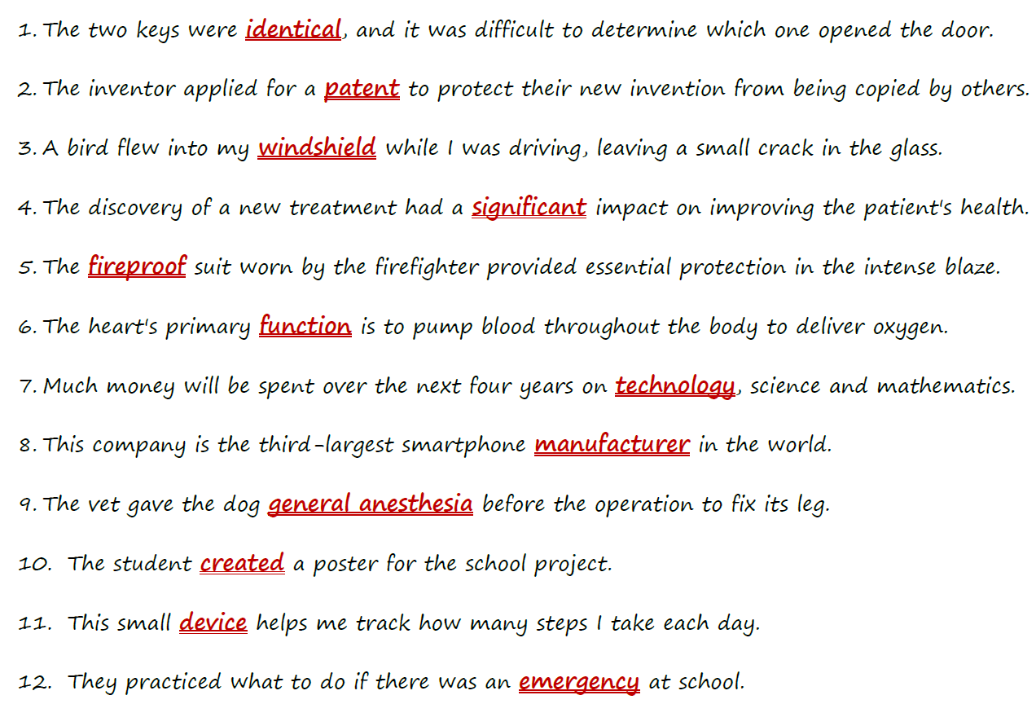
Feedback

Slide 18

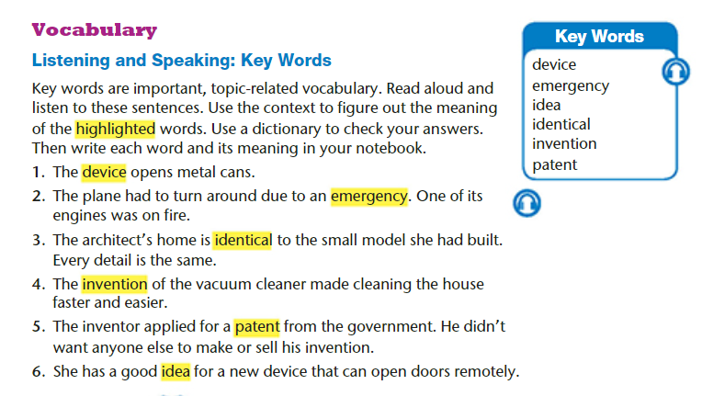
Student Book p.21

Slide 19
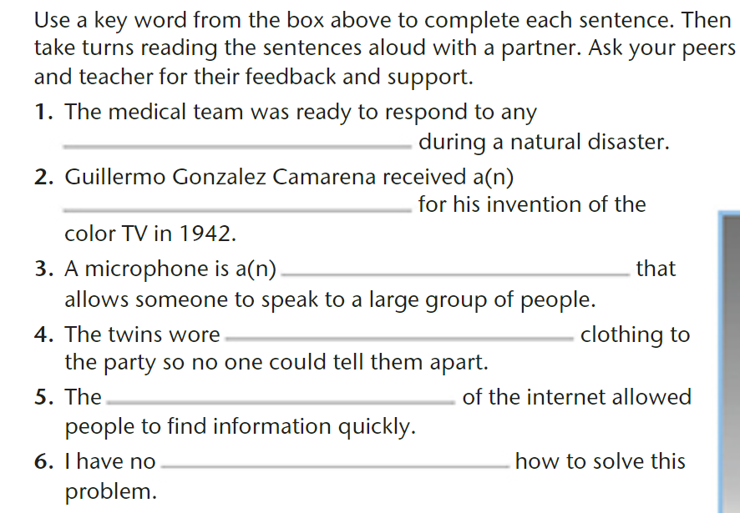
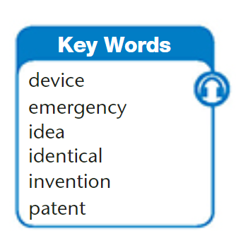
Student Book p.21

Slide 20
Student Book p.21
emergency
patent
device
identical
invention
idea

Slide 21
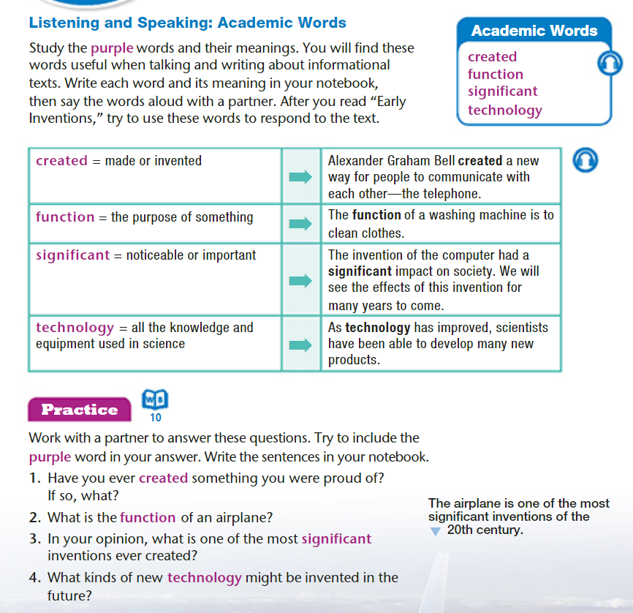
Student Book p.22

Slide 22
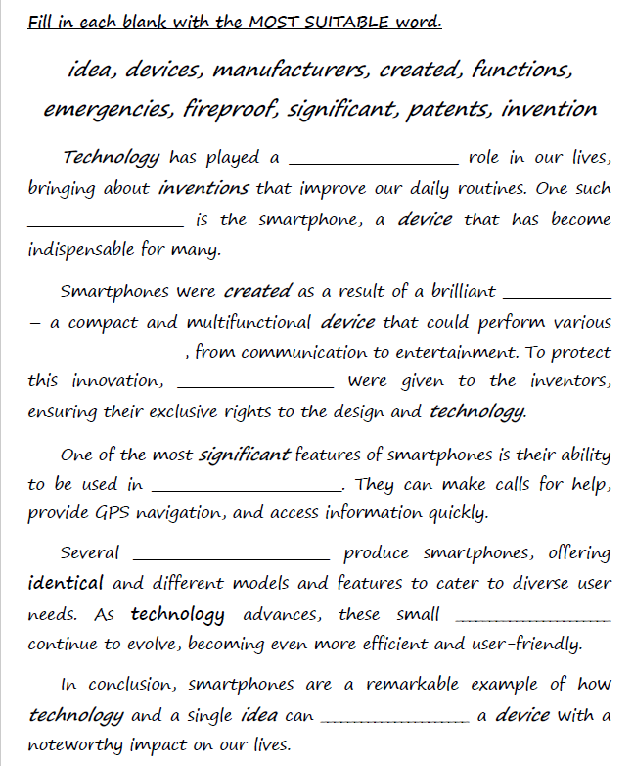

Vocabulary Practice
create
manufacturers
emergencies
invention
significant
devices
idea
patents
functions

Slide 23
Feedback
significant
invention
idea
functions
patents
emergencies
manufacturers
devices
create

Slide 24
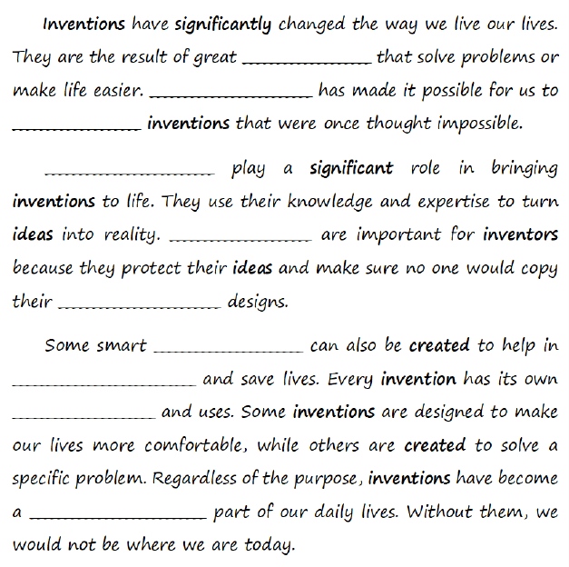
Vocabulary Practice
identical
ideas
technology
create
devices
significant
functions
emergencies
manufacturers
patents

Slide 25
Feedback
ideas
Technology
create
Manufacturers
Patents
identical
devices
emergencies
functions
significant

Slide 26
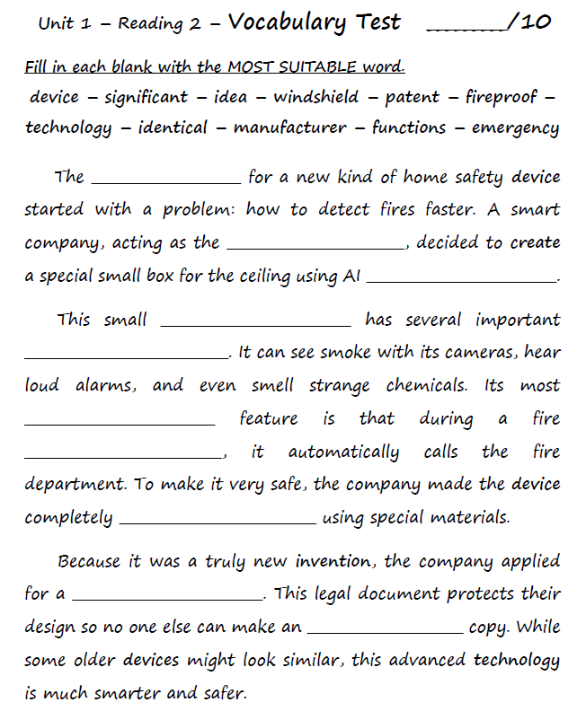
Vocabulary Test

Slide 27
Feedback
idea
manufacturer
technology
device
functions
significant
emergency
fireproof
patent
identical

