Slide 1
Save the Sea
Turtles
Unit 4 – Reading 2 page 240
Grade 5

Slide 2

True or False?

Slide 3
True or False?
Sea turtles can live over 100 years.

Slide 4
Feedback
Sea turtles can live over 100 years. True

Slide 5
True or False?
Sea turtles lay eggs in the ocean.

Slide 6
Feedback
Sea turtles lay eggs in the ocean.
False – Female sea turtles dig a hole in the sand, and they lay their eggs inside it.

Slide 7
True or False?
Eating turtle eggs is legal everywhere.

Slide 8
Feedback
Eating turtle eggs is legal everywhere.
False – It’s illegal in many places

Slide 9
True or False?
Sea turtles return to the same beach where they were born to lay eggs.

Slide 10
Feedback
Sea turtles return to the same beach where they were born to lay eggs. True

Slide 11
True or False?
Plastic pollution is a big threat to sea turtles.

Slide 12
Feedback
Plastic pollution is a big threat to sea turtles. True, sea turtles mistake plastic for food, and they choke on it.

Slide 13
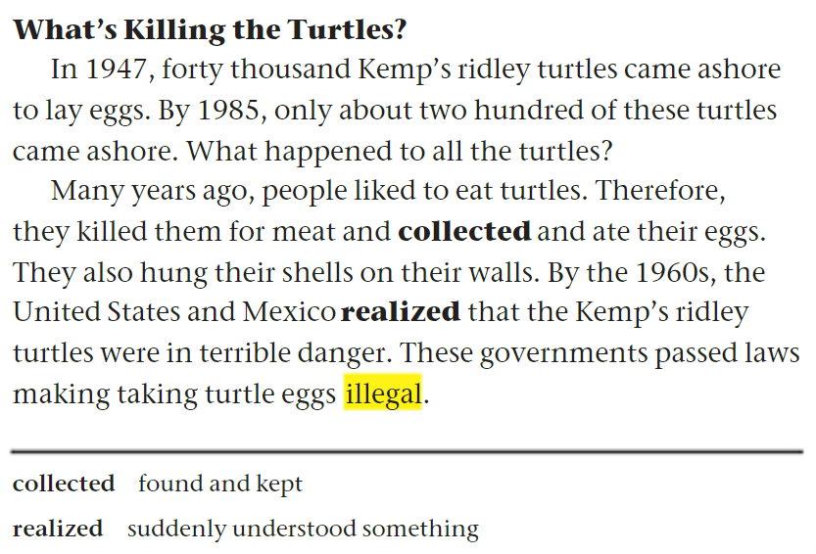

Page 240

Slide 14


Page 240
Differentiation
Student’s Number | Task
1 | Answer questions 1,5, and 6.
2 | Answer questions 2, 6 and lead the discussion
3 | Answer questions 3 and 6.
4 | Answer questions 4 and 6.
1. Participation: Each member participates and shares ideas with the group.
2. Task Completion: The task is divided fairly and is completed on time.
3. Collaboration: Group members listen to each other, respect ideas, and use only English to communicate.
4. Noise Level: Members work quietly and keep noise level appropriate.

Slide 15
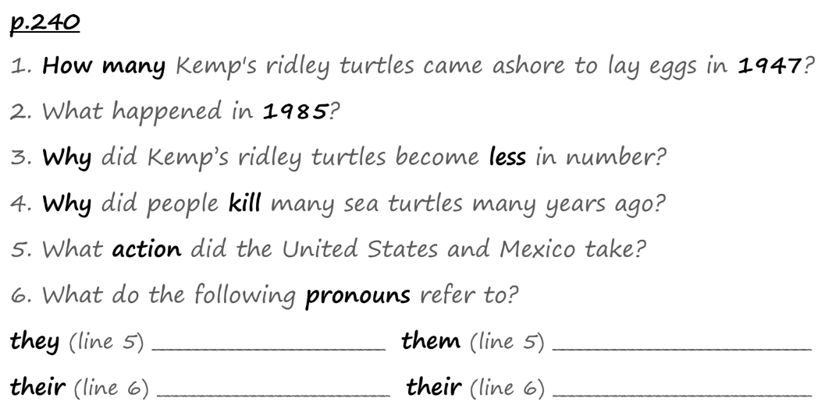
Page 240

Slide 16
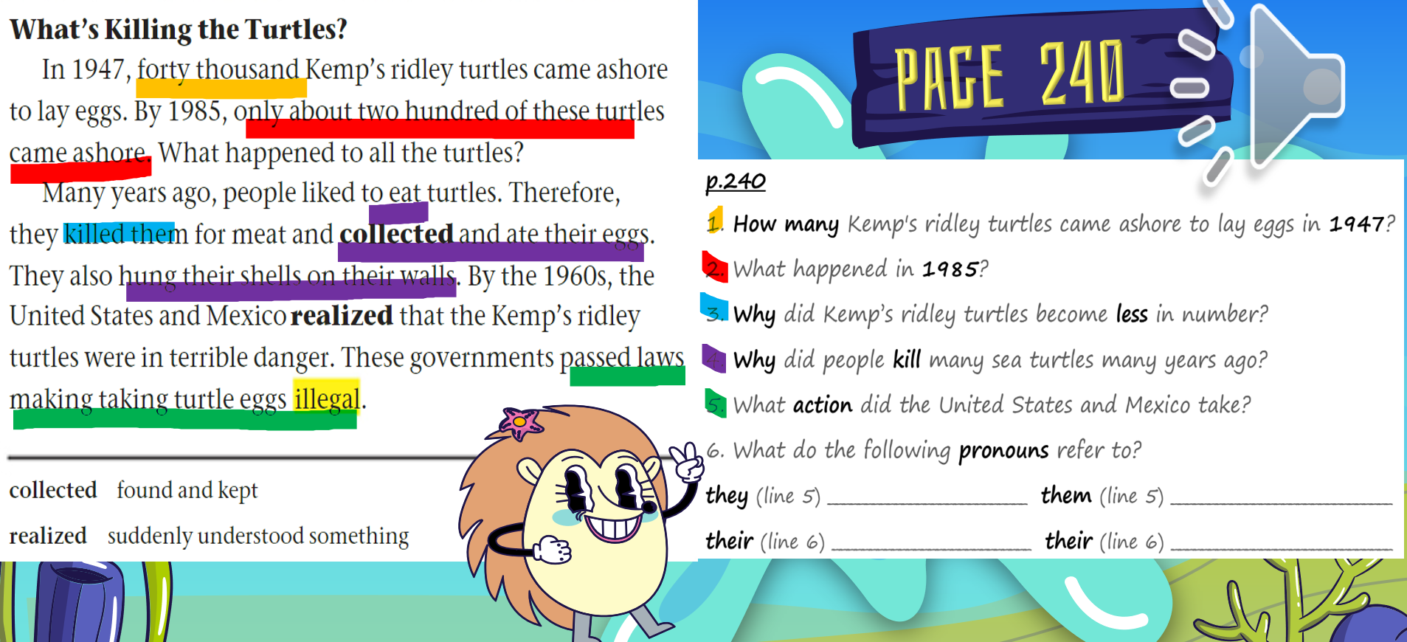
people
turtles
turtles
people

Slide 17


Buzz in – Critical Thinking

Slide 18
Buzz in – Critical Thinking
Imagine you could speak to someone who still collects turtle eggs for food or decoration. What argument would you use to try to change their mind?

Slide 19


Slide 20
Why did people kill turtles many years ago?
1. to keep them as pets
2. for their meat and eggs
3. because they were dangerous
4. to help them lay eggs

Slide 21
Why did people kill turtles many years ago?
1. to keep them as pets
2. for their meat and eggs
3. because they were dangerous
4. to help them lay eggs

Slide 22
What did people do with turtle shells?
1. threw them in the ocean
2. sold them for money
3. hung them on their walls as decorations
4. used them to make jewelry

Slide 23
What did people do with turtle shells?
1. threw them in the ocean
2. sold them for money
3. hung them on their walls as decorations
4. used them to make jewelry

Slide 24
What does the word illegal mean?
1. against the law
2. allowed
3. easy to do
4. safe

Slide 25
What does the word illegal mean?
1. against the law
2. allowed
3. easy to do
4. safe

Slide 26

Linking to Life
Have you ever learned that something you or your family did was harmful to the environment ? What did you do after learning that?

