Slide 1
Save the Sea
Turtles
Unit 4 – Reading 2 page 239
Grade 5

Slide 2
Warm-up
Acting out the Life Cycle of Sea Turtles

Slide 3
Warm-up
Acting out the Life Cycle of Sea Turtles
1. Sway like turtles swimming in the ocean.

Slide 4
Warm-up
Acting out the Life Cycle of Sea Turtles
1. Sway like turtles swimming in the ocean.
2. Crawl slowly to the beach.

Slide 5
Warm-up
Acting out the Life Cycle of Sea Turtles
1. Sway like turtles swimming in the ocean.
2. Crawl slowly to the beach.
3. Dig a hole in the sand.

Slide 6
Warm-up
Acting out the Life Cycle of Sea Turtles
1. Sway like turtles swimming in the ocean.
2. Crawl slowly to the beach.
3. Dig a hole in the sand.
4. Drop eggs into the nest.

Slide 7
Warm-up
Acting out the Life Cycle of Sea Turtles
1. Sway like turtles swimming in the ocean.
2. Crawl slowly to the beach.
3. Dig a hole in the sand.
4. Drop eggs into the nest.
5. Turn and crawl back to the ocean.

Slide 8
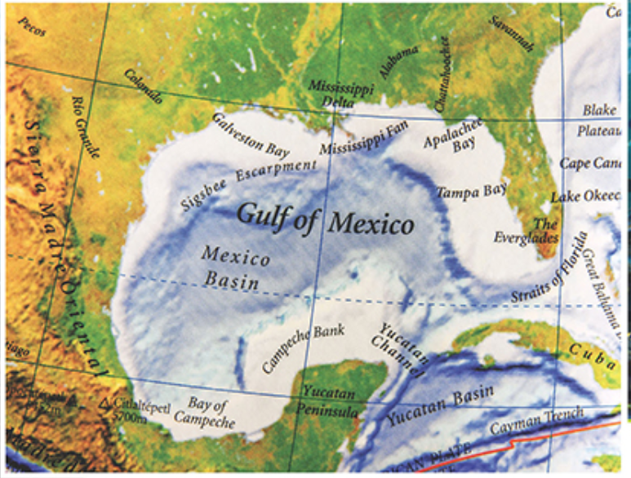
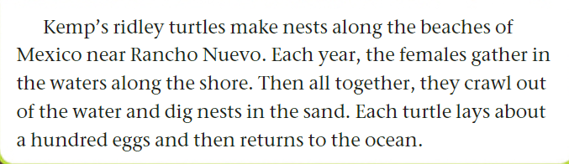

Page 239

Slide 9

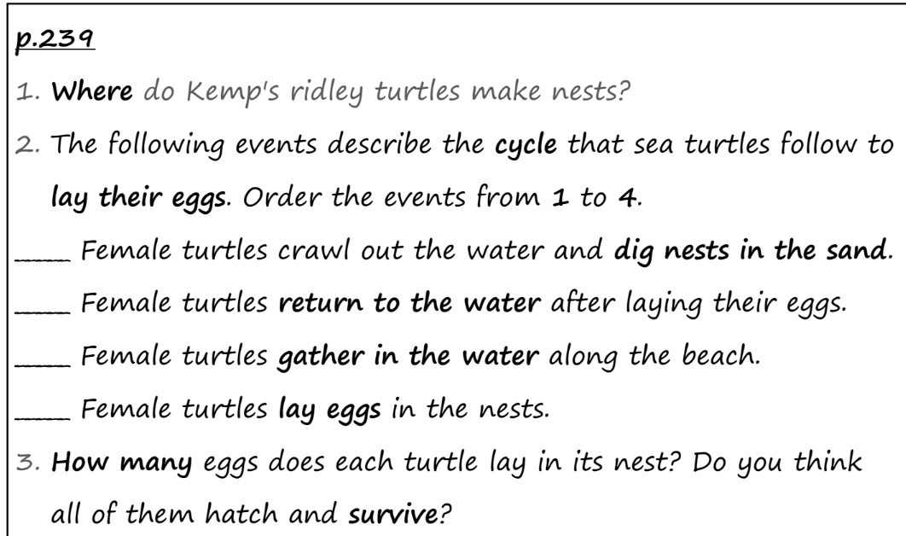
Page 239

Slide 10
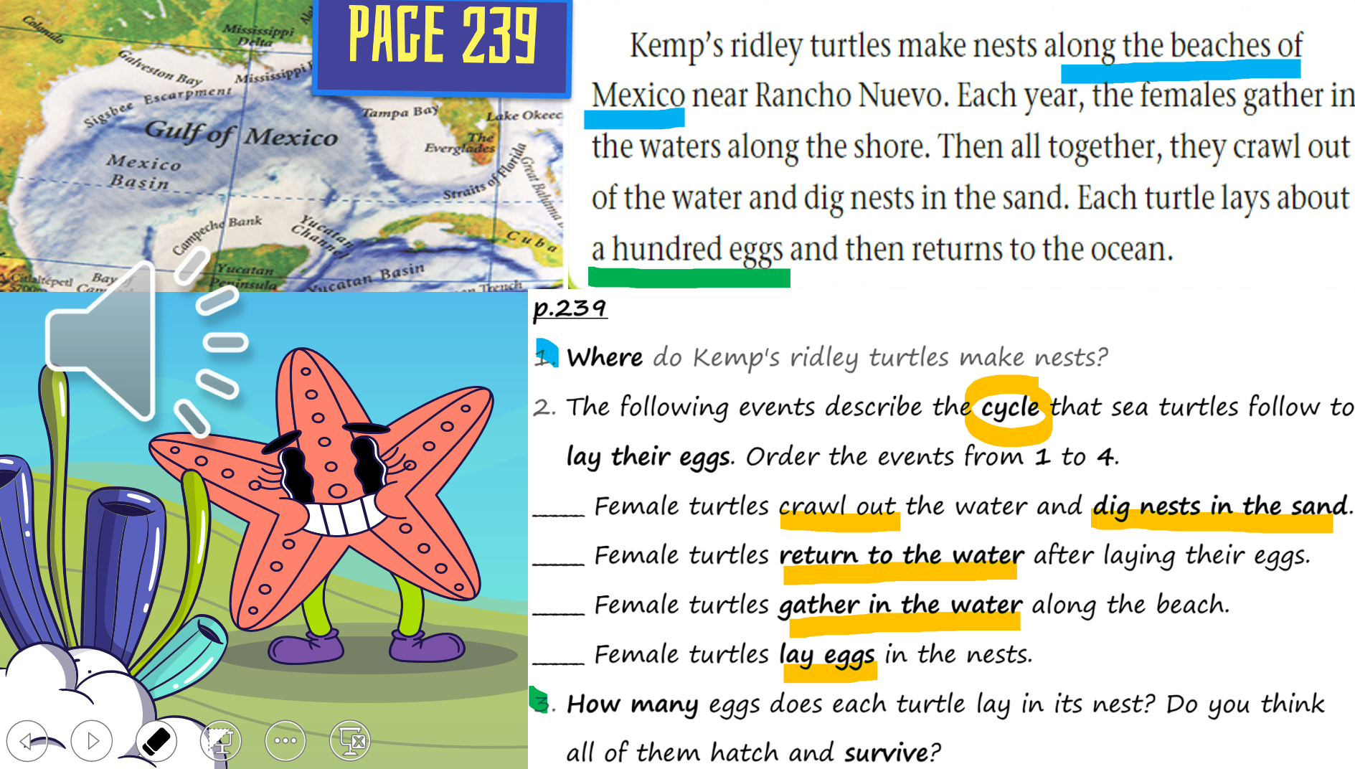
2
4
1
3
No, crabs and birds eat some of the eggs. Also, pollution and climate change affect their habitats (where they live).

Slide 11


Slide 12
Describe the life cycle of a sea turtle. 1. Females make nests on the beach, go back to the water and lay eggs there.
2. Females lay eggs, and then make nests on the beach.
3. Females go to the beach, make nests in the sand, and lay eggs inside.
4. Females lay their eggs in the ocean.

Slide 13
Describe the life cycle of a sea turtle. 1. Females make nests on the beach, go back to the water and lay eggs there.
2. Females lay eggs, and then make nests on the beach.
3. Females go to the beach, make nests in the sand, and lay eggs inside.
4. Females lay their eggs in the ocean.

Slide 14


Buzz in – Critical Thinking

Slide 15
Buzz in – Critical Thinking
- How do you think the turtles find the same beaches each year?
- What challenges do you think the baby turtles might face when they hatch?

Slide 16


Connection Question

Slide 17
Connection Question
Have you ever taken care of something important (a pet, a plant, or a younger sibling)? How is that similar to turtles protecting their eggs?

