Slide 1
Save the Sea
Turtles
Unit 4 – Reading 2 page 238
Grade 5

Slide 2
outcomes
01
02
genre
Main Ideas
Value
03
By the end of this lesson you should be able to
identify the genre of “Save the Sea Turtles” and its special elements.
explain the main ideas using your own words.
develop a sense of responsibility and empathy towards our environment

Slide 3

Buzz in
Warm-up

Slide 4

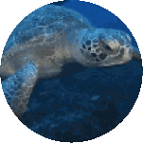
Warm-up
If this turtle could talk, what would it say to us?

Slide 5
Warm-up
If this turtle could talk, what would it say to us?
Help me. My home is in danger!
Stop littering in the ocean.

Slide 6

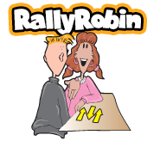
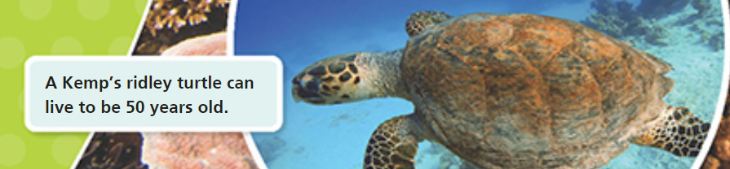

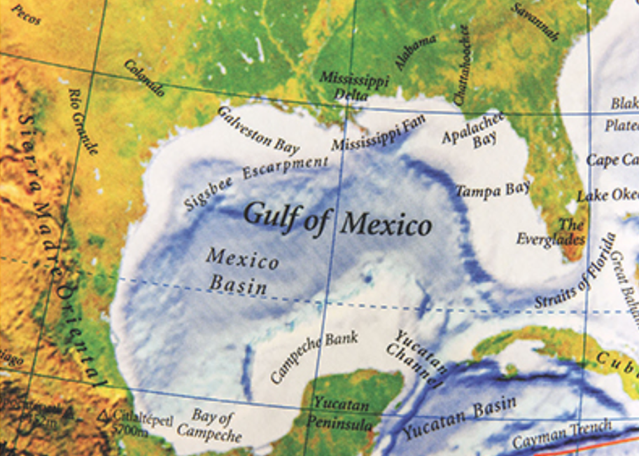
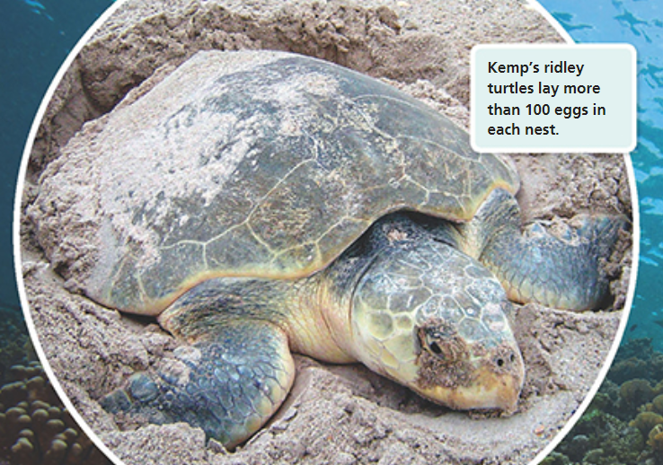
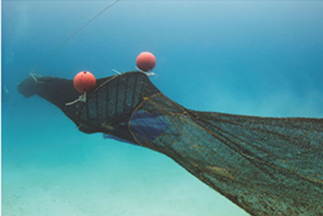
What is the genre?
What are the elements of this genre?

Slide 7
Genre: Informational Text
Elements of Informational Texts: real photographs, captions, maps and charts, headings, facts and information,…

Slide 8
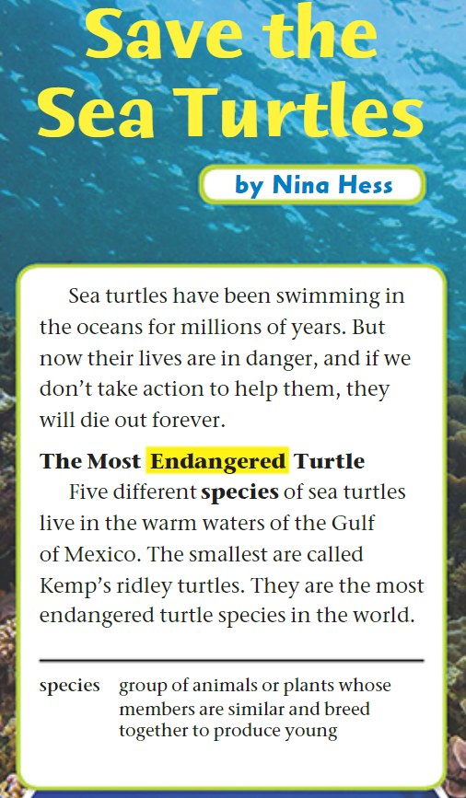

Page 238

Slide 9
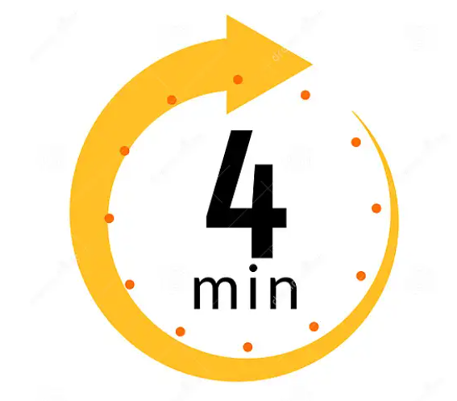
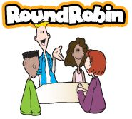
Page 240
Differentiation
Student’s Number | Task
1 | Answer questions 1, 5, and 7.
2 | Answer questions 2, 6, and 7.
3 | Answer question 3 and lead the discussion.
4 | Answer questions 4 and 7.
1. Participation: Each member participates and shares ideas with the group.
2. Task Completion: The task is divided fairly and is completed on time.
3. Collaboration: Group members listen to each other, respect ideas, and use only English to communicate.
4. Noise Level: Members work quietly and keep noise level appropriate.

Slide 10
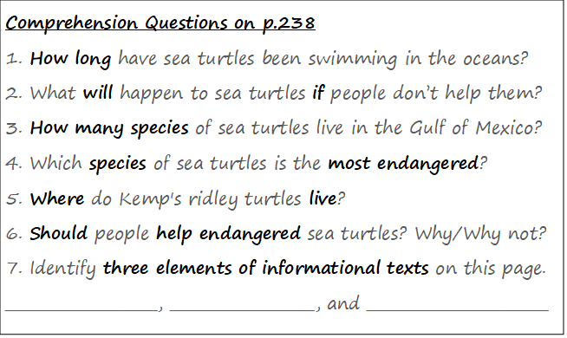
Comprehension Questions on Page 238

Slide 11
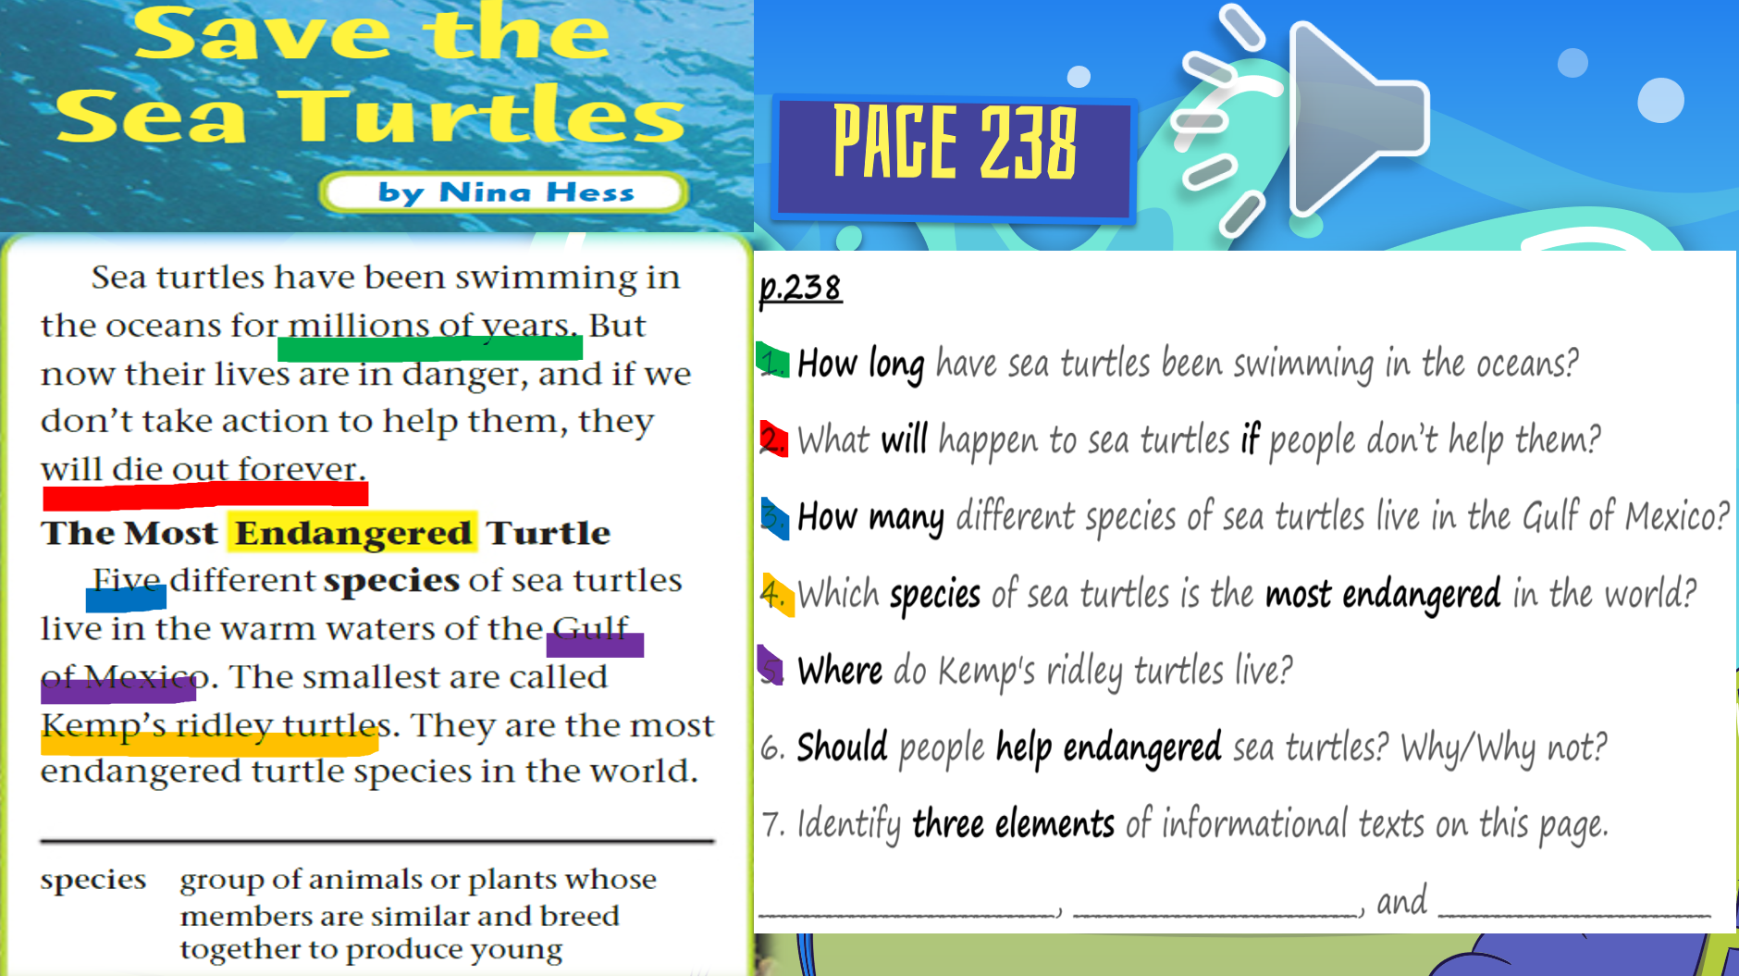
Page 238 - Feedback
Yes, we should because if we don’t, they will disappear forever.
heading
real photo
caption

Slide 12

Let’s check our understanding of the text.

Slide 13
What is the genre of “Save the Sea Turtles”?
a) short story
b) informational text
c) folktale
d) fable

Slide 14
Feedback
What is the genre of “Save the Sea Turtles”?
a) short story
b) informational text
c) folktale
d) fable

Slide 15
What will happen if we don’t take action to help sea turtles?
a) They will become stronger.
b) They will grow larger.
c) They will die out forever.
d) They will find new home.

Slide 16
Feedback
What will happen if we don’t take action to help sea turtles?
a) They will become stronger.
b) They will grow larger.
c) They will die out forever.
d) They will find new home.

Slide 17
What does the word "species" mean?
a) a group of similar animals or plants
b) a type of food
c) a very rare animal
d) a big place to live

Slide 18
Feedback
What does the word "species" mean?
a) a group of similar animals or plants
b) a type of food
c) a very rare animal
d) a big place to live

Slide 19

Buzz in – Critical Thinking

Slide 20
Buzz in – Critical Thinking
- Do you think it is important to protect animals that are endangered? Why or why not?
- What actions could people take to help prevent sea turtles from dying out?

Slide 21

Exit Ticket
2
1
3
Write one main idea from p.238 using your own words.
What is the genre?
What makes it special?
What is one action you can take to help protect animals or the environment?

