Slide 1




Writing a Compare and Contrast Essay
Grade 8

Slide 2


Outcomes
01
use a Venn Diagram to list similarities and differences between two related things
02
connect sentences using linking words and phrases that show similarities and contrast
03
compose a compare and contrast essay following the outline an introduction , two body paragraphs, and a conclusion

Slide 3
Shopping Online vs. Shopping In-Store
convenience, choices, experience, cost, trying products, service
public schools vs. private schools
cost, teaching methods, classroom size, facilities, opportunities
friends vs. siblings
choice, conflicts, support, trust, activities, age gap
two movies of the same genre
plot, characters, effects, audience
fiction vs. nonfiction
purpose, content, writing style, imagination, audience
two social media platforms
features, popularity, content, impact
village life vs. city life
environment, community, lifestyle, resources
cooking at home vs. eating out
cost, time, health, variety, social experience
school vs. university
curriculum , schedule, teaching style, class size, difficulty level, fees, activities, social environment, role of parents
reading books vs. watching movies
imagination, time, details, sensory experience
two sports
popularity, skills needed, equipment, rules
two cultures
traditions and customs, cuisine, values and beliefs, language
Android vs. IOS
customization, cost, devices, applications, security, updates,

Slide 4
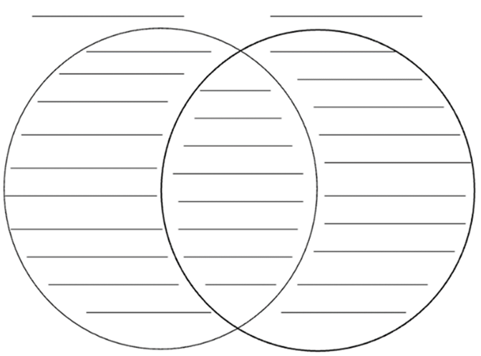
1. Brainstorming and Planning
Think of two related things that have similarities and differences. List at least three similarities and three differences between the two subjects. Use a Venn Diagram to organize your ideas.

Slide 5
2. Drafting the Introduction (first paragraph)
- Begin your introduction with a “grabber” for your first sentence, by asking a question or beginning in an interesting way that gets your reader interested right away.
- Introduce both topics to the reader by briefly summarizing each and providing background context about the two.
End your introduction with a thesis statement that states the purpose of writing the essay clearly. Your thesis statement should name the two subjects and state that they have many important (or interesting) similarities and differences + Include three points of comparison.

Slide 6
Examples of Introductions
Shopping online lets customers browse and purchase products through digital platforms, while shopping in-store involves visiting physical shops to buy items. Both methods are widely used by consumers today. This essay will examine the similarities and differences between shopping online and shopping In-store in terms of convenience, cost, and customer service.
Friends are people we choose to connect with, while siblings are family members we grow up alongside. Both relationships can strongly influence a person’s life. This essay will compare and contrast friends and siblings in emotional support, communication, and shared experiences.

Slide 7
3. Write the first body paragraph discussing the similarities between the two subjects.
Your points should be backed up with evidence/facts.
Transitional Words showing Comparison:
in comparison in the same way comparably equally
equivalently in a similar manner likewise similarly
moreover in the same way too both alike have in common as well as just like not only…but also

Slide 8
Examples of Comparison Paragraphs
Reading books and watching movies have several things in common. First, they both share the goal of telling meaningful stories that capture the audience’s attention. For example, each presents characters, settings, and events that help people explore ideas and emotions. A second way in which reading books and watching movies are similar is that they both allow audiences to learn new information and understand different perspectives. Finally, reading books and watching movies offer entertainment by giving people a break from daily routines and inviting them into another world.
To begin with the similarities, school and university both serve the important purpose of educating students and helping them grow academically. Another similarity is that students are guided by teachers or professors who provide instruction, support, and feedback. Finally, school and university require learners to complete assignments, meet deadlines, and take assessments to show their understanding.

Slide 9
4. Write the second body paragraph discussing the differences between the two subjects.
- Your points should be backed up with evidence/facts.
- Opening sentence MUST contain a transition showing you are switching to differences.
e.g. Despite all these similarities, [these two subjects] differ in significant ways.
Transitional Words showing contrast:
in contrast on the contrary on the other hand
otherwise however rather though whereas yet instead while differ from unlike even though

Slide 10
Examples of Contrast Paragraphs
Even though public schools and private schools are similar, they differ in several important ways. First, public schools are funded by the government, whereas private schools rely on tuition and independent funding. Furthermore, public schools usually have larger class sizes, while private schools often offer smaller groups with more individual attention. Lastly, public schools follow a standard national curriculum, but private schools may choose different programs or learning styles.
Although village life and city life share similarities, the two ways of living are vastly different in many ways. To begin with, village life is generally calm and peaceful, whereas city life is fast-paced and crowded. Moreover, villages often have limited resources and services, while cities provide a wide range of facilities, jobs, and opportunities. Lastly, village life usually encourages close-knit relationships and strong community bonds. However, city life tends to be more independent and less personal.

Slide 11
5. Drafting the Conclusion (last paragraph)
- Restate the main idea without repeating the same words.
- Summarize the key points of comparison or contrast (in a simple, short way).
- End with a final thought that shows why the comparison matters.
phrases to begin your conclusion
To sum up, In conclusion, To conclude, In closing,
To summarize, Taking everything into account, All things considered, To wrap it all up, Finally, it may be concluded Overall, In summary,
Overall, _________ and _________ are two _______ that can be compared in terms of __________, _________, and _________, Even though each _________ is different in its own way, they both ______________. Understanding these similarities and differences helps ________ see/choose/ know _________.

Slide 12
Examples of Conclusions
In summary, soccer and basketball are two popular sports that can be compared in terms of their rules, style of play, and required skills. Even though each sport is unique, both offer enjoyable ways for athletes to stay active and work as a team. Understanding these points makes it easier for players to choose the sport that suits them best.
To conclude, A Wrinkle in Time and The Hunger Games are two science-fiction movies that
can be compared through their themes, characters, and futuristic settings. While each film tells
a different story, both show strong young female heroes who face danger and fight for what is right.
By looking at these points, viewers can see how both movies use science-fiction elements to teach lessons about bravery, hope, and standing up for others.

Slide 13
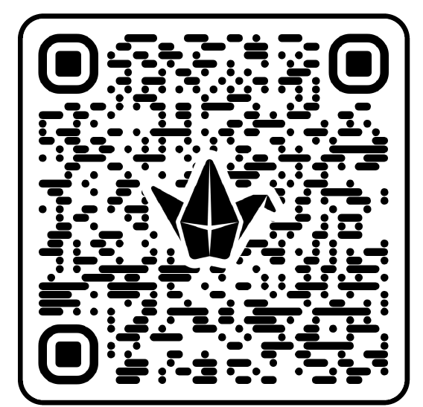

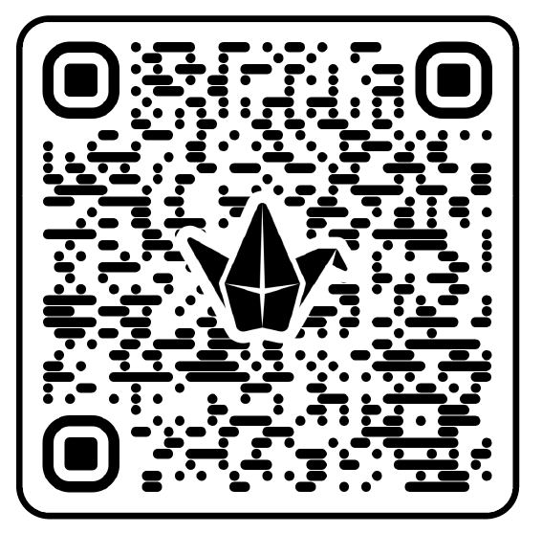
introductions and conclusion
comparison paragraphs
contrast paragraphs

Slide 14
Android vs. iOS
Android and iOS are two major mobile operating systems used in smartphones and tablets around the world. Android is developed by Google and used by many different phone brands, while iOS is created by Apple and works only on Apple devices. This essay will compare Android and iOS in customization, security, and app choices.
Android and iOS share several important similarities. First, both systems allow users to download apps, connect to the internet, and communicate with others easily. Another similarity is that each one offers features such as cameras, messaging apps, maps, and voice assistants that help people with daily tasks. Finally, both Android and iOS regularly provide updates that improve performance and strengthen user privacy.
Although Android and iOS have things in common, they also contrast in many ways. To begin with, Android offers more customization options, while iOS focuses on a simpler, more controlled design. Another difference is that iOS is usually more restricted, whereas Android gives users more freedom but also more responsibility. Last but not least, Android’s app store includes apps from many developers unlike iOS that has a more selective app store with stricter rules.
To wrap it all up, Android and iOS can be compared by looking at customization, security, and app availability. Even though each system works differently, both help people stay connected, work efficiently, and enjoy technology. Understanding these similarities and differences helps users choose the operating system that matches their needs and preferences.

Slide 15
Rubric
Content – similarities and differences | Punctuation and Capitalization | Spelling | Organization – outline and layout | Sentence Structure and Grammar | Total ______ 10
5 | 1 | 1 | 1 | 2

