Slide 1
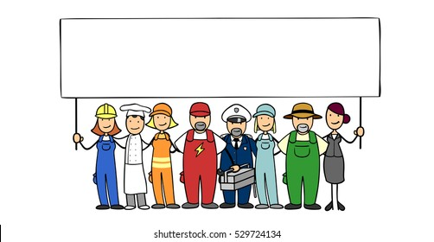
MY JOB IN FUTURE
YOUSUF MARI’E

Slide 2
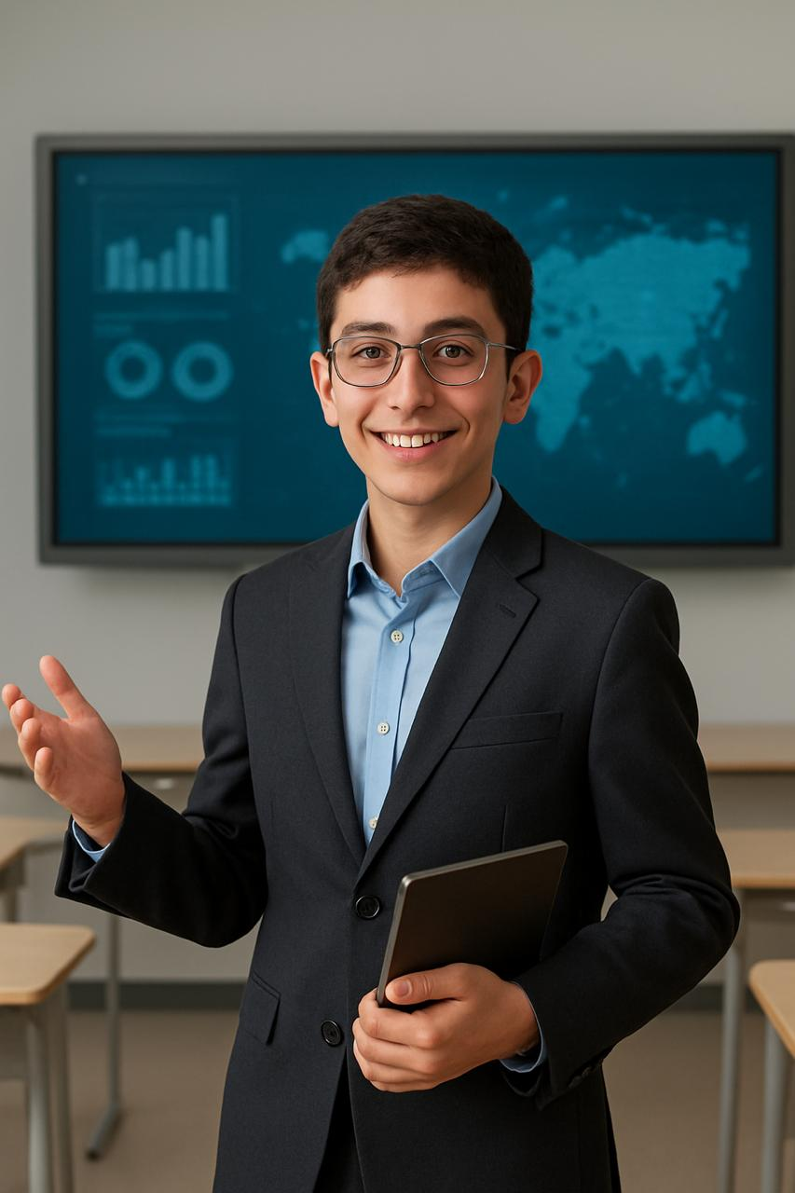
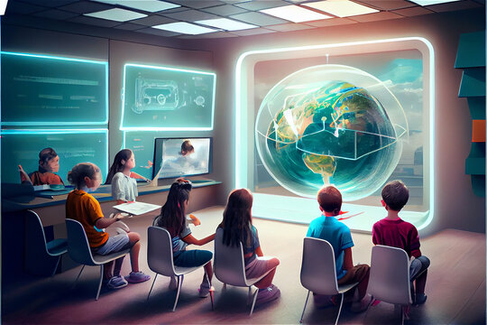
Teacher

Slide 3


Why?

Slide 4
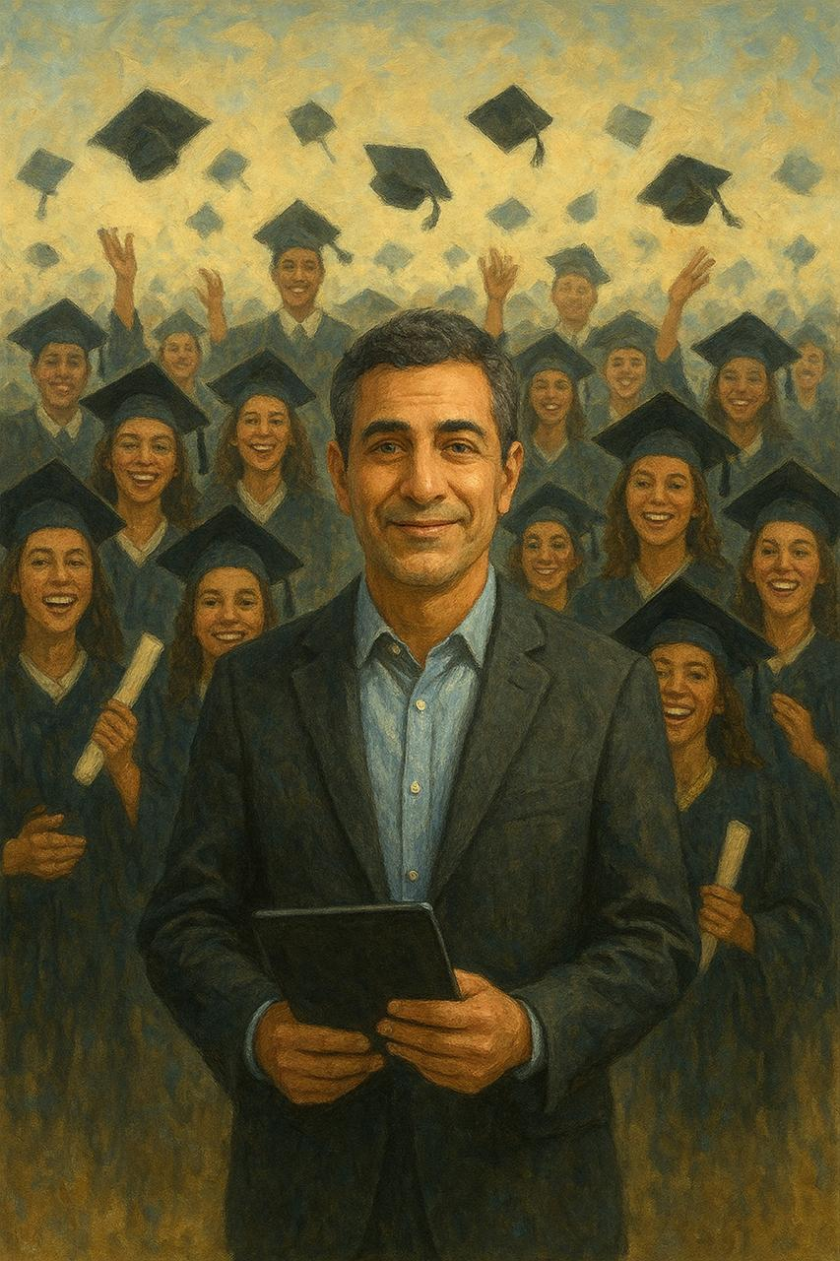

Good for Community

Slide 5


