Slide 1






What I Want to Be Someday
LAITH EHAB ALMOMANI
GRADE 2-E

Slide 2



Good morning teacher and friends. Today I am going to talk about my future JOB

Slide 3

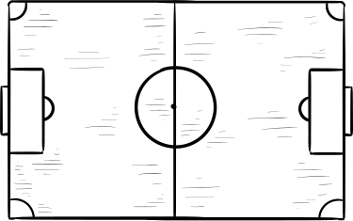
Training and Preparation
When I grow up, I want to be a professional football player. To be a great player, I will go to the gym and exercise everyday, to train my body and build strong muscles.

Slide 4

I need to practice running and scoring goals to be the BEST.

Slide 5
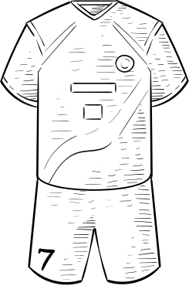
I will help my community by being a good role model. I will encourage children to play sports because exercise helps you stay fit and healthy.
LAITH

Slide 6

Dreams of Glory
I want to make my country proud.

Slide 7

Thankyou for listening

