Slide 1
My future job.
By naya sabatin.

Slide 2

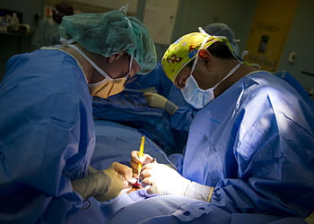
I want to be a doctor.
I heel sick people
I do surgery

Slide 3
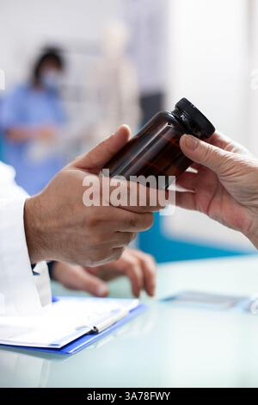

A doctor job
A doctor gives me medicen
A doctor works in the hospital

Slide 4

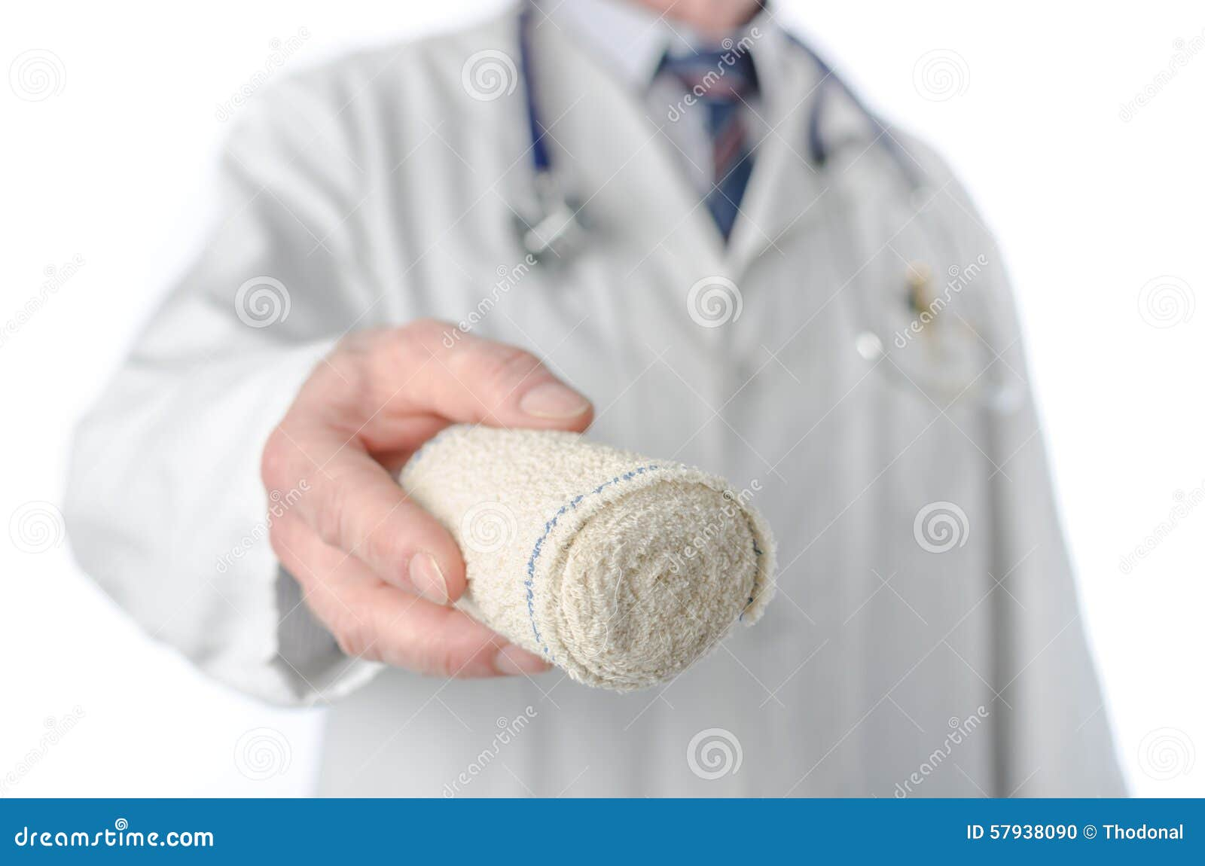
What kinds of doctors.
A doctor gives us a nedal.
A doctor gives us bandage

Slide 5

Thank you for listening
Naya rami sabatin.

