Slide 1
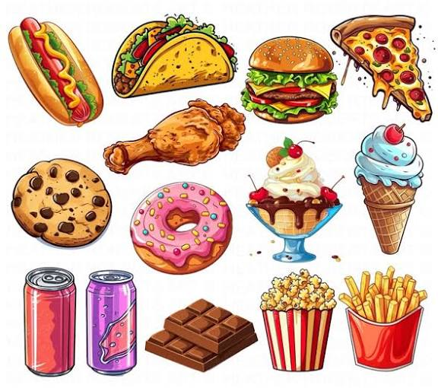
Why Junk Food Is Bad
Junk food can make our body and brain weak.

Slide 2

Obesity
Too much junk food can cause obesity.
(Too much body fat)

Slide 3
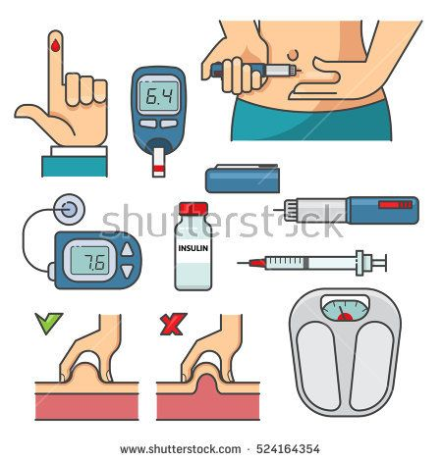
Diabetes
Eating sugary junk food can cause diabetes.

Slide 4

Brain Effects
Junk food can cause mood swings,
forgetfulness, and depression.

Slide 5

Addictive & Fatigue
Junk food is addictive and can make us feel very tired.

Slide 6
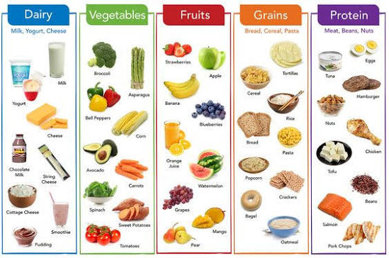
Choose Healthy Food
Healthy food keeps us strong and smart.

Slide 7
Thank you for listening
Ghina aljaber

