Slide 1


Drops Of Change
Title:
Drops of Change
A Smart Water-Saving Ceiling for Our School
Subtitle:
Transforming a damaged ceiling into an innovative water-collection system.
Presented by:(Water gaurdians)
Sarah Alkhatatbeh , Jana Aldebsi , Jasmine Abualia , Nadine Hamdan.

Slide 2
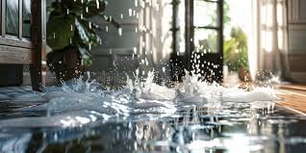
The Problem
1- A section of our school ceiling is broken and unsafe.
2- Water leaks during rain and damages the learning environment.
3- The leak causes damage to walls, floors, and furniture.

Slide 3



Why we need change
A Simple Repair Isn’t Enough.
It doesn’t solve long-term water waste.
Rainwater continues to be lost every year.
Our school still pays extra for cleaning and irrigation water.
So we asked: What if the ceiling could do more?

Slide 4
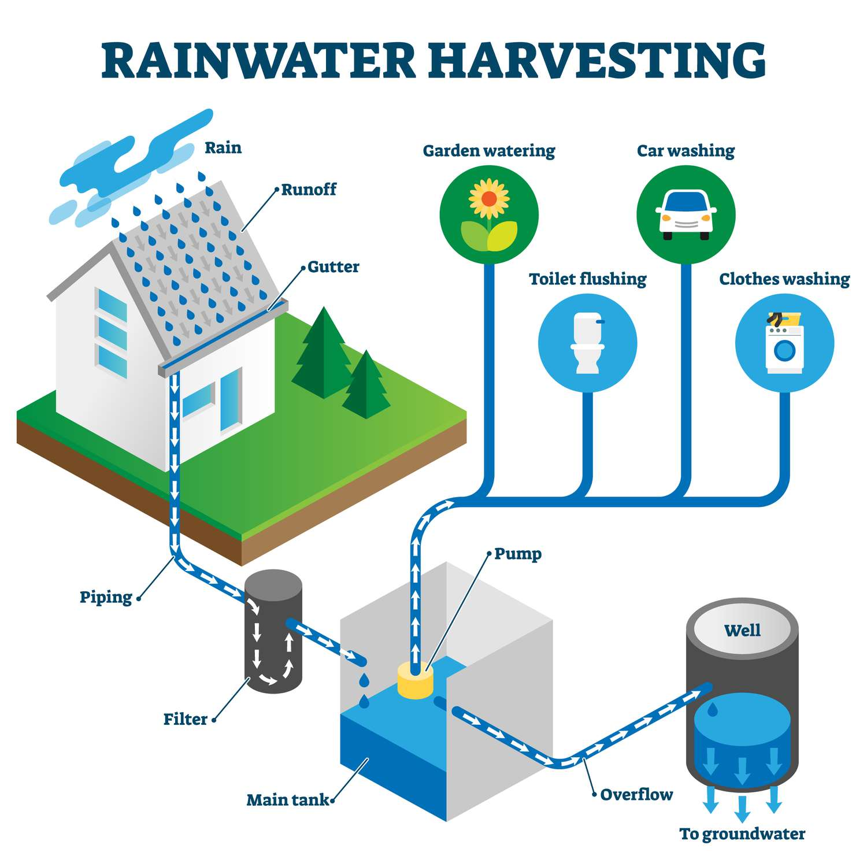
Our innovative idea
Introducing: The Water-Saving Ceiling System
A redesigned ceiling that captures and filters rainwater.
Built-in cooling panels to reduce heat inside classrooms.
Water is directed into a clean storage tank.
Safe for non-drinking uses like cleaning, irrigation, and cooling.

Slide 5

How it works
Smart Ceiling Design
Ceiling panels allow rainwater to pass through.
Filters remove dirt, dust, and debris.
Water flows through a pipe system → storage tank.
Cooling panels use collected water to lower indoor temperature.
A complete eco-friendly system.

Slide 6

Benefits
Environmental Benefits
Saves thousands of liters of water per year.
Reduces waste and supports sustainability.
School Improvements
Lower water bills.
Cooler classrooms = better learning environment.
A safer, modern, long-lasting ceiling.
Educational Impact
Teaches students about green engineering and solutions.

Slide 7
In conclusion
A Problem Turned Into Progress
Instead of simply repairing the ceiling,
we upgraded it into a sustainable water-saving system.
It protects the school, saves water, reduces costs, and cools rooms.
This project proves that real change begins with smart ideas.
Done by Iec schools students:
Sarah Alkhatatbeh, Jana aLdebsi, JASMINE ABUALIA, NADINE HAMDAN

