Slide 1



PROJECT
PROPOSAL
Jude Abu Maria, Jana Ashraf, Malika Mashaqbeh, & Wafa Al Natoor

Slide 2



STATSTICS
Taken through realizing daily attendance marking in school
Daily for each class to take attendance
18 MIN

Slide 3

PROBLEM STATEMENT
Teachers spend a lot of time marking attendance. How can we make school entry faster, safer, and more organized?

Slide 4



OUR SOLUTION
The Smart School Entry System using NFC Student ID Cards solves the problem by allowing each student to use a personalized card to enter the school. When they tap their card on the NFC reader at the gate, their attendance is recorded automatically, and the parents can get instant notifications.
Objective nº 1
Objective nº 3

Slide 5





PROJECT GOALS
Saving time by automating attendance
Improving school security
Allowing parents & teachers to track attendance easily
Reducing errors from manual attendance marking

Slide 6

PROJECT BENEFITS
Making daily school life easier and more organized
Automatically mark attendance when entering class
Student

Slide 7

PROJECT BENEFITS
Recording attendance quickly and accurately
Reducing paperwork and save time
Accessing student information instantly when needed
Improving classroom management and focus more on teaching
Teacher

Slide 8




PROJECT REQUIREMENTS
NFC
NFC Reader
NFC Cards
Computer or Server

Slide 9



PROTOTYPE

Slide 10

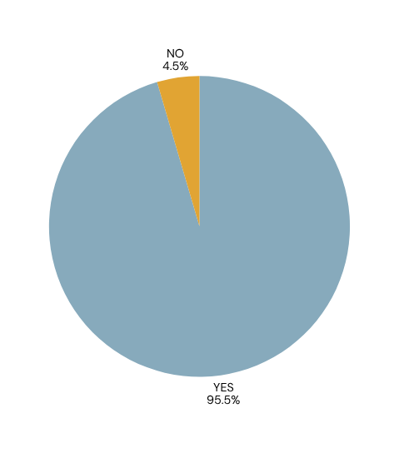




USER TESTING
A survey was conducted and our school students responded
03
02
01
Do you think a Smart ID Tap Card system (where you tap your card to enter school) is a good idea?
Would you personally like to use a tap card to enter school?
Do you think it would make the school more modern and organized?

Slide 11
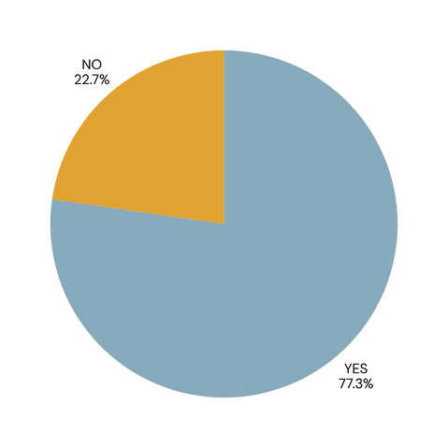
Do you think it will help teachers save time taking attendance?
Do you think some students might forget or lose their cards?
03
Would you like the tap card to be used for other things (like the library)?
Do you agree that our school should make this Smart ID Tap Card project real?
02
01

Slide 12
CONCLUSION
Implementing a Smart School Entry System using NFC School ID Cards is not just about technology it’s about creating a safer, faster, and smarter environment for students and staff. It’s a step towards the future of education.
Objective nº 1
Objective nº 3

Slide 13

THANK YOU

