Slide 1

My favorite animal
By jehan

Slide 2
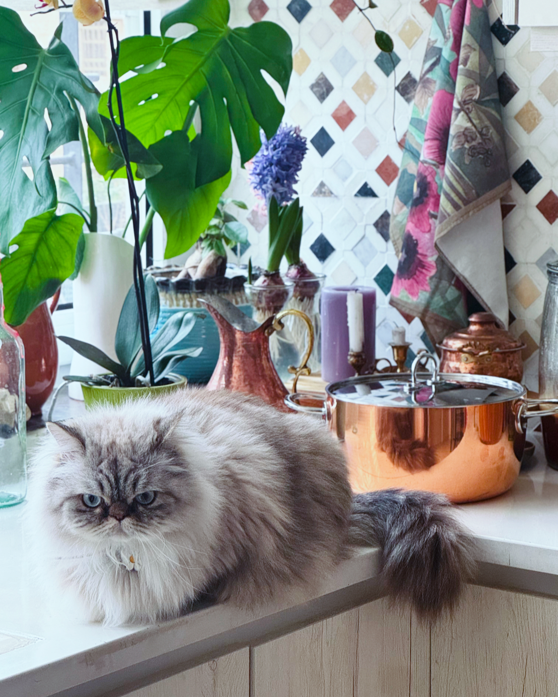
And here are some images of my cat

Slide 3
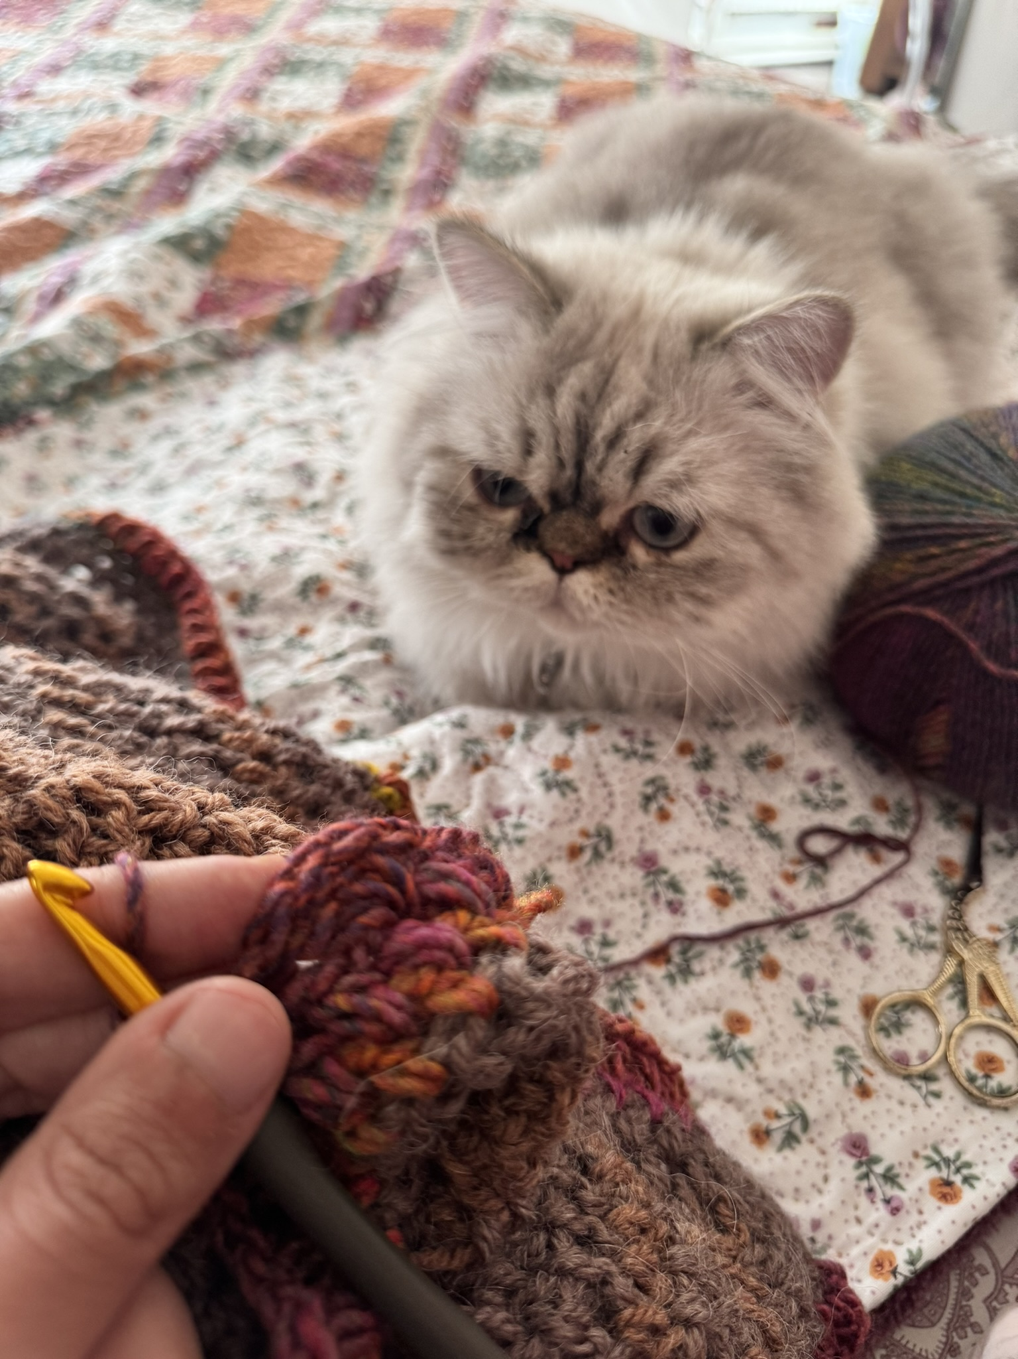

Slide 4
